Slide 1
Managing the Repositories
For users with REPOS Privileges
Version 2

Slide 2
Training Modules
g | Module 1: Overview | g | Module 5: Replacing Documents
g | Module 2: Points of Access | g | Module 6: Downloading Repository Information
g | Module 3: Uploading Documents (selecting Projects) | c | Module 7: Administering Lookup Values
g | Module 4: Editing Resources | c | Other Repository Information
Note: All of the general repository functionality is covered in the Users’ Guide
Notes:
Service Leads are members of the CIDM Team; wearing a different hat they are responsible for managing the projects that their Service/Organization wants to submit to the CIRB for consideration.
The workflow depicted in the diagram is the basis for the functions provided in the CIDM tool.

Slide 3
Module 1: Overview
What is covered
Basic privilege model for projects and resources
Understanding the unique actions/privileges associated with the Repository Manager

Slide 4
Module 1: Overview
Project Privilege Model
Permission Role | R/W/M | Permission Capabilities
PROJ MGR & Contributor | M | Uploads documents for project (Document has user’s Role) Modify document meta data (change document role, etc.)
PROJ Reader | R | Reads all project documents where personal role matches information role (NON-GOV, GOV, EXEC)
Public User | U | Unregistered; doesn’t log in Has access to the Knowledge Center Repository May Read/Download all resources marked “Public”
Repository Manager (Repos) | W | Access, modify, delete privileges for all resources in the repositories Able to set privilege levels for all documents Able to upload new documents Able to update and edit key lookup tables of information including contracts.

Slide 5
Module 1: Overview
Knowledge Center Privilege Model
Permission Role | Permission Capabilities
Registered users | Accesses resources based on privilege
Public User | Unregistered; doesn’t log in Has access to the Knowledge Center Repository May Read/Download all resources marked “Public”
Repository Manager (Repos) | Access, modify, delete privileges for all resources in the repositories Able to set privilege levels for all documents Able to upload new documents/delete selected documents/replace documents Able to update and edit key lookup tables of information including contracts.

Slide 6
Document Privileges
Module 1: Overview
Documents are assigned privilege levels:
The DEFAULT setting for all uploaded documents in the Knowledge Center is “GOV”
The DEFAULT setting for all uploaded documents in the Project Repository is the privilege level of the Uploader.
Public (users are not logged in) (Knowledge Center only)
Non-Government registered users (logged in NON GOV)
For Government purposes only (GOV)
Executive users within TMA or those assigned the privilege by TMA (EXEC)

Slide 7
What is Unique About Repository Management?
Module 1: Overview
Users may only view documents they are associated to through a project and for which they have a privilege “match”
The repository manager is able to do all things to all documents
  Has visibility into all projects and all documents.
    The list will be extraordinarily long – some projects will rapidly collect 1,000’s of documents
    Regular users only see the documents associated to their assigned projects.
  Has ability to edit the lookup lists: Document types(i.e.,1391, EA, White Paper)
  Has ability to upload documents from the main repository page for any project (and to edit all)

Slide 8
Module 2: Points of Access
What is covered
Accessing the Project Repository
Accessing the Knowledge Center Repository

Slide 9
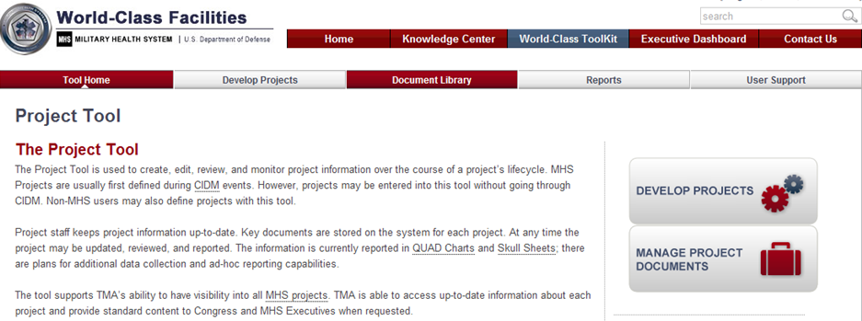
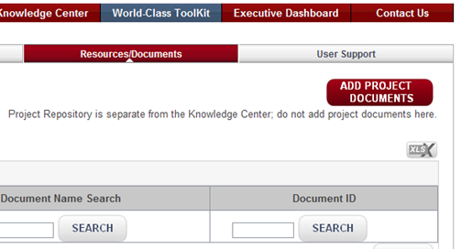
Accessing the Project Repository As Repos Manager
Module 2: Points of Access – Accessing the Resource Library
1
2
  Three Access Points
  from the Project tool navigation bar
  from the manage project documents button (available only to Repos)
  from the knowledge center (available only to Repos)
3
Notes:
Only the User with REPOS privileges will be able to see the PROJECT REPOSITORY Button in # 3 above.
Only REPOS will have an UPLOAD button in the Project Repository View
It is important for users to upload their documents from a specific Project Information Page so there will not be mistakes associated with the ties between the resource and. the projects.

Slide 10
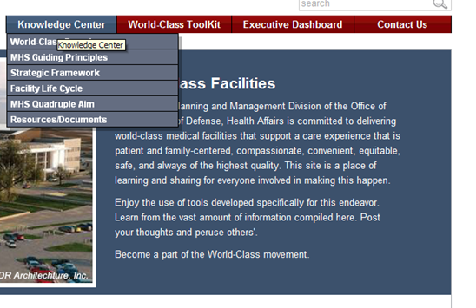
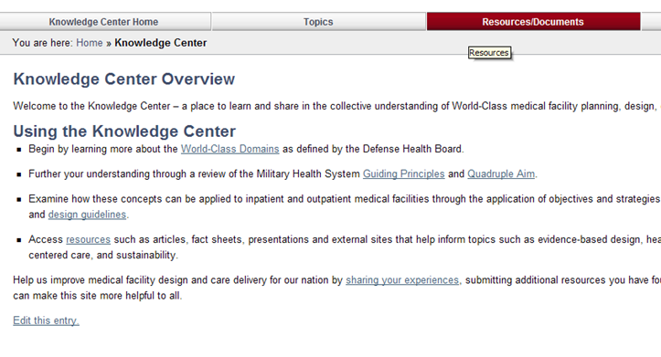
Accessing the Project Repository As Repos Manager
Module 2: Points of Access – Accessing the Resource Library
1
  Getting to the Knowledge Center Resources
  Access from the Main Navigation Bar -Resources
  Knowledge Center navigation Bar (Resources/ Documents)
2
Notes:
Only the User with REPOS privileges will be able to see the PROJECT REPOSITORY Button in # 3 above.
Only REPOS will have an UPLOAD button in the Project Repository View
It is important for users to upload their documents from a specific Project Information Page so there will not be mistakes associated with the ties between the resource and. the projects.

Slide 11
Module 3: Uploading Documents
What is covered
Adding Resources
Difference in Knowledge Center Resources and Project-Centric Resources

Slide 12
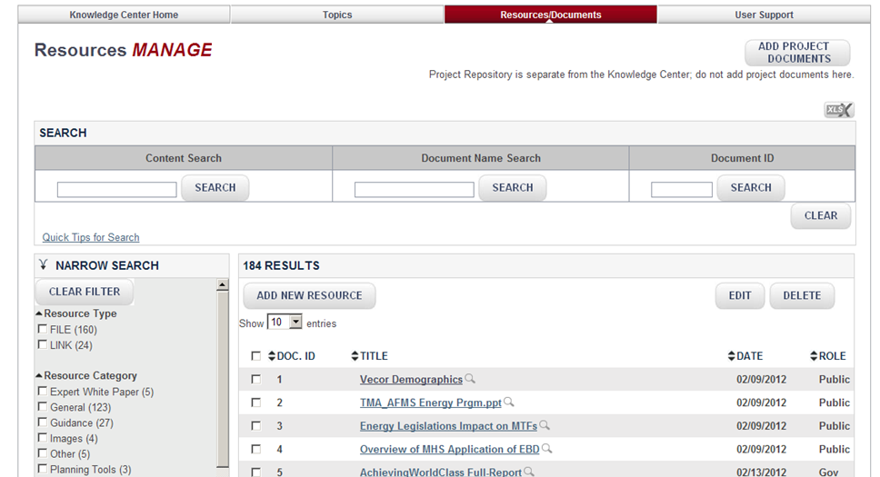
Uploading a Document(s) – Getting Started
Module 3: Uploading Documents
  The manager may add one or more documents at a time
  Meta data is collected about each document
  After an upload the data may be added – or at anytime in the future
  The more data added to the resource, the easier it is to find with the search functions and filters
  Each uploaded document gets its own unique ID

Slide 13
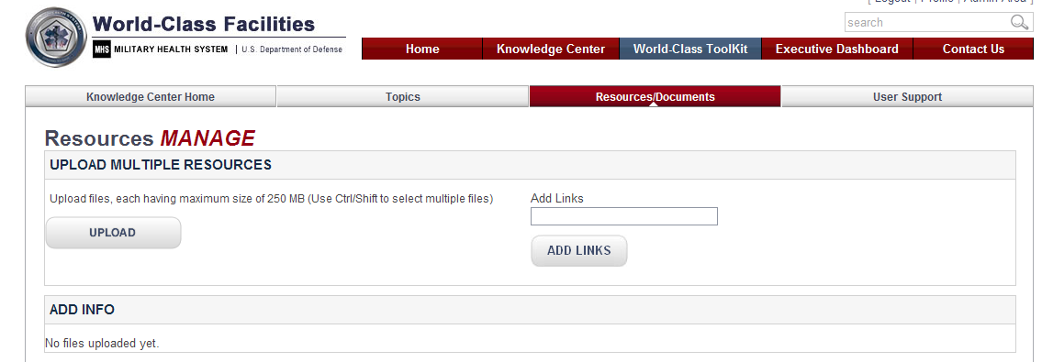
Uploading a document(s) – getting started
Module 3: Uploading Documents
  Two types of resources may be uploaded:
    An electronic file
    A link to a webpage
  Some file types are not allowed; users will be informed if they try to upload a file of the wrong type
  Files greater than 250 MB also may not be uploaded (try zipping like materials together)
  After an upload the data can be added – or at anytime in the future
1
2

Slide 14
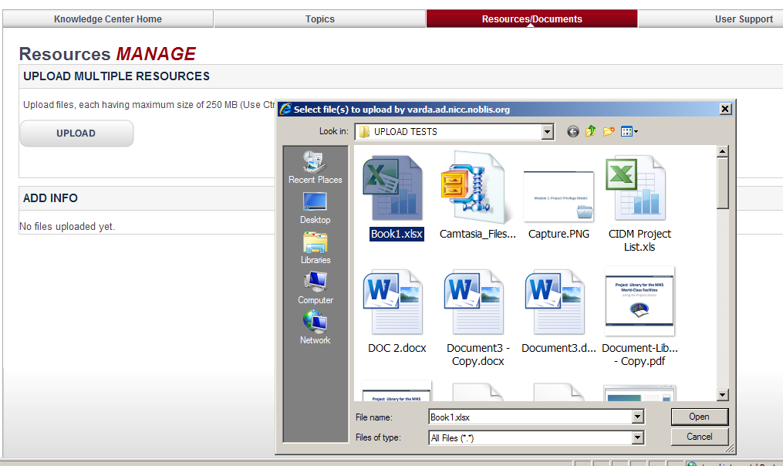
Uploading a document(s) – Selecting Documents/Files
Module 3: Uploading Documents
  Select upload files button
  Users may select 1 or more documents at a time to be uploaded (hold CNTRL key down while selecting)
  Select OPEN when ready
  System uploads all selected documents
  Some file types are blocked – the system won’t upload and will notify the user
1
2
3

Slide 15
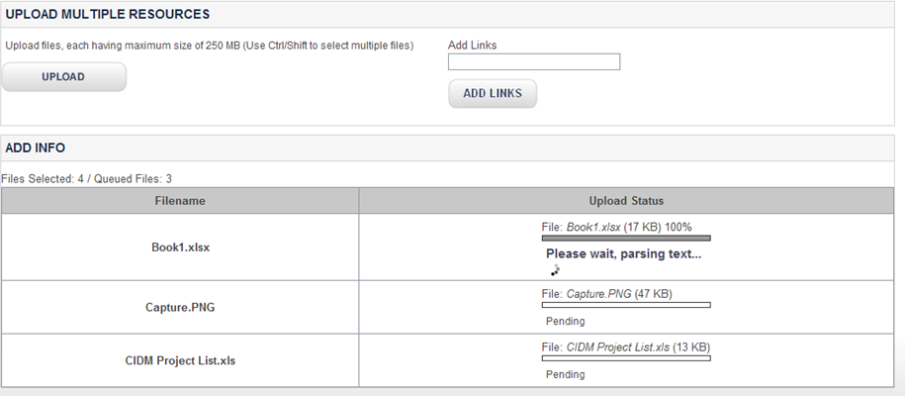
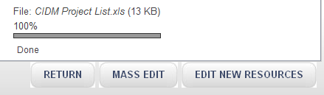
Uploading a document(s) – Waiting for Indexing
Module 3: Uploading Documents
  Uploading takes time – the more you upload, the more time is required
  System stores the document and then “reads” everything in the document and adds the content into the search index
  The user will know while this is going on
1,2,3
4
  4. and when it is done

Slide 16
Uploading a document(s) – Waiting for Indexing
Module 3: Uploading Documents
  Upon successful UPLOAD, each document has its own unique ID
  The user now has three options:
    Return back to the starting place – where they first selected UPLOAD
    Edit each document one at a time (more details can be added)
    Or mass edit all as a group (fewer details but swifter updating process
  What is important to remember?
    The manager is adding the key elements required for swiftly finding a document or a group of documents

Slide 17
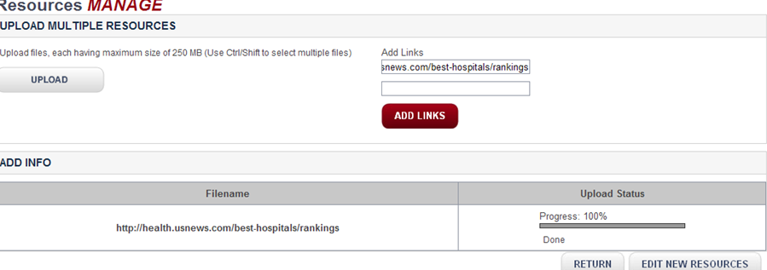
Adding Links
Module 3: Uploading Documents
  Links are added similarly to documents – only the user pastes in the link instead of uploading a file
  Until the user leaves this page, they may continue adding links to the list
  When finished, the user has an opportunity to edit information about the website
1
2
3

Slide 18
Module 4: Editing Resources
What is covered
What is the difference in Knowledge Center Resources and Project Resources
Editing one resource at a time
Editing many resources at a time (Mass Edit)
Deleting Resources

Slide 19
Comparing/contrasting the Data Collected
Module 4: Editing Resources
The system collects: File Type, File Size, File Name, who uploaded, when Uploaded
The system provides default values: Document Date, Security Role, Project Association
The user may modify and add the following values:
Project Repository Data
Knowledge Center Data
Title/Name
Security Role
Document Date
Abstract
Document Version Comment
Keywords
Associated Project
Project Association
Document Type
CIDM Event
Title/Name
Security Role
Document Date
Abstract
Document Version Comment
Keywords
Publisher
Publisher type
Topics
Resource Category
Author

Slide 20
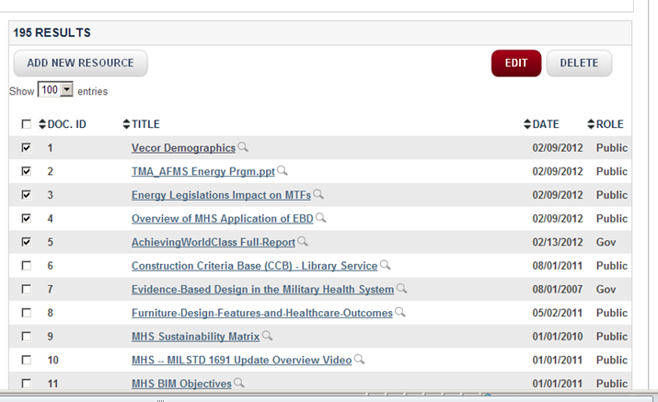
Select Documents and Then EDIT button
Module 4: Editing Resources
  From either repository – the manager may select one or more documents to edit
  If the user selected 1 document, then the single edit form will be provided; if the user selected more than 1 document, a mass edit page will be provided.

Slide 21
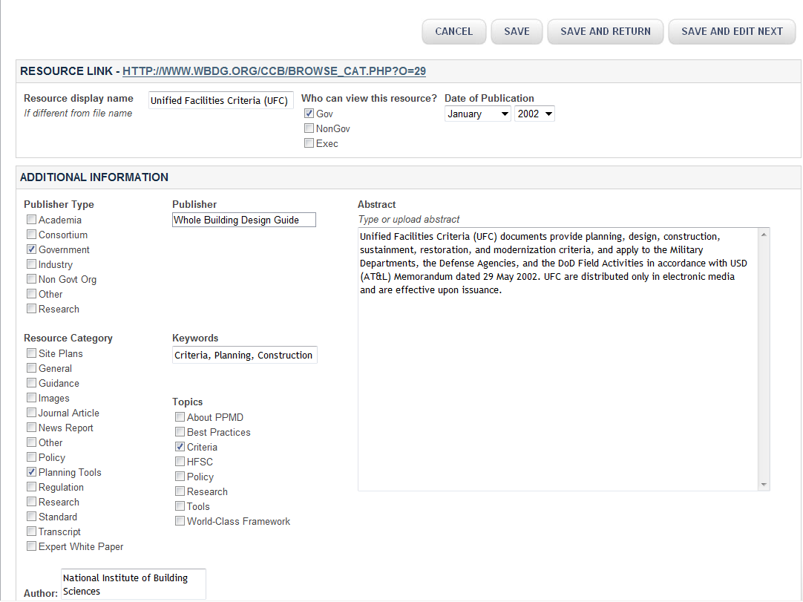
Edit Metadata – Knowledge Center View
Module 4: Editing Resources
Edit all Metadata Fields to ensure accurate abstracts, searches/filters for all users

Slide 22
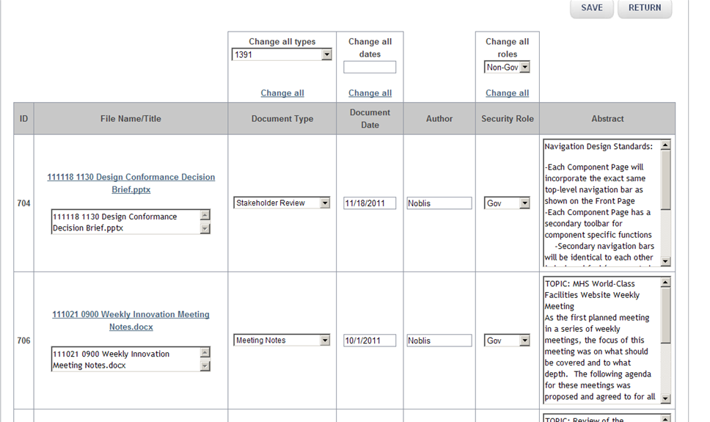
Edit Metadata – Mass Edit – Project Repository View
Module 4: Editing Resources
  Mass edit is a tabular view of selected documents
  Users may change all data displayed
  Users may globally change some of the fields
  Note: Not all of the information fields are included in mass edit

Slide 23
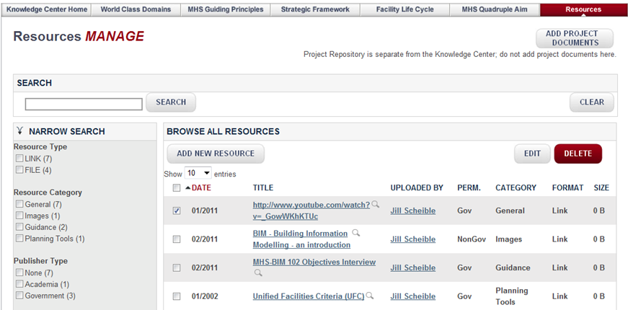
Remove Resource
Module 4: Editing Resources
Resources may be removed by the Repository Manager(s)
Click the checkbox next to the item to be removed and Select “Delete”
The system tracks all activity that occurs in relation to a resource;
If the document is being deleted because a new version is available – there is a replace function (next module)

Slide 24
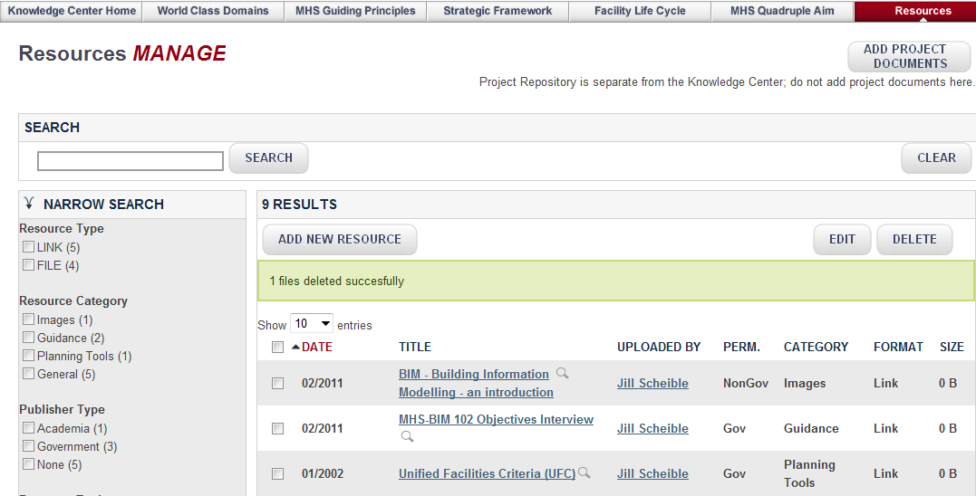
Resource Removed from Library List
Module 4: Editing Resources
Link (or Document) is successfully removed from the Resource Library List signified by “green” message

Slide 25
Module 5: Replacing a document
Resource Library
What is covered
Replacing a document
Viewing document history

Slide 26
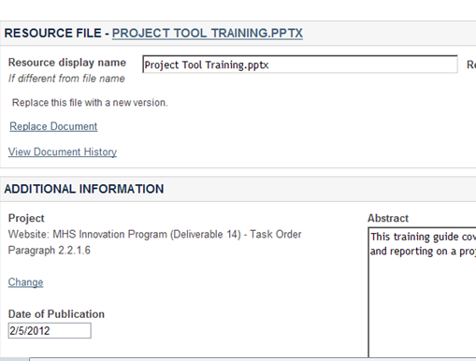
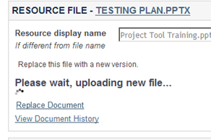
Replace a Document
To replace a document, find the document in the list and select it (alone). The Single-Edit Page will be provided
The user selects the REPLACE Link and identifies the new document.
While the document is being replaced (and the new version indexed) the user will have a Wait Message
The previous version is maintained in the repository but it is taken out of the main list. The New Document is assigned the original’s Resource ID
Any links sent with that original ResourceID will still be viable – but they will lead to the new document and not the original
1
2
3

Slide 27
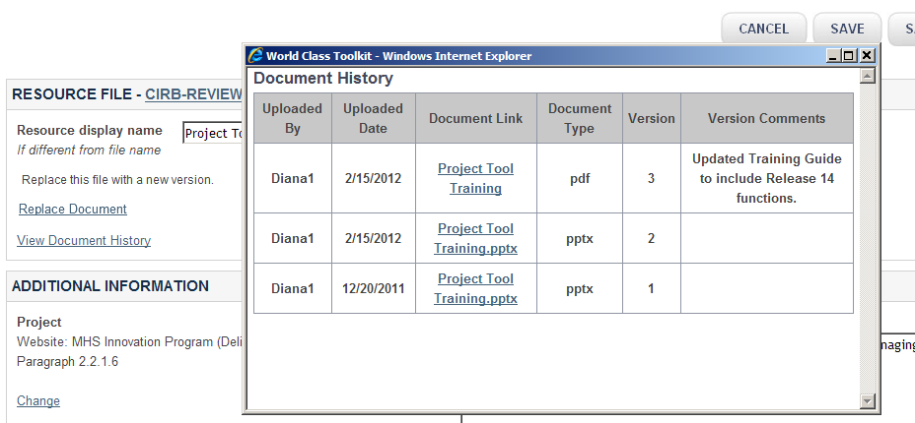
Viewing the History
The user selects the link “View Document History”
A record of each previous document is kept in the repository data store
If the user added Version Comments when editing the document, then that note will be included in the history view
2
1
3

Slide 28
Other Repository Information
What is covered
Downloading KC List
Downloading Project Repository List
Sending Links

Slide 29
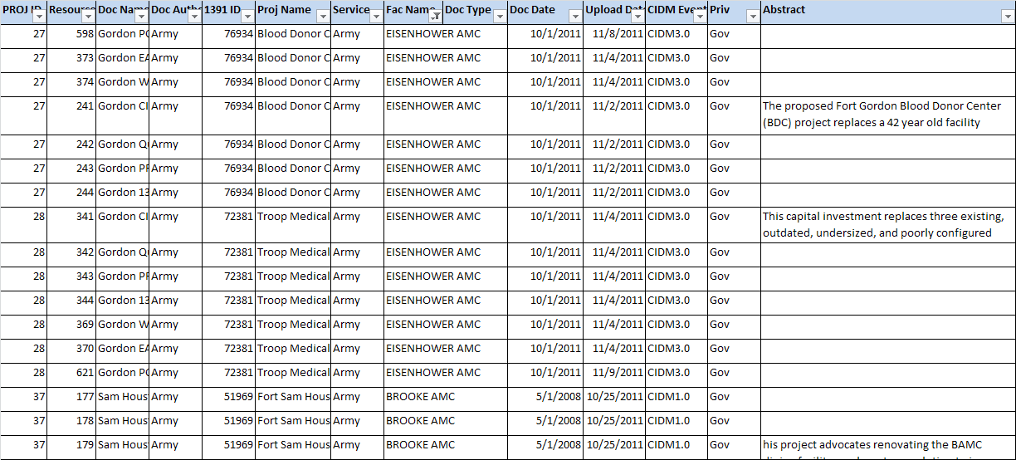
Downloading a List
Other Repository Information
Above the tabular list of documents in each repository is an EXCEL Icon
Users are able to download a complete list of resource items in CSV format

Slide 30
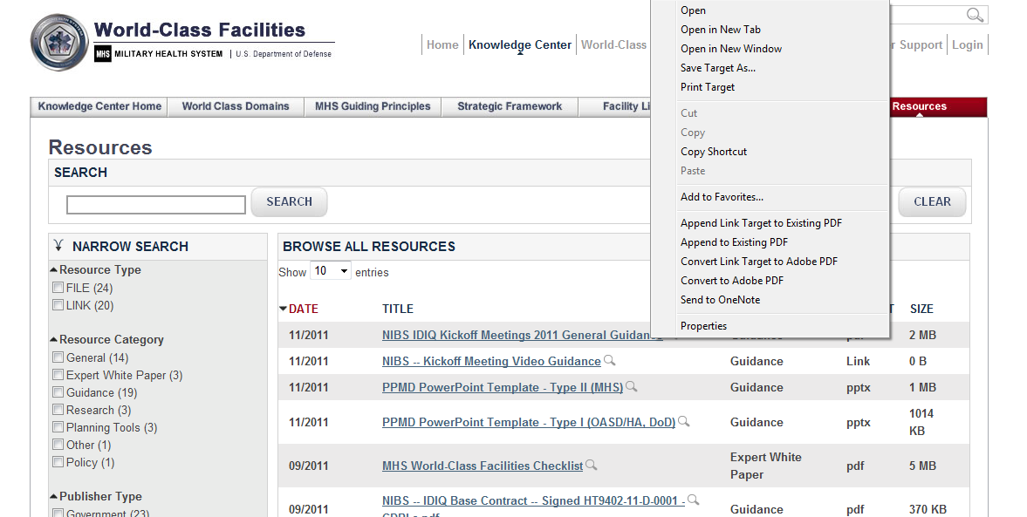
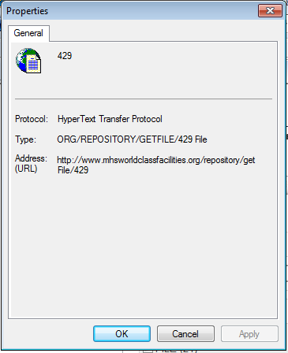
Getting a Document’s Address
7. Getting a Document’s Address
In order to get the address of a document:
“Right click" on the link to the document
Select "properties“
  The link to the actual document is shown

