Slide 1
Users’ View of the Project Library
For General Users with Basic Privileges
Version 1

Slide 2
Training Modules
g | Module 1: Overview
g | Module 2: Accessing the Project Document Library
g | Module 3: Using the Search Function
g | Module 4: Viewing and Editing Documents
g | Module 5: Replacing a Document

Slide 3
Module 1: Overview
What is covered
Project Document Library
Basic privilege model for project documents
Understanding the actions/ privileges associated with general users

Slide 4
Module 1: Overview
Project Document Library
The purpose of the Project Library is to provide one place to view all of the documents that a user has privileges to access.
The repository is a cross-project view of these documents
  All documents of a type or related to a milestone for all of the users’ projects may be seen at one time as a collection.
Users have access to the libraries of their assigned projects – based on their privilege level. If a document has a privilege level of “EXEC” then only user with the same privilege level will be able to access the document.

Slide 5
Module 1: Overview
Project Privilege Model
Permission Role | R/W/M | Permission Capabilities
PROJ MGR & Contributor | M | Uploads documents for project (Document has user’s Role) Modify document meta data (change document role, etc.) Replace a document
PROJ Reader | R | Reads all project documents where personal role matches (NON-GOV, GOV, EXEC)
Repository Manager (Repos) | W | Access, modify, delete privileges for all resources in the repositories Able to set privilege levels for all documents Able to upload new documents Able to update and edit key lookup tables of information including contracts.
Users may view all documents they are associated to through a project and for which they have a privilege “match”
Manager/Contributor may view/edit/delete documents associated to their assigned projects
Readers may view documents associated to their assigned projects

Slide 6
Document Privileges
Module 1: Overview
Documents are assigned one of the three privilege levels:
The DEFAULT setting for all uploaded documents in the Project Repository is the privilege level of the Uploader.
Non-Government registered users (NON GOV)
For Government purposes only (GOV)
Executive users within TMA or those assigned the privilege by TMA (EXEC)

Slide 7
Module 2: Accessing the Project Library
What is covered
Accessing the Project Document Library

Slide 8

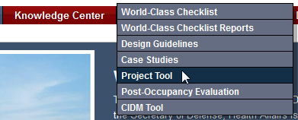
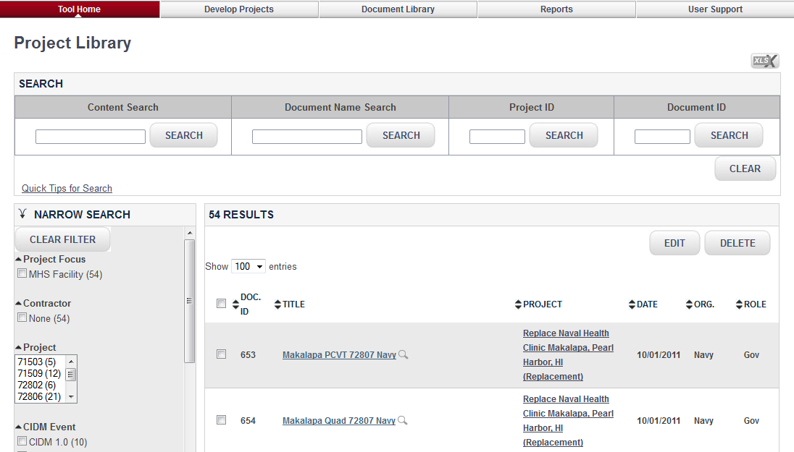
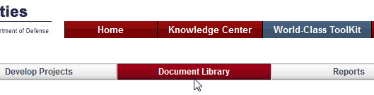
Access to the Project Library through the Project Tool
Module 2: Accessing the Project Library
From Home Page, choose “World-Class ToolKit”
Next, select “Project Tool”
Select “Document Library”
to open the Project Library page
1
4
2
3

Slide 9
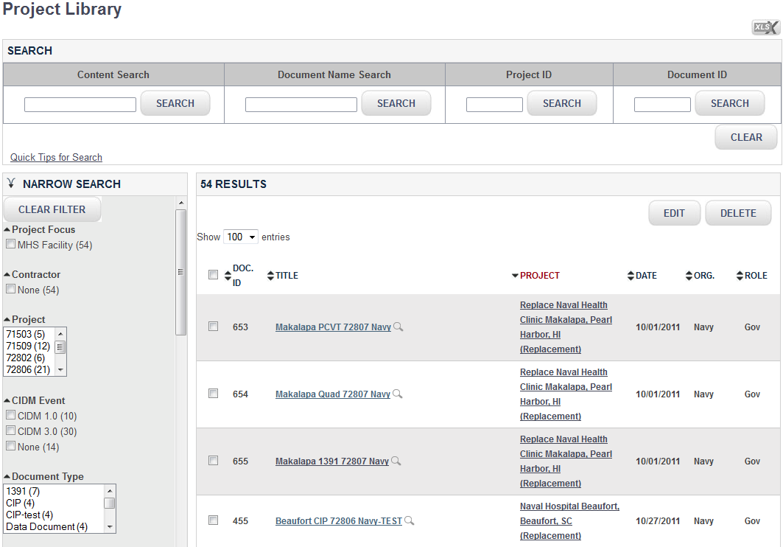
Viewing and Accessing Project Library
Module 2: Accessing the Project Library
On the Project Library page, users can view all documents they are associated to through a project and for which they have a privilege “match”
Users can search documents by Content, Document Name, Project ID and Document ID
Users can perform filter search for documents. Filter Search can be narrowed by various filters. More than one can be chosen simultaneously
2
3
1

Slide 10
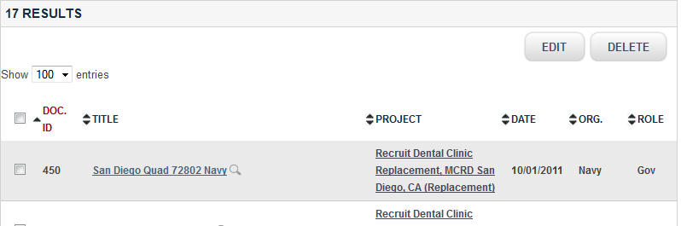
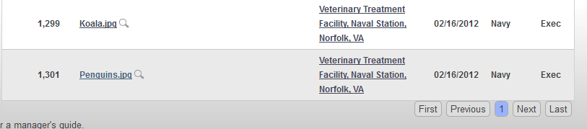
Viewing and Accessing Project Library
Module 2: Accessing the Project Library
Users can sort on each column. The “Category” in red is the current sort column
Users can change the number of documents listed
Users can navigate by moving to first, last, next, previous
2
1
3

Slide 11
Module 3: USING THE SEARCH FUNCTION
What is covered
Using the Search and Filter Mechanisms

Slide 12
Using the Search Function
Module 3: Using the Search Function
AND, OR must be upper case!
Searching by Terms
To find a term type it in the box:
To find more than one term, type in each term:
To find a phrase add quotation marks:
Boolean searches
To find at least one of the terms
To find all of the terms:
To find document with 2 or more terms and possibly another use:
Test
Facility OR Project OR Manage
Facility Project Management
Facility AND Project AND Manage
Facility + Project + Manage
“Facility Project Management”
Fuzzy Searches with Wildcards
The ‘?’ looks for terms that match that with the single character replaced. To search for "text" or "test" use:
Multiple character wildcard searches looks for 0 or more characters. To search for test, tests or tester, use :
You can also use the wildcard searches in the middle of a term.
Note: Do not use the * or ? symbols at the beginning of a search term
(facility OR project) AND Manage
Very Fuzzy Searches
To find “sort-of-alike terms”, use the ~
  Returned documents with following terms:
    Department, partnering, departure
Te?t
Partner~
Test*
Te*t
For more information on the search engine: Apache.org

Slide 13
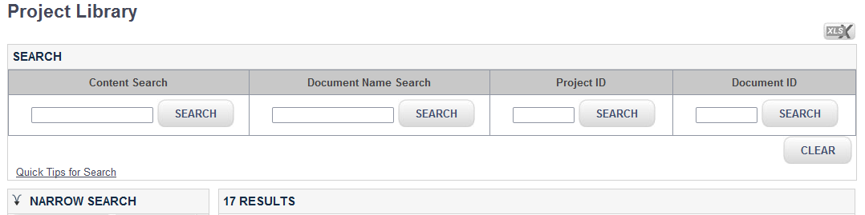
Search Documents
Module 3: Using the Search Function
For some quick tips for Search using the Search function (see previous page)
Search methods:
  Content Search: User may search document by typing any word (1 or more) which exists in the content of the document.
  Document name search: User may search document by typing any word (1 or more) which exists in the name of the document.
  Project ID search: User may type the specific Project ID, or can use search with wildcards
  Document ID search: User may type the specific Document ID, or can use search with wildcards
Selection of the “Clear” button will clear all search values (including filter searches)
Following a search/filter, the number of resources found is displayed
2
1
3
4

Slide 14
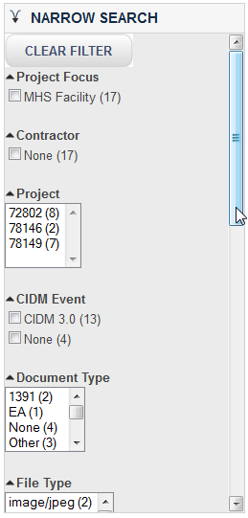
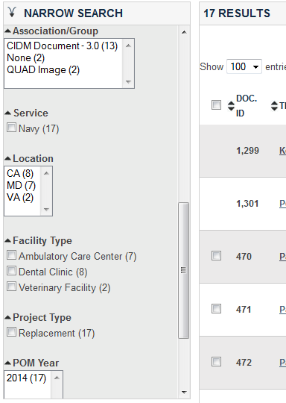
Search Documents
Module 3: Using the Search Function
Search can be narrowed by choosing a specific filter. More than one filter category can be chosen simultaneously
Scroll down for more filter search categories
Number of document that match all searches will appear next to the selection.
Selection of the “Clear all” button will clear all filter values
Following a search/ filter, the number of resources found is displayed
5
4
1
3
2

Slide 15
Module 4: Viewing & editing documents
What is covered
Viewing & Editing Documents on the Project Library page
Mass Editing
Editing Single Document

Slide 16
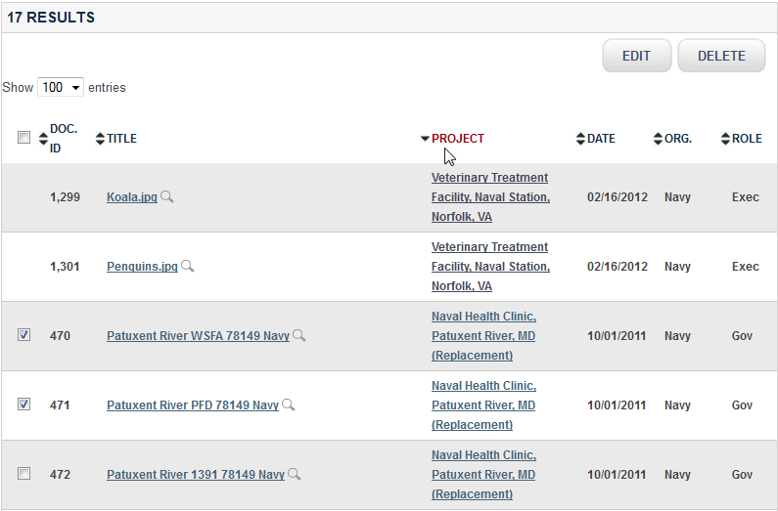
Viewing and Editing Documents
Module 4: Viewing & Editing Documents
Users can view all documents they are associated to through a project and for which they have a privilege “match”. Manager/ Contributor may view/edit/delete documents..
User can edit or delete one or more documents, by checking the box(es) then select Edit or Delete.
If the user selected 1 document, then the single edit form will be provided; if the user selected more than 1 document, a mass edit page will be provided (see next page).
User can view document by clicking on the document title link. The document will open in a separate window. User can also select the magnifying glass, to view a snapshot information of the document.
1
1
2

Slide 17
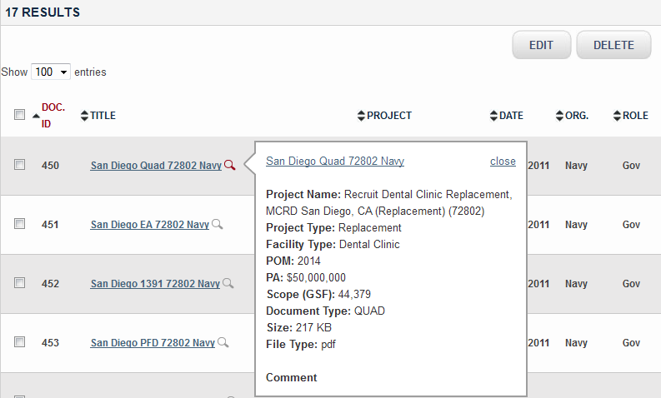
Viewing a Project Document
Module 4: Viewing & Editing Documents
Click on the title, to open a link or document in a separate window.
Click on the magnifying glass to view the abstract before downloading the entire document
2
1

Slide 18
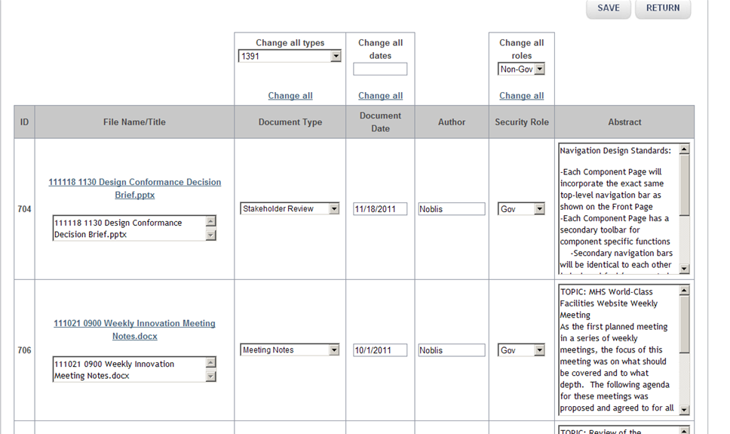
Mass Editing
Module 4: Viewing & Editing Documents
Mass edit is a tabular view of selected documents
Users may change all data displayed
Users may globally change some of the fields
Note: Not all of the information fields are included in mass edit
2
1

Slide 19
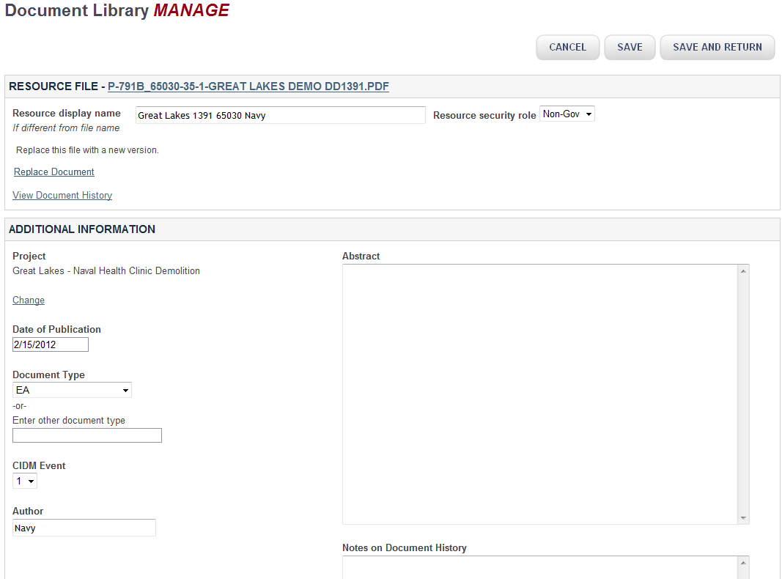
Editing Single Document
Module 4: Viewing & Editing Documents
Edit all Metadata Fields to ensure accurate abstracts, searches/filters for all users

Slide 20
Module 5: Replacing a document
What is covered
Replacing a document
Viewing document history

Slide 21
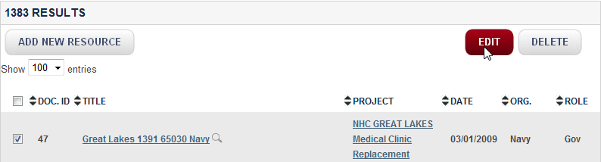
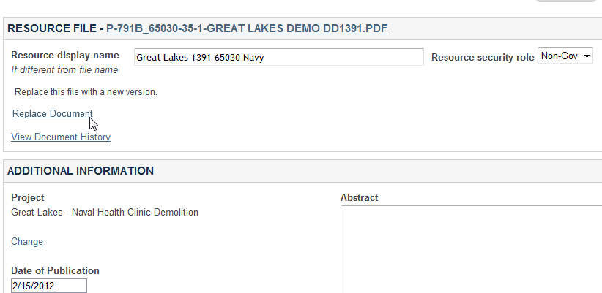
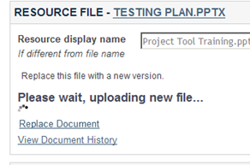
Replace a Document
Module 5: Replacing a Document
1
To replace a document, find the document in the list and select it (alone). The Single-Edit Page will be provided
The user selects the REPLACE Link and identifies the new document.
While the document is being replaced (and the new version indexed) the user will have a Wait Message
The previous version is maintained in the repository but it is taken out of the main list. The New Document is assigned the original’s Resource ID
Any links sent with that original Resource ID will still be viable – but they will lead to the new document and not the original
2
3

Slide 22
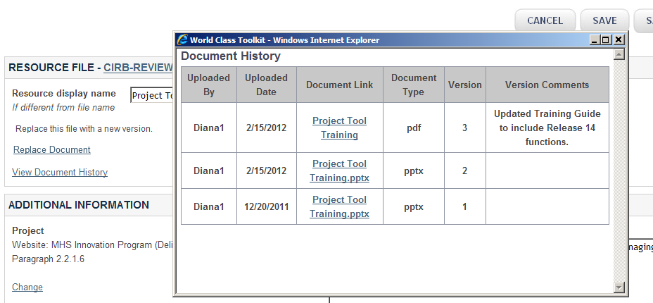
Viewing the History
Module 5: Replacing a Document
The user selects the link “View Document History”
A record of each previous document is kept in the repository data store
If the user added Version Comments when editing the document, then that note will be included in the history view
2
1
3

