Slide 1
Resource Library for the MHS World-Class Facilities
Using the Resources Library
Version 2

Slide 2
Training Modules
g | Module 1: Accessing the Resource Library
g | Module 2: Viewing and Accessing Resources
g | Module 3: Finding a Specific Resource
Notes:
Service Leads are members of the CIDM Team; wearing a different hat they are responsible for managing the projects that their Service/Organization wants to submit to the CIRB for consideration.
The workflow depicted in the diagram is the basis for the functions provided in the CIDM tool.

Slide 3
Module 1: accessing the resource library
What is covered
Getting to the resource library and document privileges

Slide 4

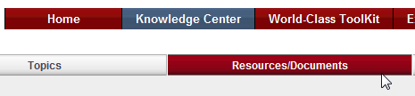
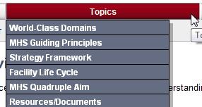
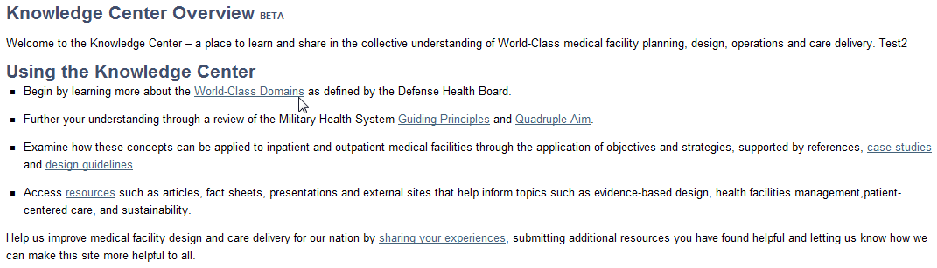
Getting to the Resource Library
Module 1: Accessing the Resource Library
  Select Resources/Documents from The Knowledge Center menu bar or from the Knowledge Center Home
  From the Knowledge Center Page, users can view detailed information of selected topics
1
1
2
2

Slide 5


Resource Document Privileges
Module 1: Accessing the Resource Library
Documents are assigned one of the three privilege levels:
Users can view all resource documents where personal role matches information roles
Public & non-Government registered users (not logged in NON GOV)
For Government purposes only (GOV)
Executive users within TMA or those assigned the privilege by TMA (EXEC)
Note:
Users can tell if they are logged in at the top of the page: or
Users may request a user ID – select LOGIN and then the REGISTER link…
Notes:
Chantal, can you fix the text boxes on this slide? Thanks
Lan

Slide 6
Module 2: viewing and accessing the resources
What is covered
Navigating and Using the Resource Features

Slide 7
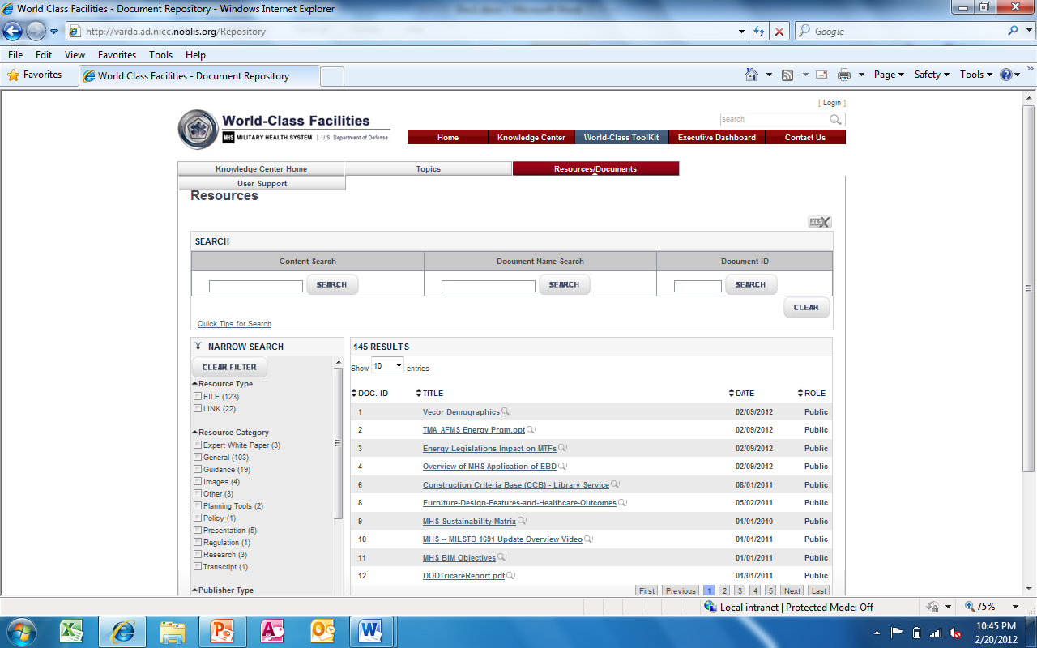
What is the Resource Library?
Module 2: Viewing and Accessing the Resources
The Library is made up of resources – documents, images, website links
Each resource may be opened or downloaded from the library list
The list may be organized by the user

Slide 8
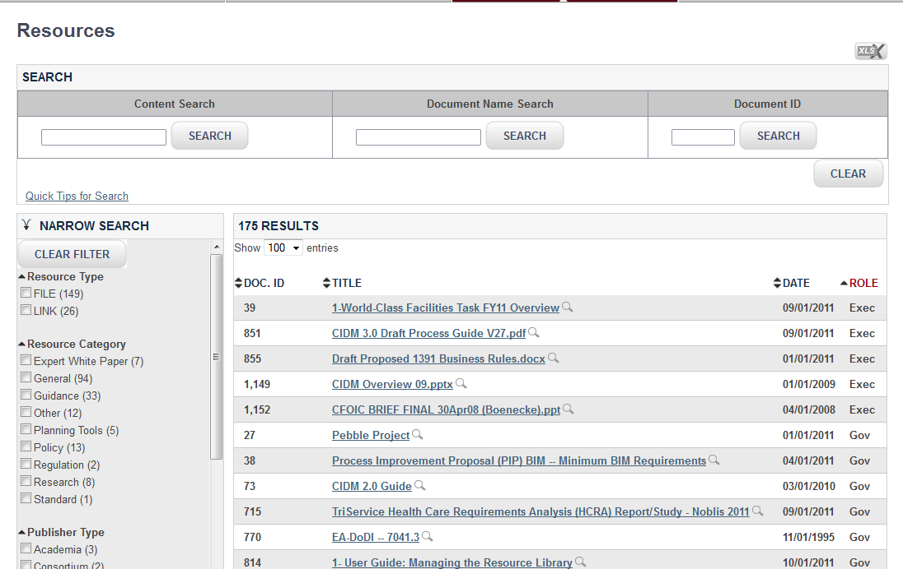
Viewing and Accessing Resource Library
Module 2: Viewing and Accessing the Resources
On the Resource Library page, users can view all resources for which they have a privilege “match”
Users can search documents by Content, Document Name, and Document ID
Users can perform filter search for document. Filter Search can be narrowed by various filters. More than one can be chosen simultaneously
2
3
1

Slide 9
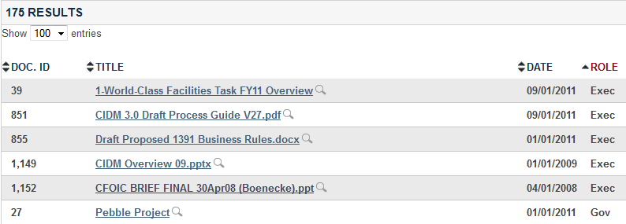
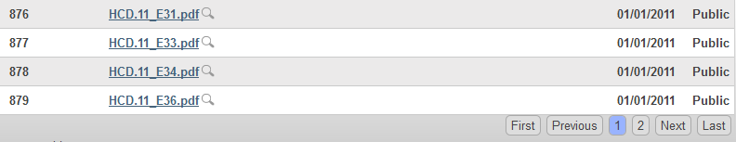
Viewing and Accessing Resource Library
Module 2: Viewing and Accessing the Resources
Users can sort on each column. The “Category” in red is the current sort column
Users can change the number of documents listed
Users can navigate by moving to first, last, next, previous
Click on the title, to open a link or document in a separate window.
Click on the magnifying glass to view the abstract before downloading the entire document
2
1
5
4
3

Slide 10
Module 3: Finding a specific resource
What is covered
Using the Search, Filter, and Sort Mechanisms

Slide 11
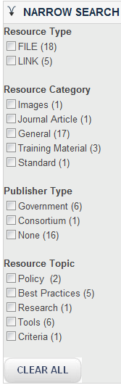


Search Roadmap
Module 3: Finding a Specific Resource
  Search: Add search Term(s)
1
2
  Sort all Resources by these choices
4
  Following a search/filter, the number of resources found is displayed
3
  Clearing a Search or a filter
  Any new entry to the Search window after filters are chosen will clear all of the filters from “Narrow Search”
  Selection of the “Clear” button will clear all search values
  Selection of the “Clear filter” button will clear all filter values
5
  Search can be narrowed by these filters. More than one can be chosen simultaneously.

Slide 12
Using the Content Search Function
Search Can be by Content,
Module 3: Finding a Specific Resource
AND, OR must be upper case!
Searching by Terms
To find a term type it in the box:
To find more than one term, type in each term:
To find a phrase add quotation marks:
Boolean searches
To find at least one of the terms
To find all of the terms:
To find document with 2 or more terms and possibly another use:
Test
Facility OR Project OR Manage
Facility Project Management
Facility AND Project AND Manage
“Facility Project Management”
Facility + Project + Manage
Fuzzy Searches with Wildcards
The ‘?’ looks for terms that match that with the single character replaced. To search for "text" or "test" use:
Multiple character wildcard searches looks for 0 or more characters. To search for test, tests or tester, use :
You can also use the wildcard searches in the middle of a term.
Note: Do not use the * or ? symbols at the beginning of a search term
(facility OR project) AND Manage
Te?t
Very Fuzzy Searches
To find “sort-of-alike terms”, use the ~
  Returned documents with following terms:
    Department, partnering, departure
Partner~
Test*
Te*t
For more information on the search engine: Apache.org

Slide 13
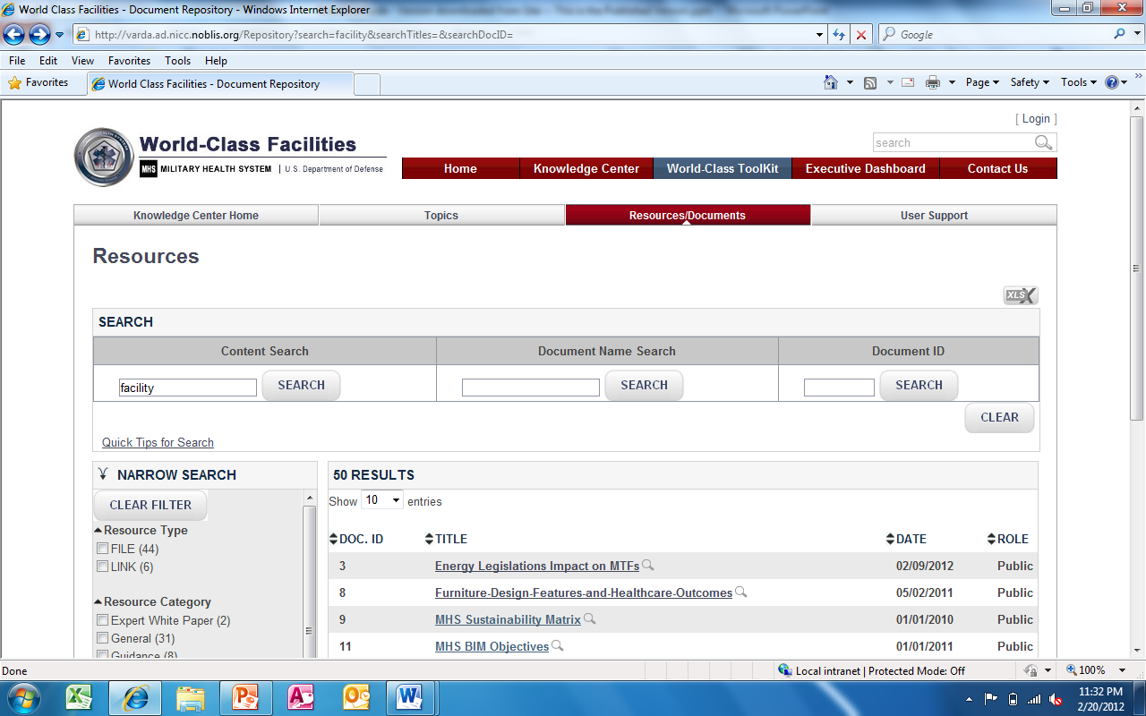
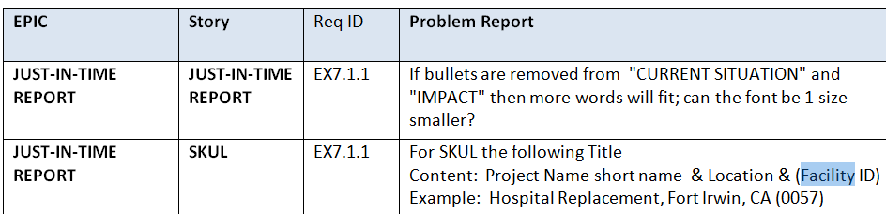
Searching by Content
Module 3: Finding a Specific Resource
Enter one or more terms in the Content Search box
The search is performed on the content of the resources, keywords and abstracts
Example: Excerpt below shows “facility” was not found in the title, but in the body of the document

Slide 14
Searching by Document Name or ID
Module 3: Finding a Specific Resource
Enter part of or the whole document name to search for a resource by Document Name
Enter Document ID to search for a resource by Document ID
Each document is assigned a unique ID

Slide 15
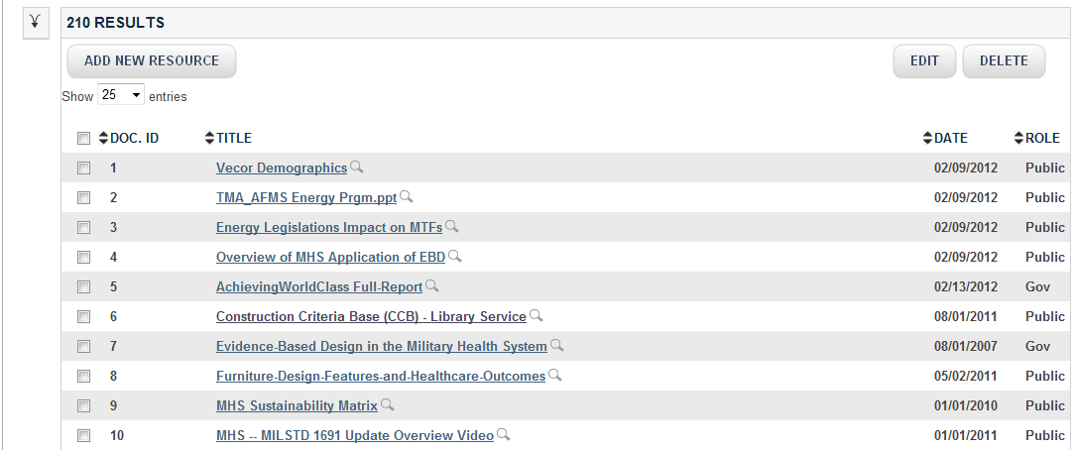
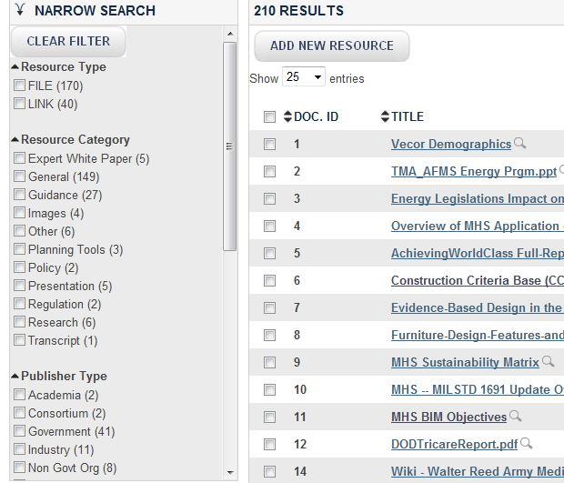
Managing the List Size
Module 3: Finding a Specific Resource
Users can open and close the filter – to make list wider (close) or to use filters (open)

Slide 16
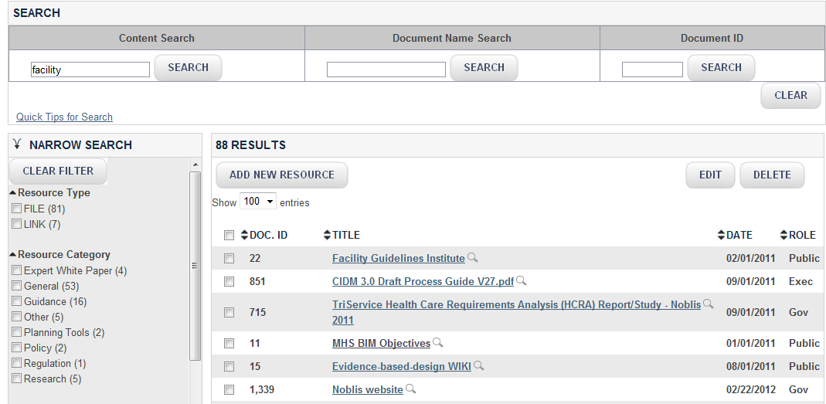
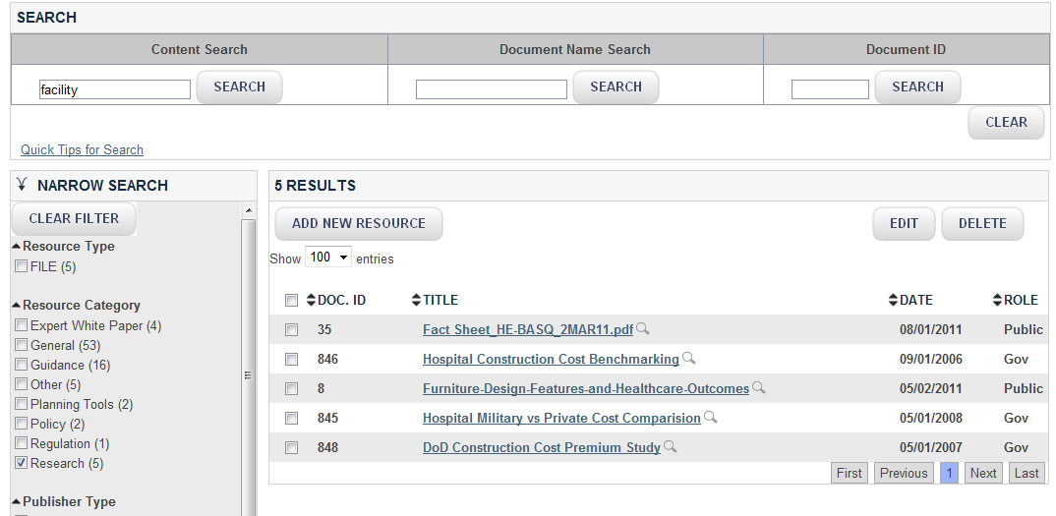
Searching and Filtering Together
Module 3: Finding a Specific Resource
The top document returned in a search is the most relevant resource
Search and “Narrow Search” work in concert: Here documents with “facility” in them were filtered with the term “Research”
The results went from 88 documents to five when the filter was applied
2
1
  Anytime a new search term is used, all “checks” in “Narrow” Search are cleared
3

Slide 17
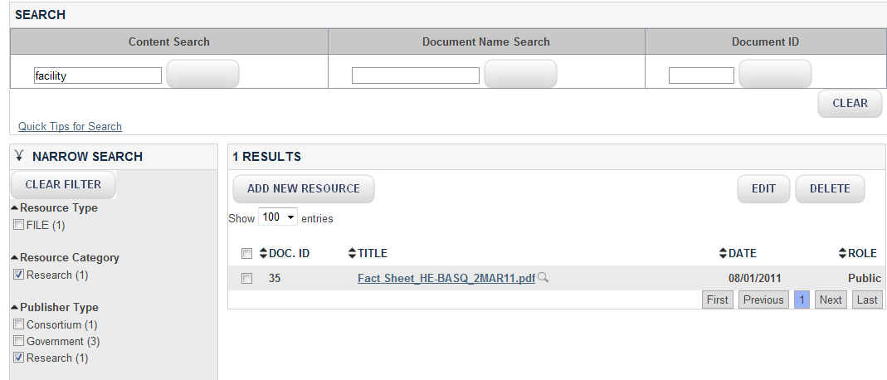
Continue to Narrow the Search
Module 3: Finding a Specific Resource
Continue to narrow the search with a further choice: From Publisher Type, we chose the one “Research” topic, and thus narrowed the search to one choice
If a new Search term is used, it clears all choices from “Narrow Search”

