Slide 1
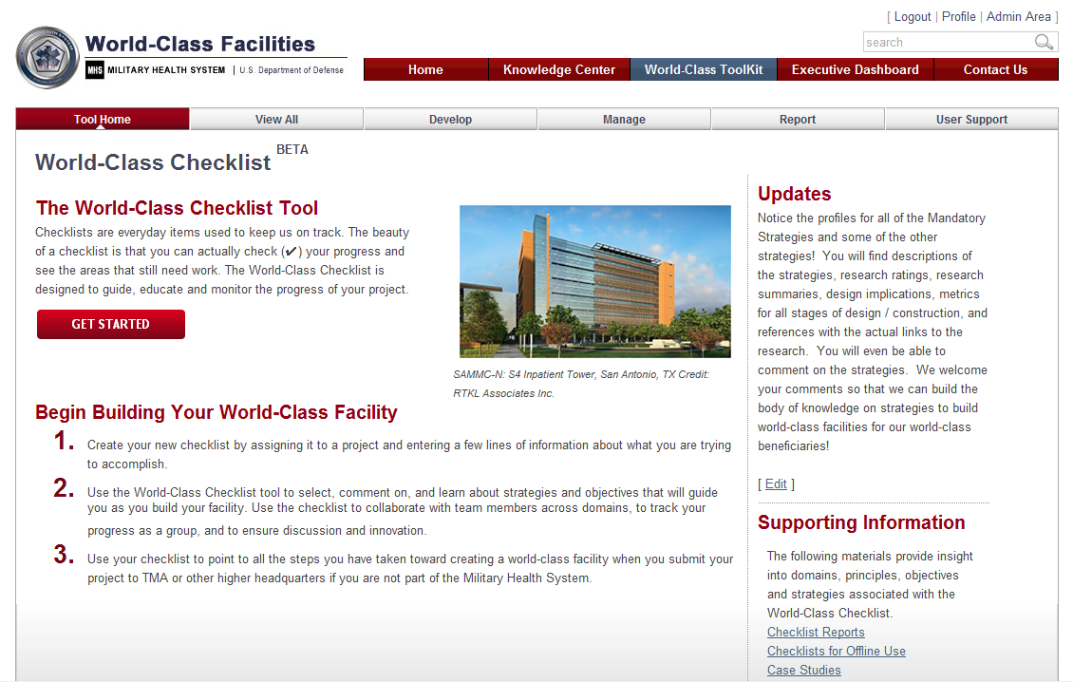
Checklist Training

Slide 2
Checklist Overview and Background

Slide 3
What are the World-Class Checklist/Toolkit?
The Checklist/Toolkit provides a platform to share knowledge and provide a structured approach to ensuring provision of world class medical facilities consistent with the vision articulated by the Defense Health Board and codified by Congress
The Checklist/Toolkit is a tool to:
Promote World-Class design strategies throughout the facility lifecycle in support of World-Class domains
Guide visioning for the facility – clearly identify and place the key principles and objectives of world-class in front of the leaders and planners
Monitor design strategies throughout the life cycle of the facility
MHS Guiding Principles for the WC Checklist
Provide patient and family-centered care
Achieve world-class quality and safety
Create a positive work environment
Improve operational effectiveness
Be sustainable with a high level of community responsibility
Provide high value & be good stewards of taxpayer money
Be evidence and performance based
Design for maximum flexibility, standardization & growth
Decision making based on best practices and innovation
Notes:
NOTES

Slide 4
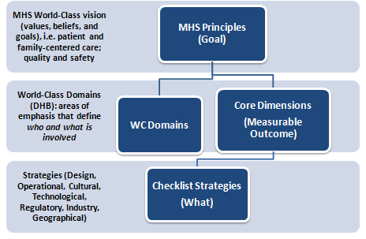
World-Class Checklist Structure
Checklist Structure
Each of the MHS Guiding Principles is supported by one or more checklist strategies
Strategies are grouped by relevance to a lifecycle and a DHB domain
There are 167 strategies; 20 are mandatory for MHS Facility Projects
Each strategy is associated with a specific lifecycle phase for when it should be considered
Each strategy is associated with a “lead” – the responsible stakeholder is either the facility manager, the command or MHS
Some strategies are mandatory (20) and the others are things to consider
Strategies vary based on:
  Facility Type – not all strategies apply
  Lifecycle phase - not all strategies apply
  Mandated strategies – if they don’t apply, users provide reason and deselect the strategy
Notes:
NOTES

Slide 5
Training Modules
g | Module 1: Accessing the Checklist | g | Module 5: Using the Strategy Selection List
g | Module 2: Creating a Checklist | g | Module 6: Using the Strategy Viewer to View a Strategy
g | Module 3: Accessing an Already Created Checklist | g | Module 7: Modify Checklist
g | Module 4: Understanding the “Elements” on the Checklist Page
g
c
Available module & functionality
Not developed
Notes:
Service Leads are members of the CIDM Team; wearing a different hat they are responsible for managing the projects that their Service/Organization wants to submit to the CIRB for consideration.
The workflow depicted in the diagram is the basis for the functions provided in the CIDM tool.

Slide 6
Module 1: Accessing the Checklist

Slide 7
Module 1: Accessing the Checklist
What is covered
Logging into the Website
From the Top Navigation
Bar
Checklist Main Page
Checklist Navigation Bar

Slide 8
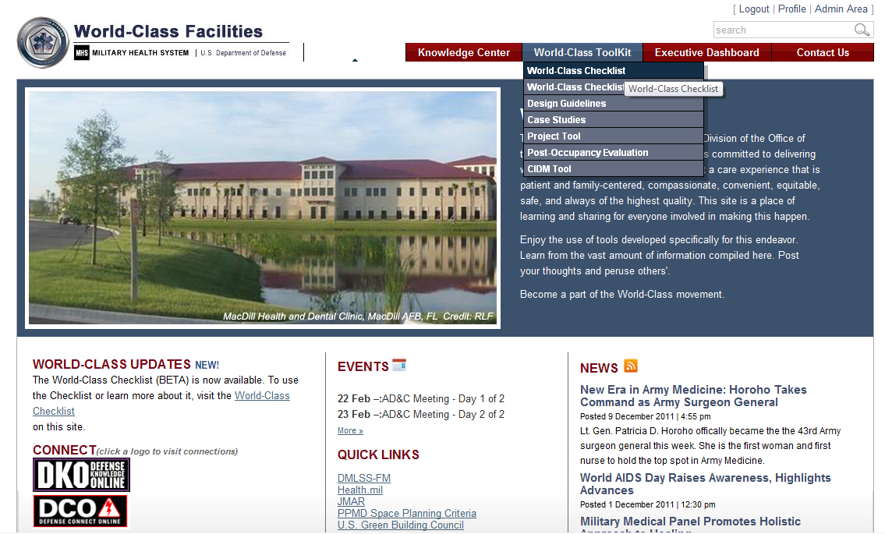
From the Top Navigation Bar
MODULE 1: Accessing the Checklist
User must be logged in
From the main navigation bar select World-Class Toolkit | World-Class Checklist

Slide 9
Checklist Main Page
MODULE 1: Accessing the Checklist
Check this section for any new updates to the Checklist
Select Get started to view checklists you might have already created or to create a new checklist
Includes information on Checklist background, principles, case studies, etc.

Slide 10
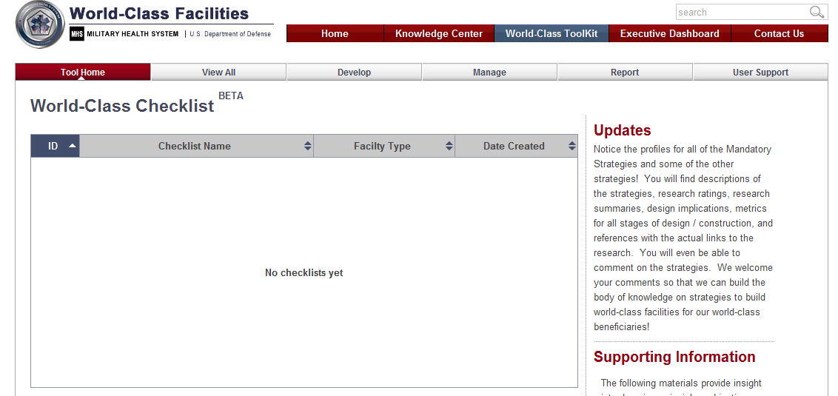
Checklist Navigation Bar
MODULE 1: Accessing the Checklist
Select “Develop” to create a new checklist or modify existing checklist information
Select “User Support” to access the User Guide and email user support
Select “manage” to create or modify teams, inform POC, and submit to TMA
Select “Reports” to create Checklist and Strategy Reports

Slide 11
Module 2: Creating a Checklist

Slide 12
Module 2: Creating a Checklist
What is covered
Name
Facility Type
Life Cycle

Slide 13
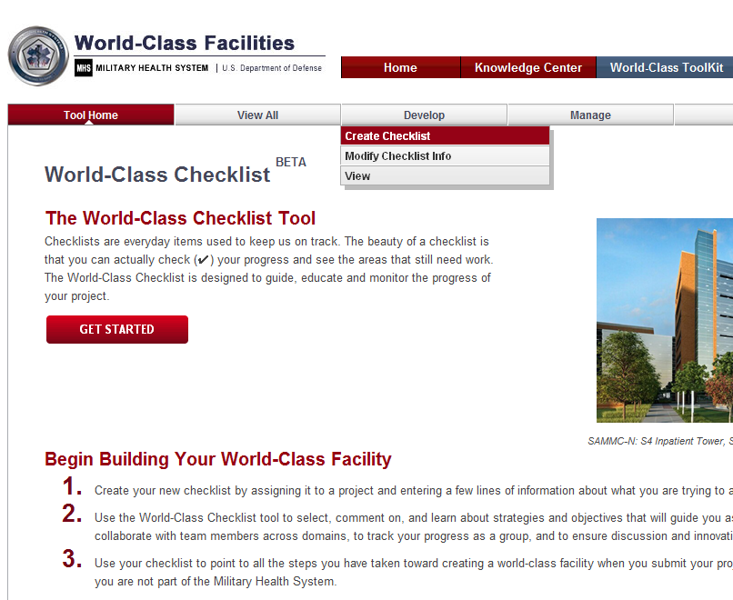
Creating a Checklist
MODULE 2: Creating a Checklist
From the Develop tab, click on “Create Checklist”

Slide 14
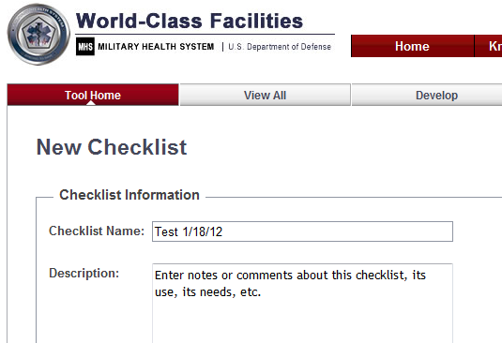
Name and Description
MODULE 2: Creating a Checklist
Type a Checklist name for you new checklist
Click on Description and add a description if desired.

Slide 15
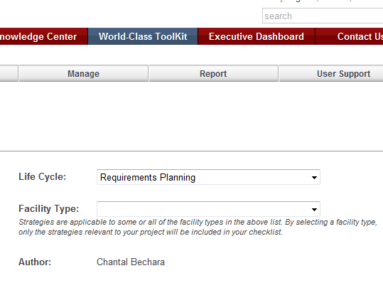
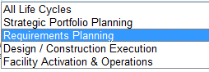
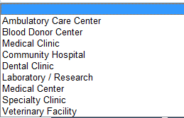
Life Cycle and Facility Type
MODULE 2: Creating a Checklist
1. When a new checklist is created, the default Facility Life Cycle Phase is Requirements Planning. The Facility Life Cycle Phase controls which objectives and strategies display in the checklist. You can change the phase at anytime.
1
2
2. By selecting a facility type, only the strategies relevant to your project will be included in your checklist

Slide 16
Module 3: Accessing an
Already Created Checklist

Slide 17
Module 3: Accessing an Already Created Checklist
What is covered
Accessing an already created checklist

Slide 18
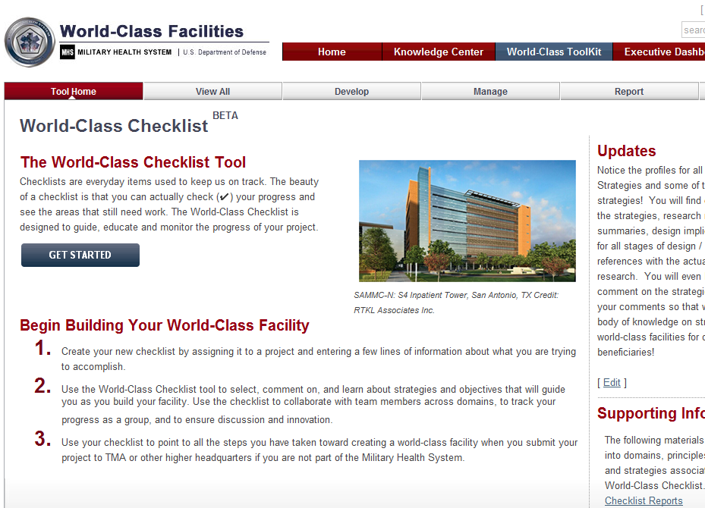
Accessing an Already Created Checklist
MODULE 3: Accessing an Already Created Checklist
From the Checklist main page, click on “Get Started”

Slide 19
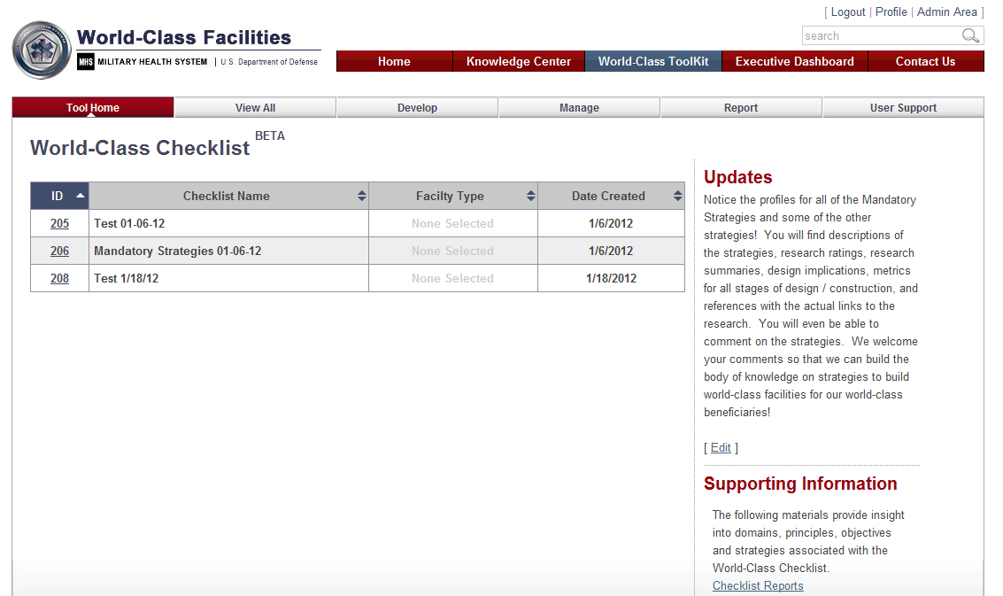
Accessing an Already Created Checklist
MODULE 3: Accessing an Already Created Checklist
Checklists you have previously created will appear in order. Click on the checklist (ID) you wish to open

Slide 20
Module 4: Understanding the
“Elements” on the Checklist Page

Slide 21
Module 4: Understanding the “Elements” on the Checklist Page
What is covered
Domain
Lifecycle
Filters
Strategy Selection List
  Check Box
Strategy Viewer
  Each Element
  Comment Box

Slide 22
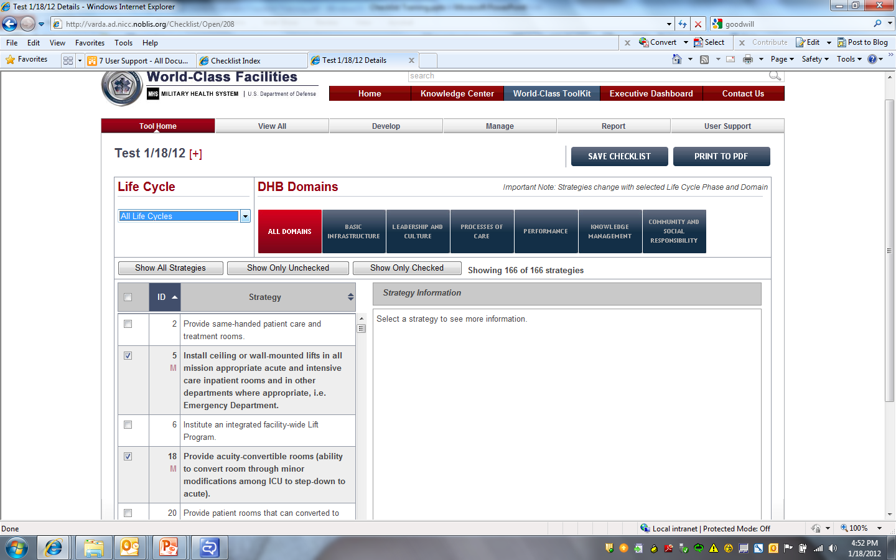
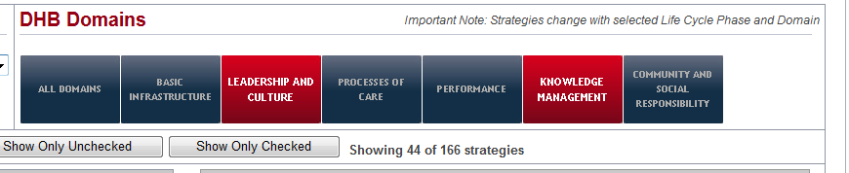
Domain
MODULE 4: Understanding the “Elements” on the Checklist Page
To change to a different domain, CLICK the desired DOMAIN button. The system will update the Objectives and Strategies accordingly
You can choose multiple domains

Slide 23
Lifecycle
MODULE 4: Understanding the “Elements” on the Checklist Page
The Life Cycle phase drop down menu filters the list of available Objectives and Strategies

Slide 24
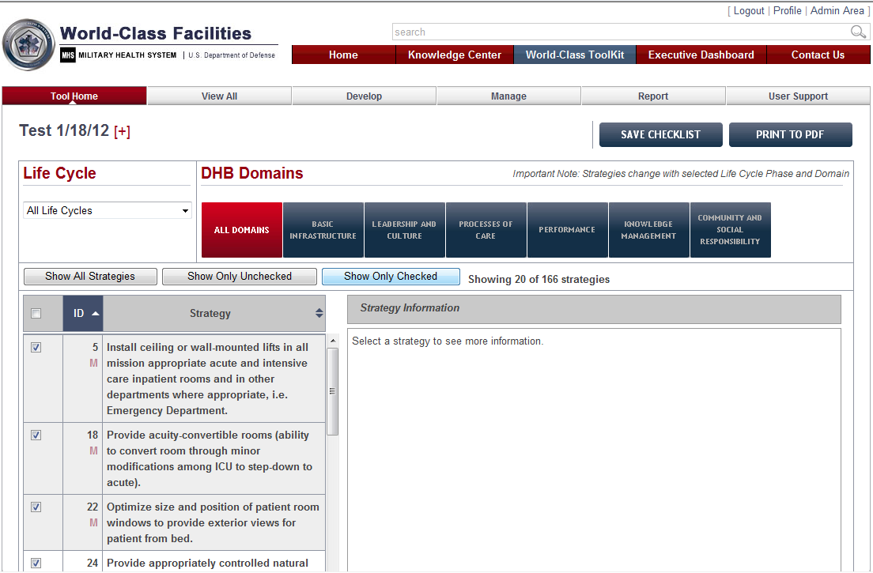
Filters
MODULE 4: Understanding the “Elements” on the Checklist Page
1
2
3
You can choose to show all strategies (checked and unchecked)
You can choose to show only those strategies that are unchecked
You can choose to show only checked strategies

Slide 25
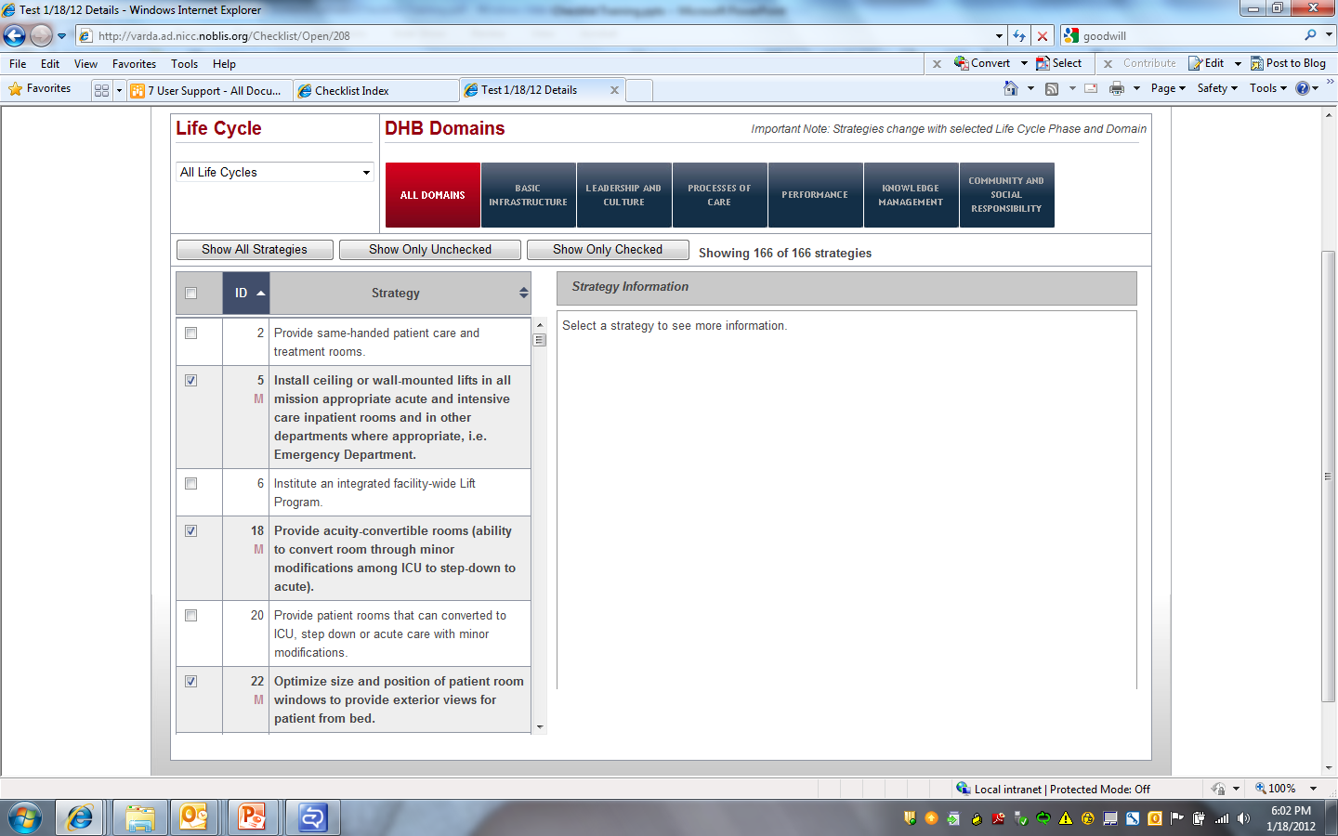
Strategy Selection List
MODULE 4: Understanding the “Elements” on the Checklist Page
Click the checkbox next to the desired strategy. A checkmark will appear in the checkbox for the selected strategy. A checkmark will also appear for the strategy whenever it appears under additional objectives.
To deselect a strategy, click the checkbox again to remove the checkmark. The system will remove the checkmark everywhere else it appears under additional objectives.

Slide 26
Strategy Viewer
MODULE 4: Understanding the “Elements” on the Checklist Page
Select “Show All Strategies for viewing all strategies or “Show Only Unchecked” to view strategies that were not selected for the Checklist

Slide 27
Module 5: Using the Strategy Selection List

Slide 28
Module 5: Using the Strategy Selection List
What is covered
Select a Strategy
Write a Comment

Slide 29
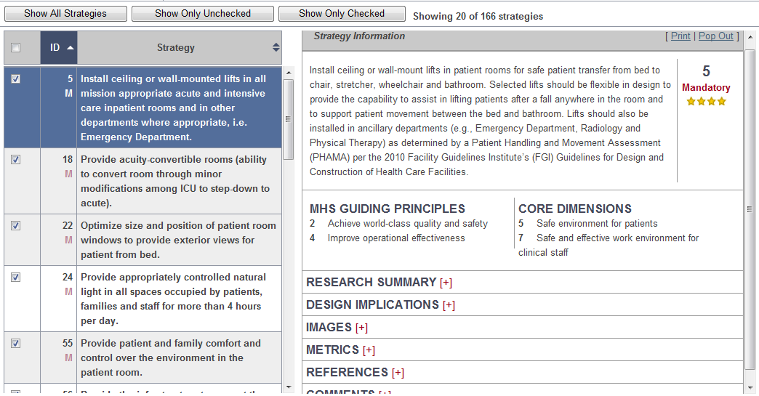
Select a Strategy
MODULE 5: Using the Strategy Selection List
To select and view a Strategy, click once on it. It will turn blue. The information will appear in the “Strategy Information” box on the right hand side.
To view strategy information (Research Summary, Design Implications Images, Metrics, References, etc.) click on the [+] sign to expand it

Slide 30
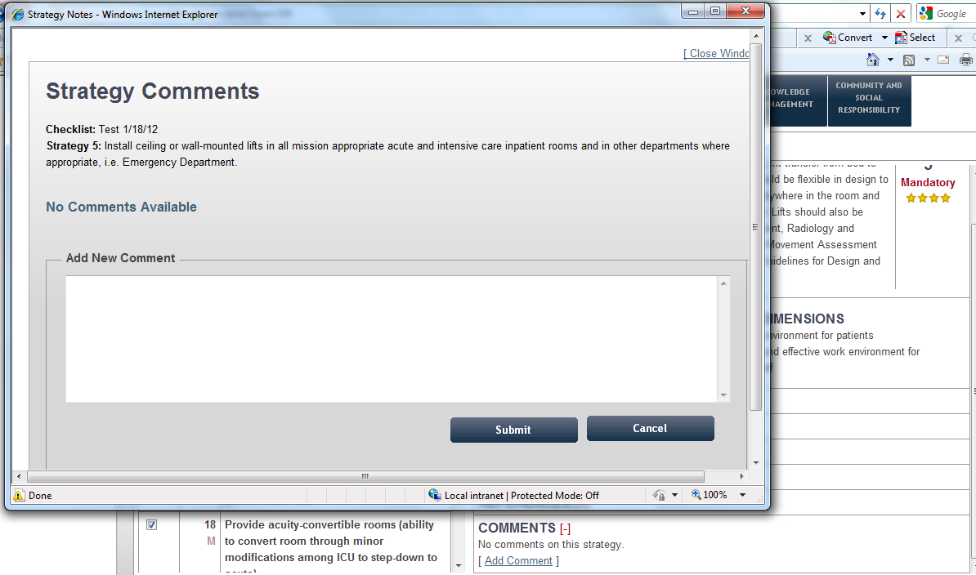
Write a Comment
MODULE 5: Using the Strategy Selection List
2
2. Add your comment then press Submit
1. To add a comment, expand the “Comments” tab by click on the plus sign. Click on “Add Comment”
1

Slide 31
Module 6: Using the Strategy
Viewer to View a Strategy

Slide 32
Module 6: Using the Strategy Viewer to View a Strategy
What is covered
Popup the Right Side and Printout
Printout the Checklist

Slide 33
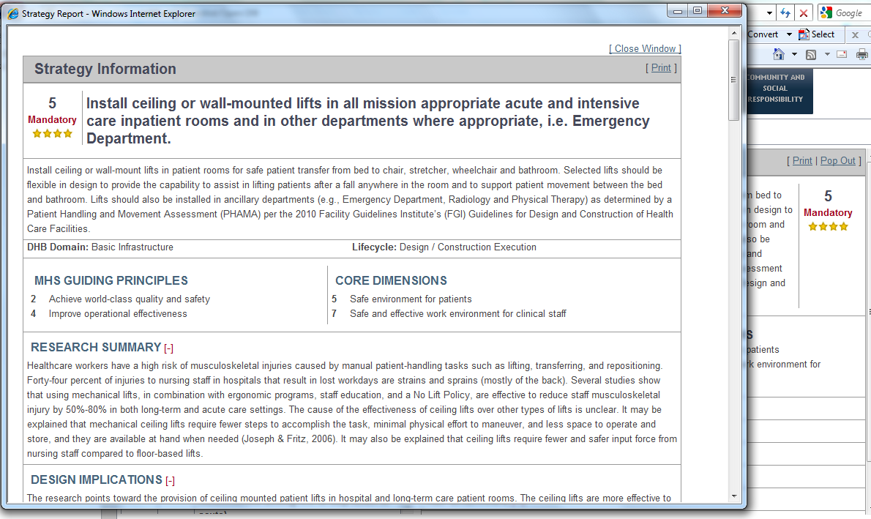
Popup the Right Side and Printout
MODULE 6: Using the Strategy Viewer to View a Strategy
2
3
1
On the Strategy Information screen, click on “Pop Out”
The “Strategy Information Report” window appears
Click on “Print” to print the Report

Slide 34
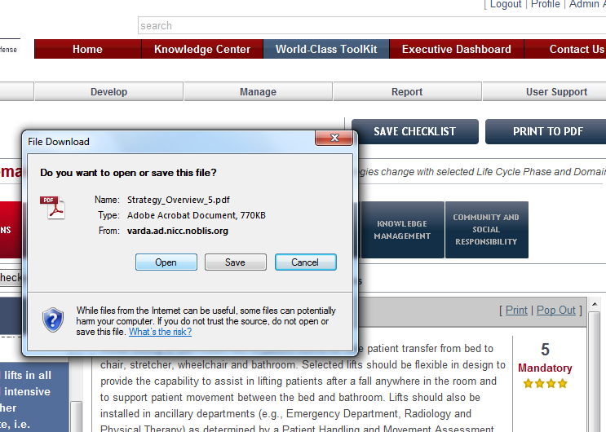
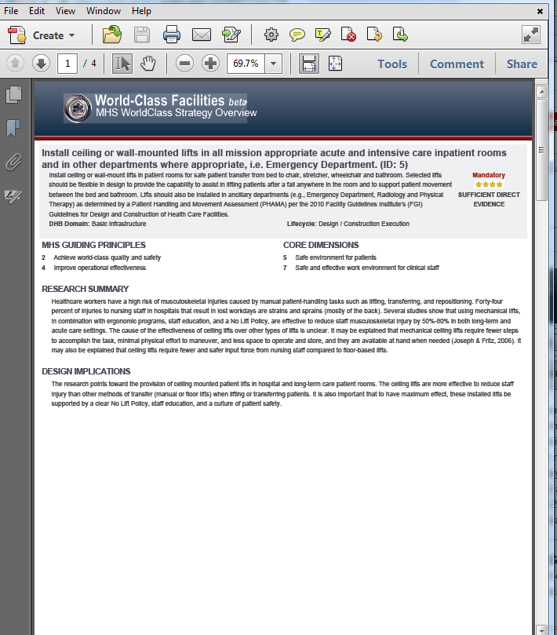
Printout the Checklist
MODULE 6: Using the Strategy Viewer to View a Strategy
3. If you click Open, a PDF of the Report open.
3
2
1
On the Strategy Information screen, click on “Print”
A “File Download” window appears. Click Open to open the Report or Save to save it to your hard drive

Slide 35
Module 7: Modify Checklist

Slide 36
Module 7: Modify Checklist
What is covered
Change Name
Change Facility Type
Change Life Cycle

Slide 37
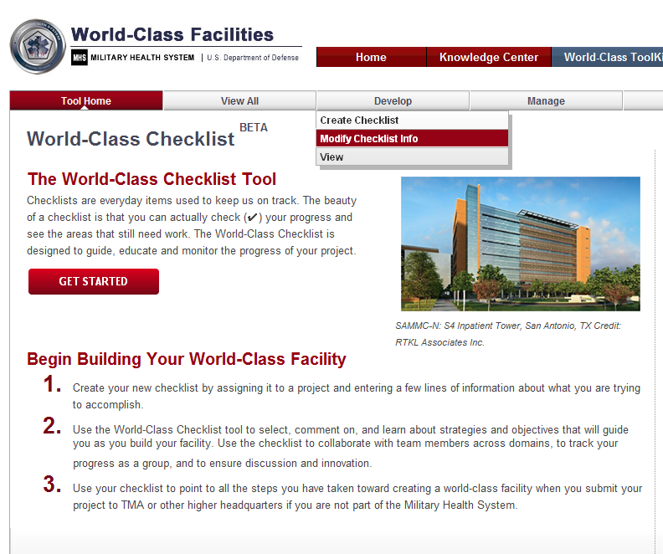
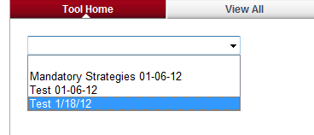
Change Name
MODULE 7: Modify Checklist
1. From the Checklist main window, click on the Develop tab and choose “Modify Checklist Info”
1
2
2. From the drop down list, select the Checklist you would like to modify

Slide 38
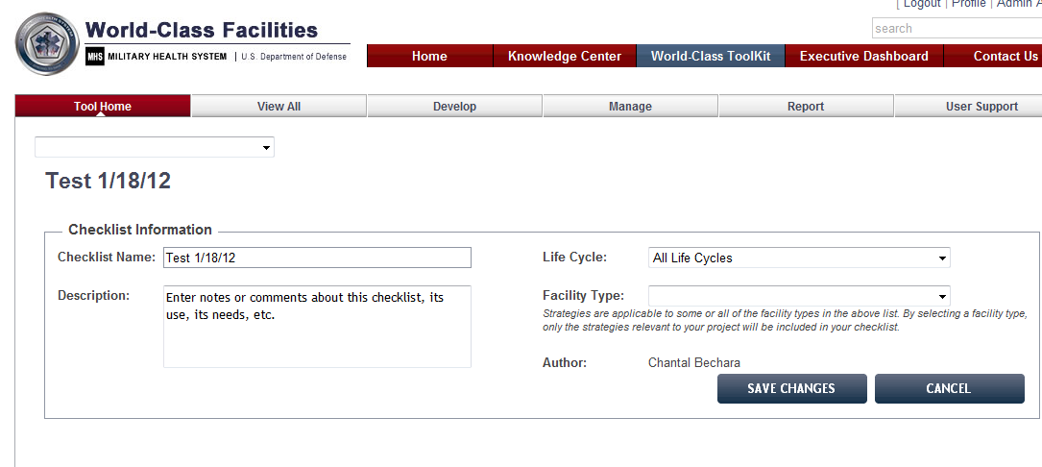
Change Name, Facility Type, and Life Cycle
MODULE 7: Modify Checklist
1
3
2
The Checklist information window appears. You can change the Name by retyping over the old name.
From the drop down menu, you can change the Facility Type
From the drop down menu, you can change the Life Cycle

