Slide 1

Project Tool Training
Part of the WCToolkit for MHSWorldClassFacilities.org

Slide 2
Training Modules
g | Module 1: Project Privilege Model | g | Module7: Adding Project Information
g | Module 2: Accessing Project Tool | g | Module 8: Milestones
g | Module 3: Viewing Projects | g | Module 9: Managing Project Documents
g | Module 4: Creating Projects and Modifying Primary Information | c | Module 10: Skull Sheets and QUADs
g | Module 5: Building a Project Team | g | Module 11: Closing a Project
g | Module 6: Project Information Pages
g
c
Available module & functionality
Not developed
Notes:
Service Leads are members of the CIDM Team; wearing a different hat they are responsible for managing the projects that their Service/Organization wants to submit to the CIRB for consideration.
The workflow depicted in the diagram is the basis for the functions provided in the CIDM tool.

Slide 3
Module 1: Project Privilege Model

Slide 4
Module 1: Project Privilege Model
Permission Role | R/W/M | Permission Capabilities
PROJ MGR | M | Create a Project Assign other users to be managers Assign project contributors (read/write) Assign reading permissions to other users Modify primary project information Close Project All Project Contributor Permissions
PROJ CONTRIB | W | Writes information on project ; adds milestone information Uploads documents for project (Document has user’s Role) Modifies document meta data (change document role, etc.) All Project Reader Permissions
PROJ READER | R | Reads all project information Reads all project documents where personal role matches information role (NON-GOV, GOV, EXEC)
Repository Manager (Repos) | W | All users with privileges for “REPO” will have access to all projects and project documents by default

Slide 5
Training Guide Focus
Focus of this guide is Project Manager, Contributor and Reader
Project “Super users” – REPOS – should also review the functions related to:
  Administering project lookup data
  Managing the project repository

Slide 6
Module 2: Accessing Project Tool

Slide 7
Module 2: Project Tool – Starting Out
What is covered
Accessing the tool
Main Page look & feel
Navigation bar
Updating project tool information
Accessing project tool functions
Closing a project
Who is involved
All users assigned access to the project
The Project administrators

Slide 8
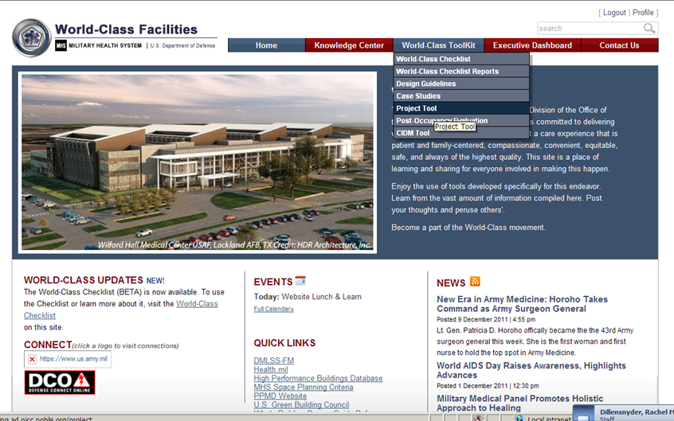
Accessing Project Tool
MODULE 2: Accessing Project Tool
User must be logged in
From the main navigation bar select World-Class Toolkit | Project tool

Slide 9
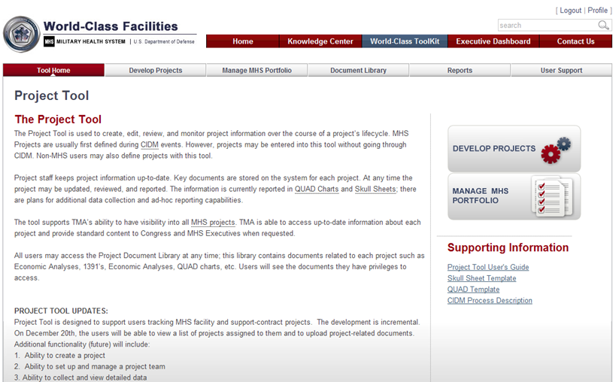
Project Tool Main Page
MODULE 1: Project Privilege Model
Project Tool Navigation Items
Get started
Project administrators can update this page – they will see an “EDIT” link.

Slide 10
Module 3: Viewing Projects

Slide 11
Module 3: Viewing Projects
What is covered
What is on the project list page
What projects a user views
Business rules concerning projects on the viewer
Using the filters and search
Who is involved
All users assigned access to the project
The Project administrators

Slide 12
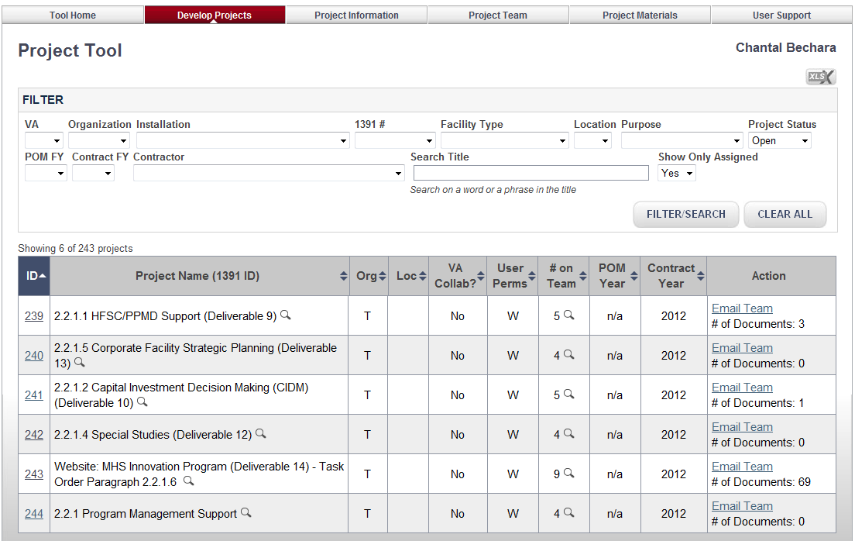
The Project Viewer
MODULE 3: Viewing Projects
Viewer Purpose – give users a comprehensive “at-a-glance” view of all projects they are associated with and access to key project related information management activities
Main Elements:
  Navigation
  Filters and Search
  List of projects
  Popup project info
  Popup team info
  Email the team
  Number of documents associated with the project
  Select a project to work on (Module 6)
1
John Jones
2
3
6
4
5
7
8
The project tool is helping PPMD manage 2 types of projects. There are MHS facility projects and internal organization support contract projects.

Slide 13
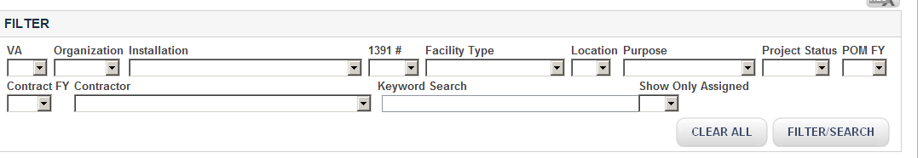
The Project Viewer – Filters and Search
MODULE 3: Viewing Projects
Users may have assignments to both types of projects. Over time, there will be an increasing number of projects in a user’s list. Filters help reduce the list and support ability to quickly find a project. The Filter/ Search – locate specific projects; limit list length
For Facility Projects, the list may be filtered by basic facility information: Organization, Installation, 1391#, Facility Type, Location
Project Title Search
Only REPOS will see
Other Filters:
VA: project involved with Veterans Affairs?
Project Status: Open or Closed?
Project Title Search: search for an exact phrase in the title and find all projects with that phrase (exactly as typed in)
Purpose: is project a facility project or a contract support project
Show only Assigned: Project Admins see all projects. They may limit the list to just those they are actually assigned to “YES”. The default filter is Assigned = Yes
Contractor: for projects that are “Contract Support” (not Facility), filter by contractor name

Slide 14
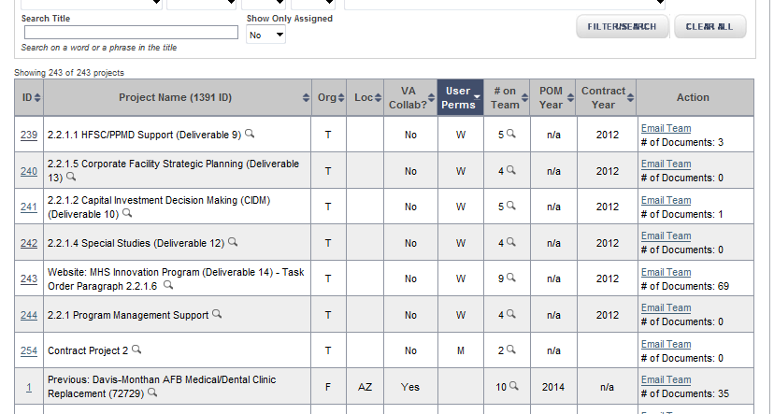
The Project Viewer – List of Projects
MODULE 3: Viewing Projects
  Main Elements:
  Sortable columns
  Project Names
  Project Service Organization
  Location
  Whether or not there is VA collaboration involved
  The user’s permissions in relation to the project
  The Eye-Glass icon opens up quick views of Project information and Team information
  Project ID is linked to the project information page
1
2
3
4
5
6
7
8
Each user has a specific assignment to a project. The assignment determines extent of activities that the user can perform for the project:
M or W: can upload documents
R: can view documents
If it is “ “, then the user has Project Administrator privileges. All PPMD staff are initially assigned that role. It can be removed on request.

Slide 15
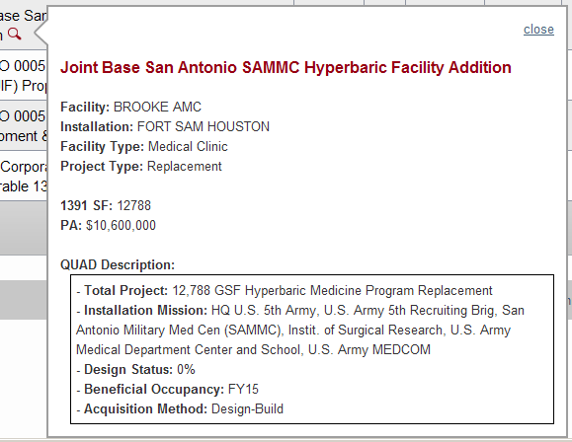
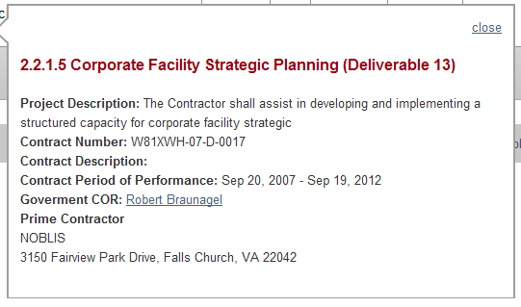
The Project Viewer – Popup Information
MODULE 3: Viewing Projects
Popup viewers: provide key information about each project without requiring user to leave the page.
Where ever the “eye glass” Icon is, users may click on it and expect a Popup Information view
Different viewer based on type of project – MHS Facility or MHS Contract Support
Information includes basic specs and provides first section of the QUAD chart. When this information is updated, its reflected in this popup.
Contract Support: contract information with other descriptive information.

Slide 16
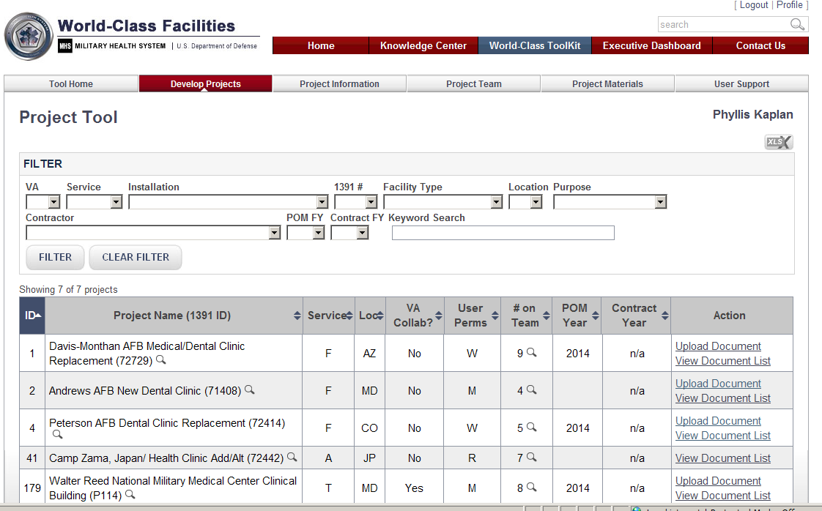
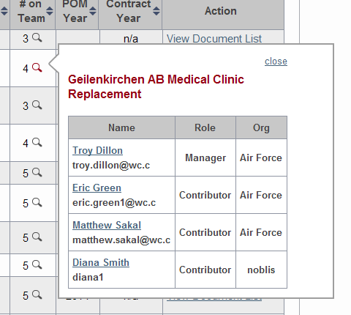
The Project Viewer – Team Popup
MODULE 3: Viewing Projects
Team Popup – give users an “at-a-glance” view of all current team members assigned to the project and their role and access information. Users can open an email session by clicking on the user’s name.
Main Elements:
  Name of user hyperlinked to the user’s email address
  Complete spell-out of the email address
  User’s role on the project
  User’s organization
John Jones
3
4
1
2
Project managers can access a complete view of all current and past assignees to a project in the “Build/Manage Teams” function

Slide 17
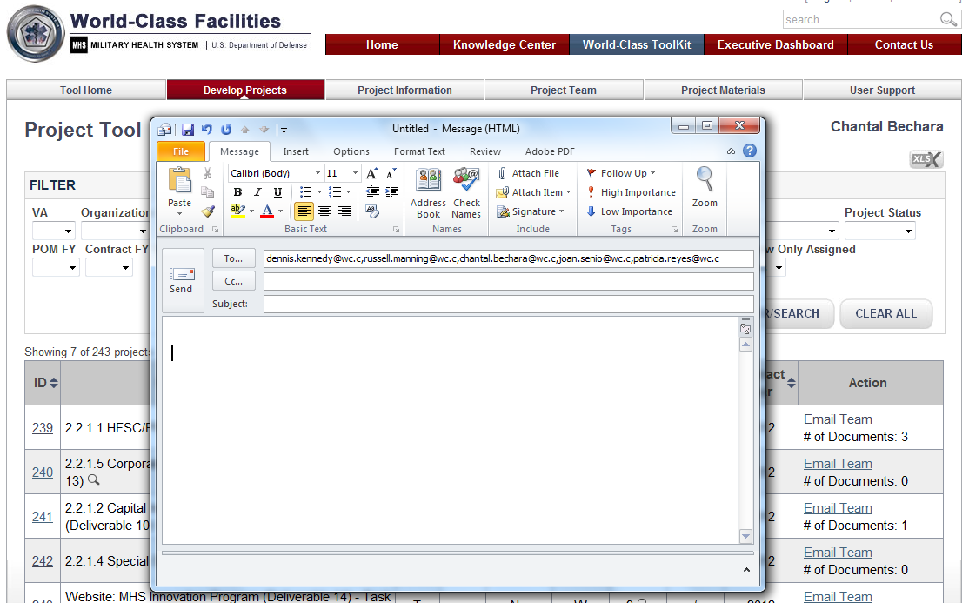
Project Actions – eMail Team
MODULE 3: Viewing Projects
Email Team – give users the ability to send an email to all current team members assigned to the project.
John Jones
Main Elements:
Link to your email account
All Team Members’ emails already pre-populated in the “To” field

Slide 18
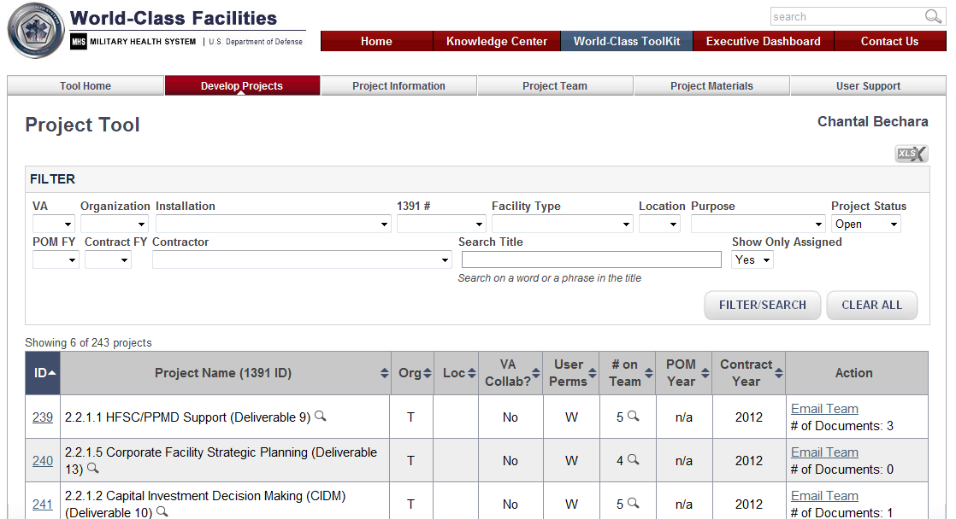
The Project Viewer – Number of Documents
MODULE 3: Viewing Projects
John Jones
The number of documents associated with a project are shown in the “Action” column

Slide 19
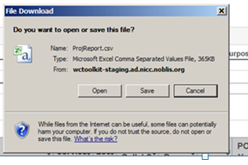
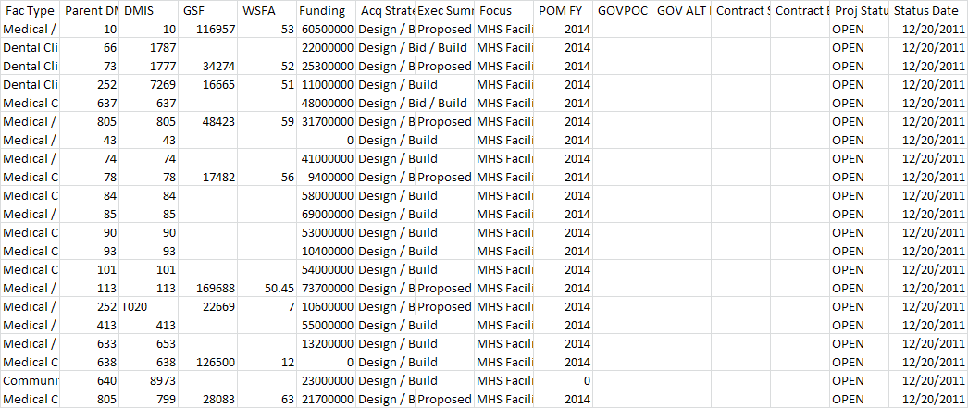
The Project Viewer – Printing Out Project List
MODULE 3: Viewing Projects
Users may download a list of projects with project information for all projects they are assigned. The list is in CSV format – opens with EXCEL. It is not formatted.
John Jones

Slide 20
Module 4: Creating Projects and
Modifying Primary Information

Slide 21
Module 4: Creating Projects and Modifying Primary Information
What is covered
Creating a MHS Facility project vs. a Contract Support Project
Finding a DMIS
Modifying the basic information
Business rules for what is required to create and modify projects
Who is involved
All users with “Manager” (M) privileges to a project
The Project administrators

Slide 22
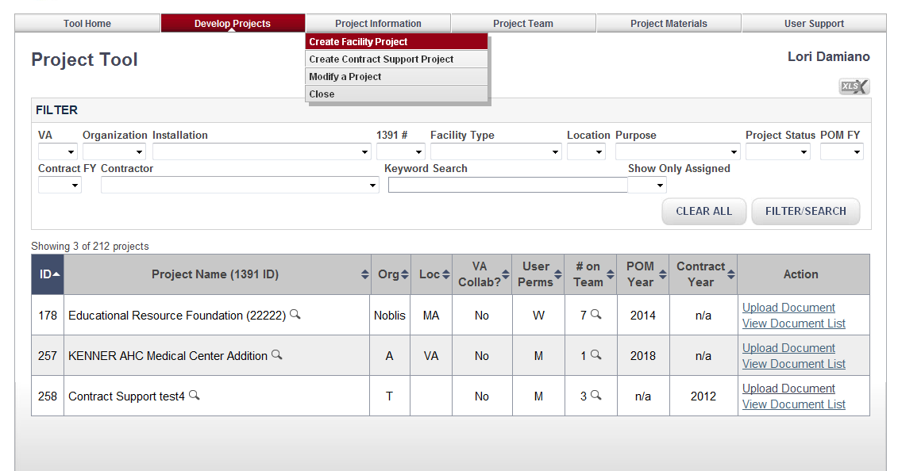
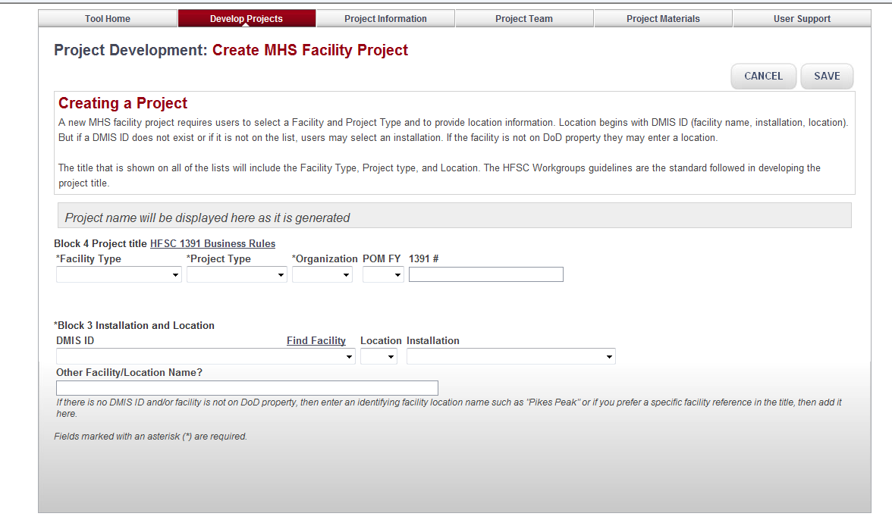
Creating Projects – Creating a MHS Facility project
MODULE 4: Creating Projects and Modifying Primary Information
From the Project Viewer, Select Project Information → Create Facility Project
The Create MHS Facility Project Page opens

Slide 23
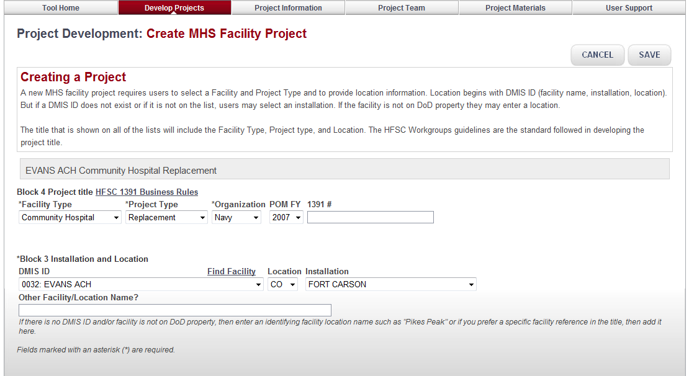
Creating Projects – Creating a MHS Facility project
MODULE 4: Creating Projects and Modifying Primary Information
Main Elements:
  System generated project name (based on information entered below)
  Link to HFSC 1391 Business Rules
  Project Information Input
    Facility Type (required)
    Project Type (required)
    Organization (required)
    POM FY
    1391 #
  A location is required by entering one or more of the following
    DMIS ID
    Location
    Installation
    Manual Enter
  A title is composed of Location & Facility Type & Project Type
  Facility Lookup (see slide 30 for more detail)
1
2
3
5
4

Slide 24
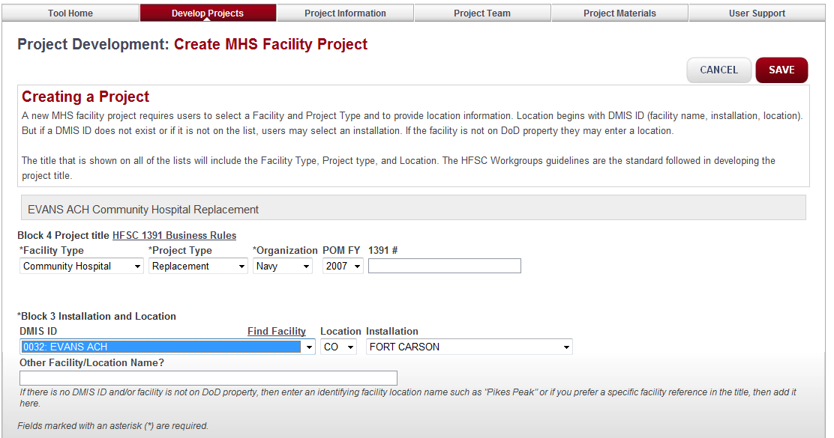
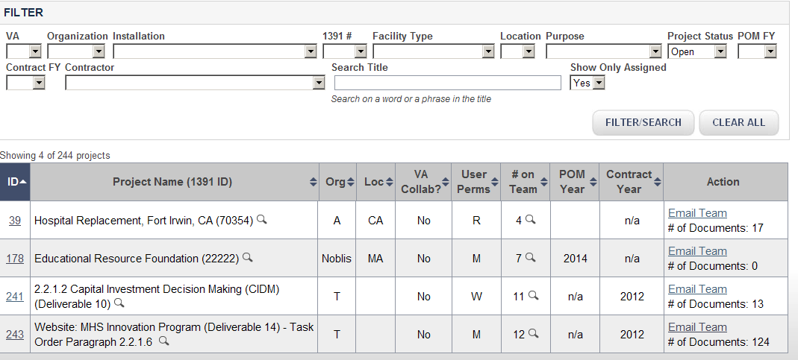
Creating Projects – Creating a MHS Facility project
MODULE 4: Creating Projects and Modifying Primary Information
2
2. Click Save
1. Input project information
1
3. New Project shows up on Project Viewer
3

Slide 25
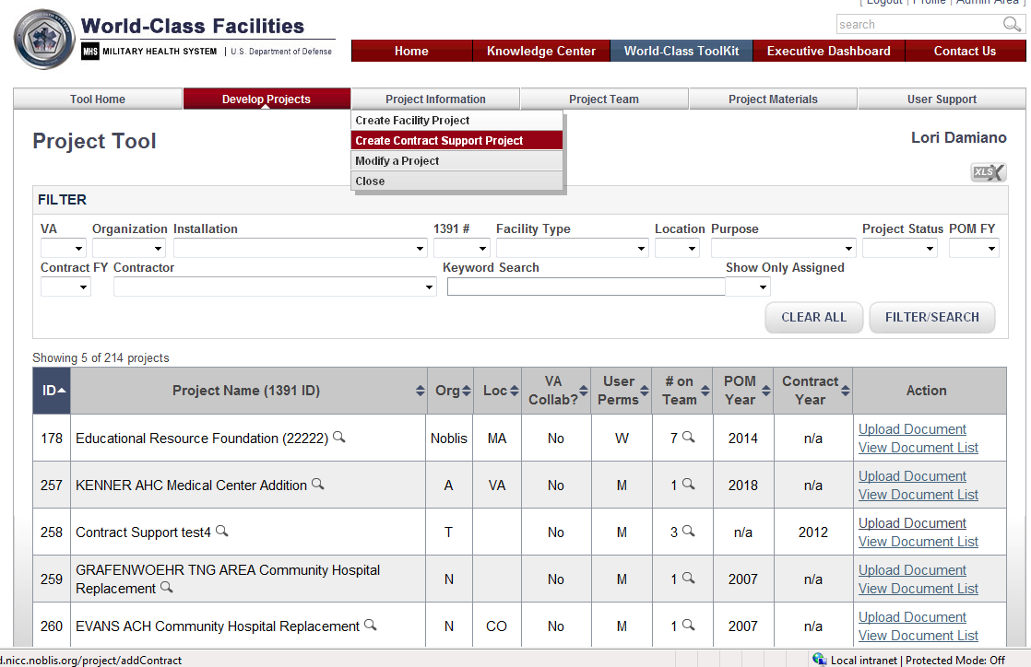
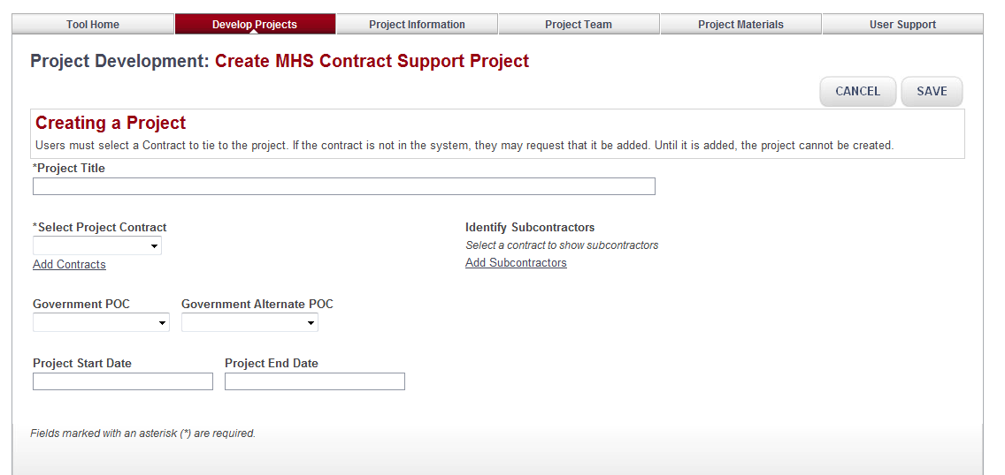
Creating Projects – Contract Support Project
MODULE 4: Creating Projects and Modifying Primary Information
From the Project Viewer, Select Project Information → Create Contract Support Project
The Create Contract Support Project Page displays

Slide 26
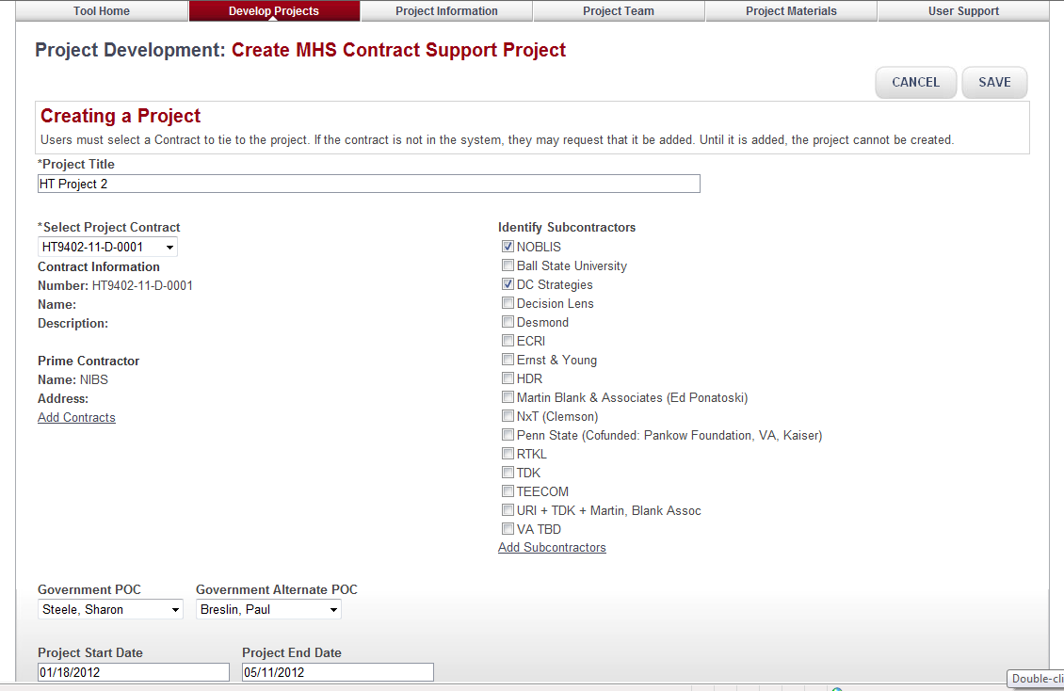
Creating Projects – Contract Support Project
MODULE 4: Creating Projects and Modifying Primary Information
1
Main Elements:
  Add the Project Title
  Select the Project Contract (must be attached to a contract). Includes link to add a new contract if not listed.
  Pick the Subcontractors available for that contract. Includes link to add in a new subcontractor.
  POC and Alternate POC
  Project Start and End Dates
2
3
4
5

Slide 27
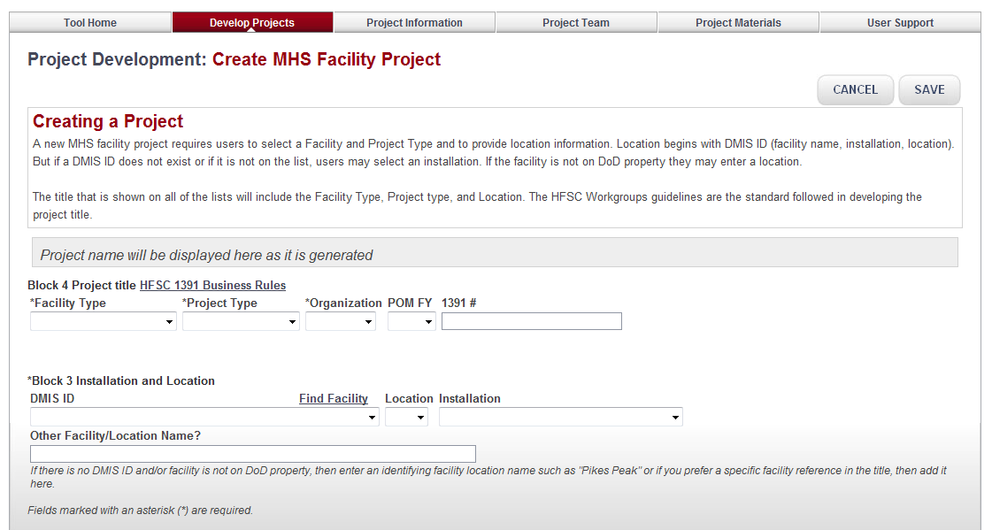
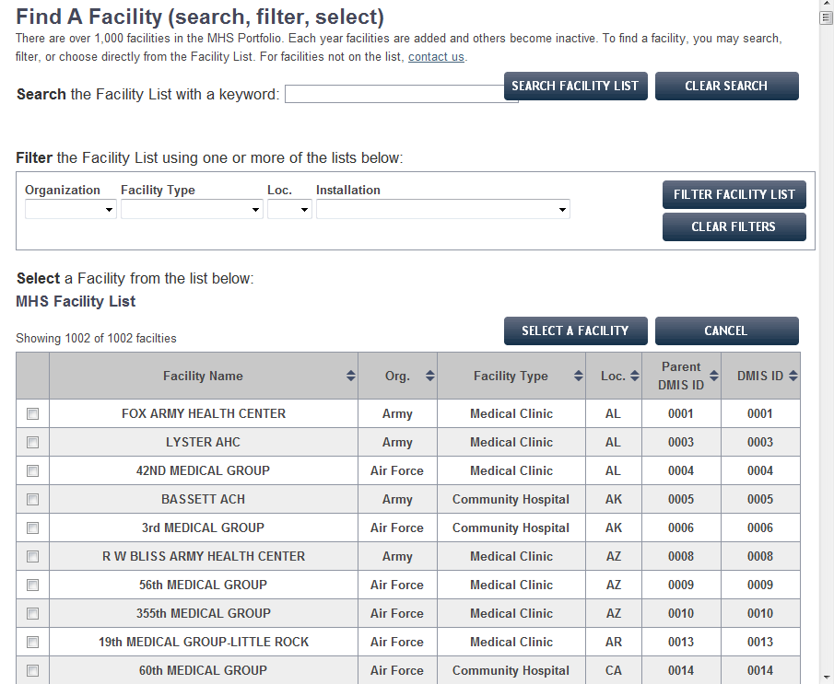
Creating Projects – Finding a DMIS
MODULE 4: Creating Projects and Modifying Primary Information
If the DMIS ID isn’t known, click here to find it by selecting the facility from the popup list.

Slide 28
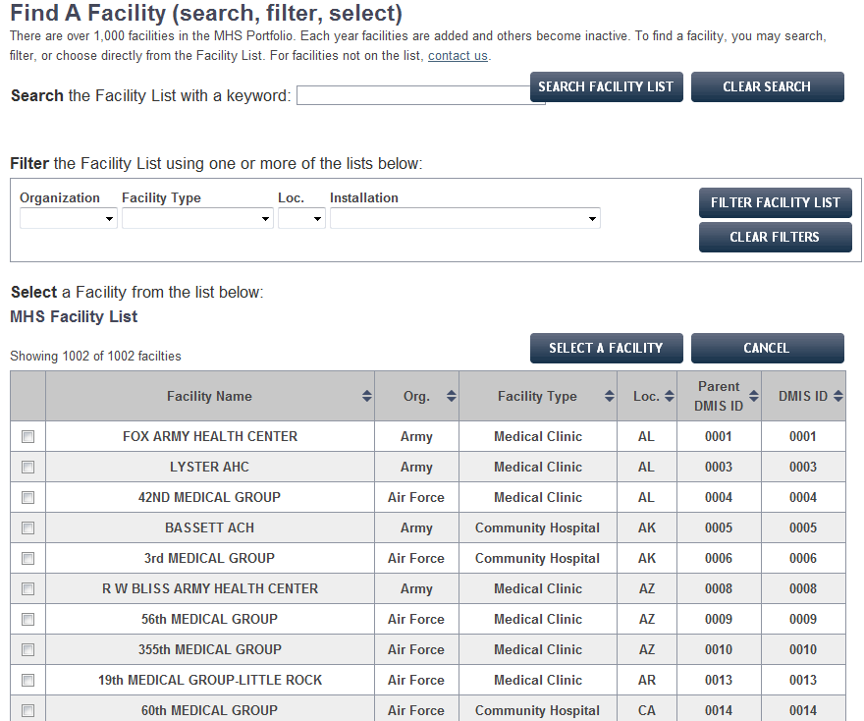
Creating Projects – Finding a DMIS
MODULE 4: Creating Projects and Modifying Primary Information
3 Ways to find a facility:
  Search by Keyword
  Filter the Facility List by filtering on Organization, Facility Type, Location or Installation (may sort on more than one)
  Select a facility from the list (each column is sortable)
1
2
3

Slide 29
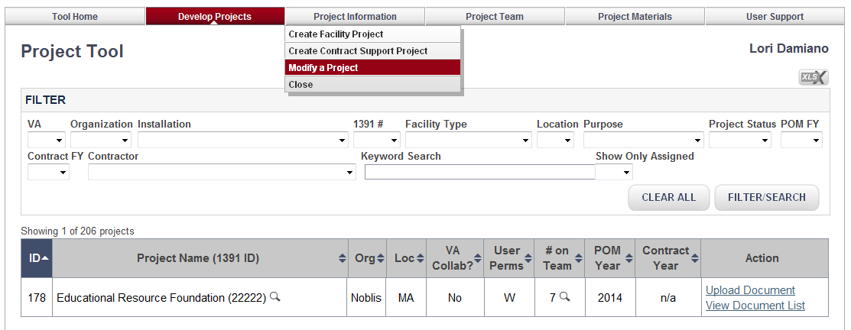
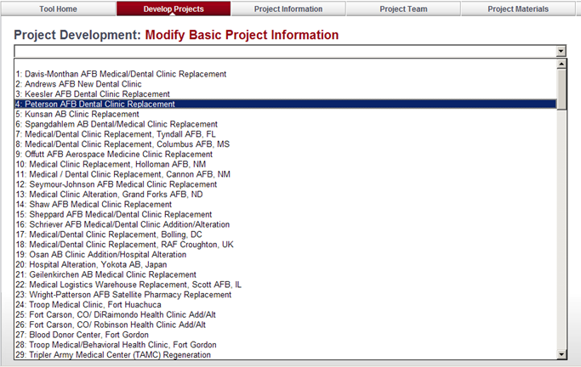
Creating Projects – Modifying the Basic Information
MODULE 4: Creating Projects and Modifying Primary Information
1. Select Modify a Project from the Project Information dropdown
1
2. Modify Project page displays
2
Hint: if you know the Project ID, start typing it into the picklist – the system will take you right to the number

Slide 30
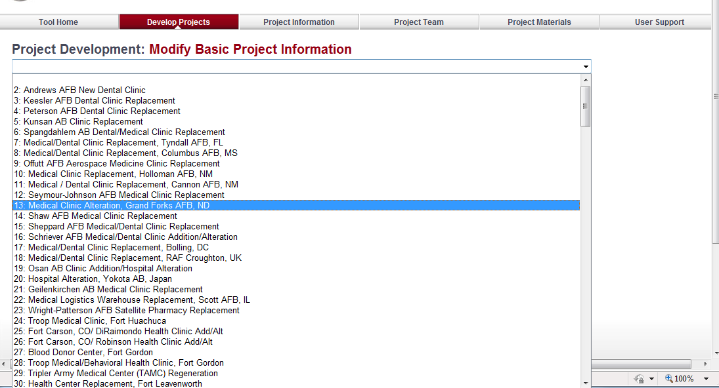
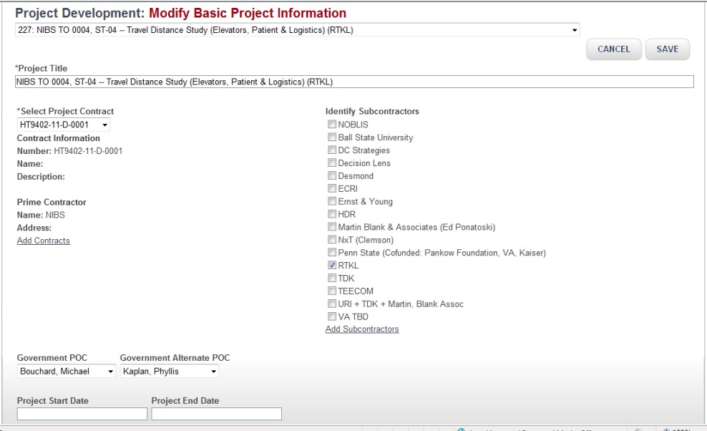
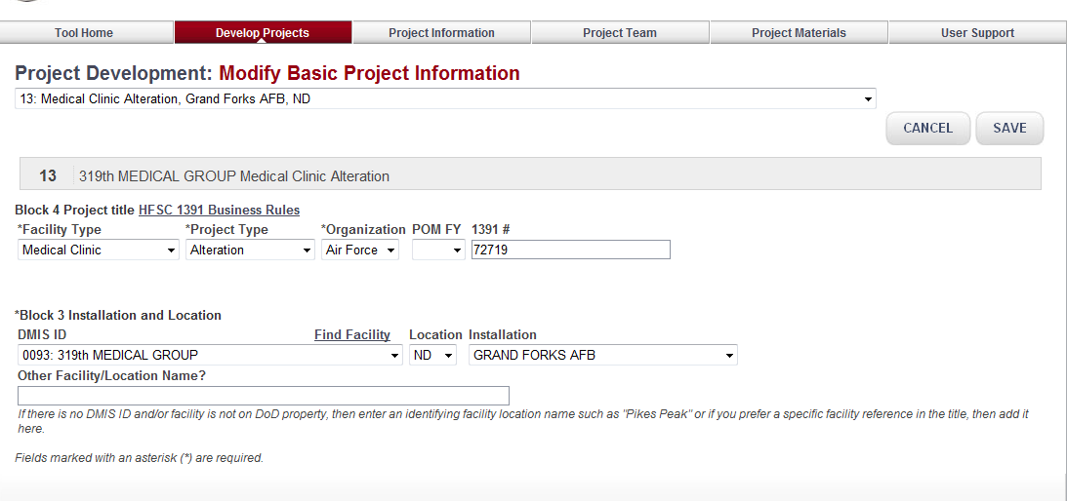
Creating Projects – Modifying the Basic Information
MODULE 4: Creating Projects and Modifying Primary Information
Using the dropdown arrow, select the project to modify.
To quickly reach the project – type in the Project ID
The window that displays depends on the type of project.
MHS Facility Project screen with editable information.
MHS Contract Support Project with editable information

Slide 31
Creating/Modifying Projects – Business Rules
MODULE 4: Creating Projects and Modifying Primary Information
MHS Facility Project :
Project Creator:
The user must be GOV or EXEC
The user who creates the project is assigned role PROJ MGR
Project POCs and ALTERNATES:
By Default, the selected POC and Alternate are “Managers” for the Project
Project Data Rules:
If a project is already in the database with a 1391# then a new project cannot be created with the same 1391#
The user must identify a type of facility, facility name, and type of project – all of which are combined into the Project name.

Slide 32
Creating Projects – Business Rules
MODULE 4: Creating Projects and Modifying Primary Information
Contract Support Project :
Project Creator:
The user must be GOV or EXEC
The user who creates the project is assigned role PROJ MGR
Contract Requirements:
Project can only be saved as a new project if it has an associated contract
Only contracts that are open (POP is not over) can be tied to a project
If contract doesn’t exist in database, then user contacts the Proj Admin and requests addition of the contract
Only Project Admin with role = REPOS can create/modify contract and contractor information
Project POCs and ALTERNATES:
Selection of Project POCS and Alternates made from a PICKLIST of all GOV and EXEC users)
By Default, the selected POC and Alternate are “MGR” for the Project

Slide 33
Modifying the Basic Information – Business Rules
MODULE 4: Creating Projects and Modifying Primary Information
Modify MHS Facility Project Information:
If a project is associated with a current CIDM event, it may not be edited (not on the list)
If a project is CLOSED it is not on the list
The 1391# cannot be changed to one that is already assigned to another project in the database.
Modify Support Contract Project Information:
The user must be GOV or EXEC
Project can only be modified if it is Open:
Selection of Project POCS and Alternates made from a PICKLIST of all GOV and EXEC users)

Slide 34
Module 5: Building a Project Team

Slide 35
Module 5: Building a Project Team
What is covered
Creating a team
Adding users
Removing users
Modifying user roles
Viewing team history
Who is involved
Project Managers
Project administrators

Slide 36
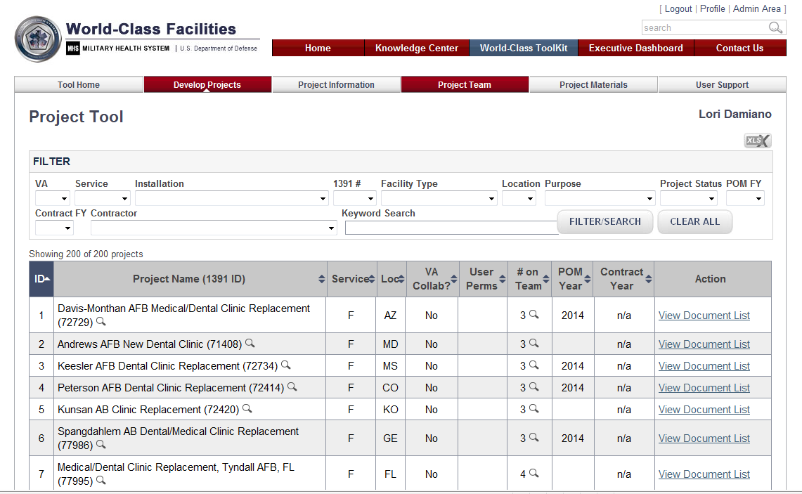
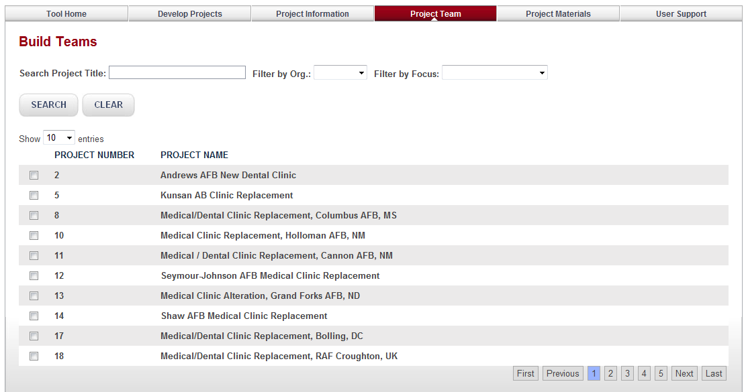
Project Teams – Creating a Team
MODULE 5: Building a Project Team
Project Team Navigation
Build Teams page opens
Click a Project to add Team Members

Slide 37
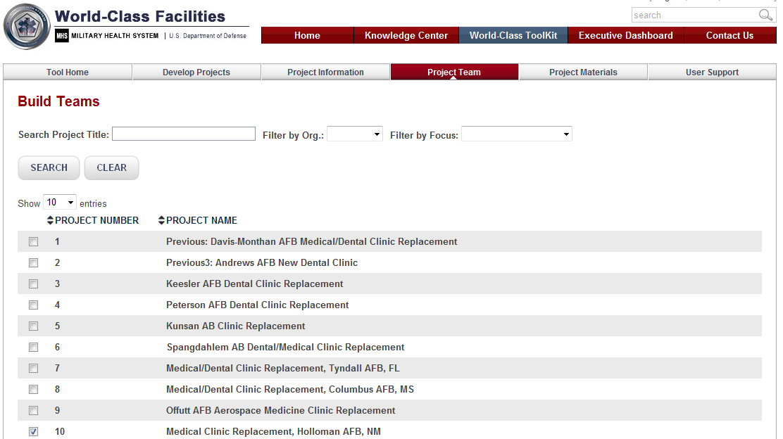
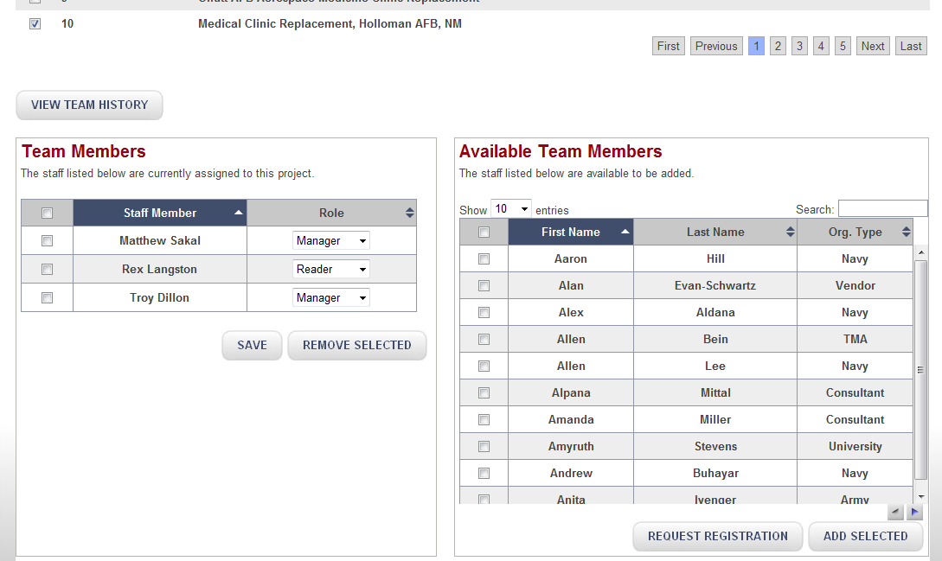
Project Teams – Adding Users
MODULE 5: Building a Project Team
The search capability checks user names, and organization names (which are not shown on the table)
The POPUP provides specific information about each user
2. Team Member options appear on the bottom of the screen.
2
3
1
1. Select a Project

Slide 38
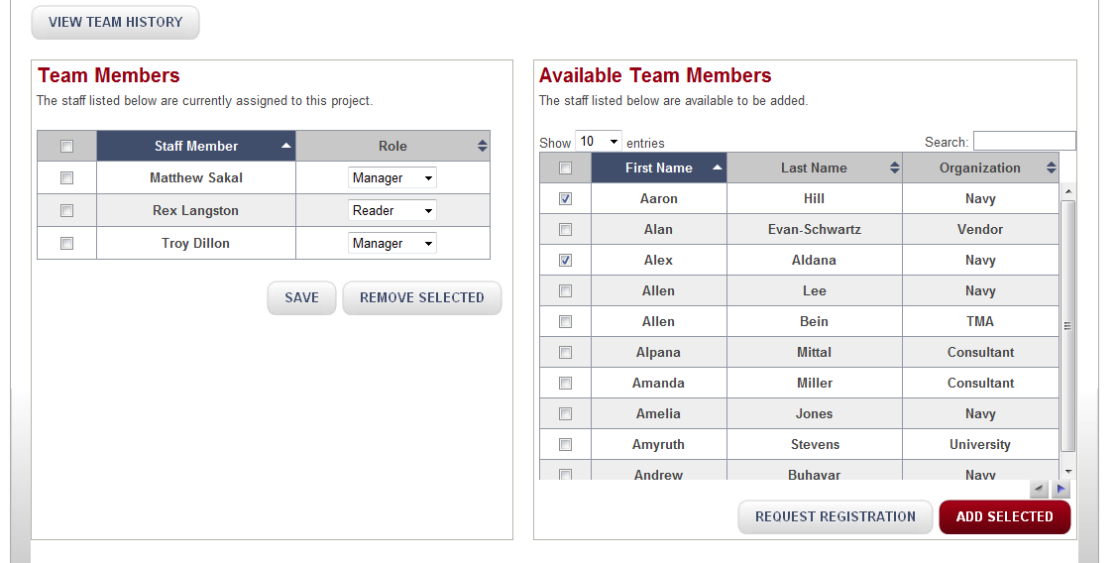
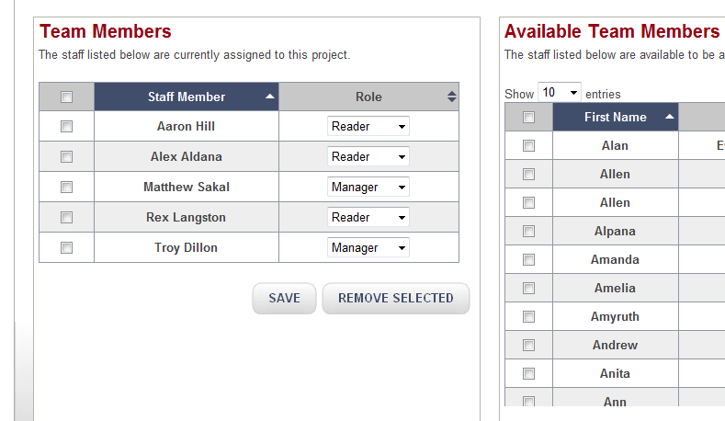
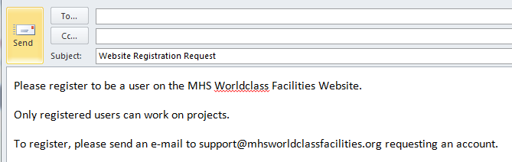
Project Teams – Adding Users
MODULE 5: Building a Project Team
From the list of available team members on the right, select those to be added to the project
Click ADD SELECTED
Team members are added to the project team and appear on the left
To register a user, click REQUEST REGISTRATION
Support will receive the email and send an enrollment request to the requested user

Slide 39
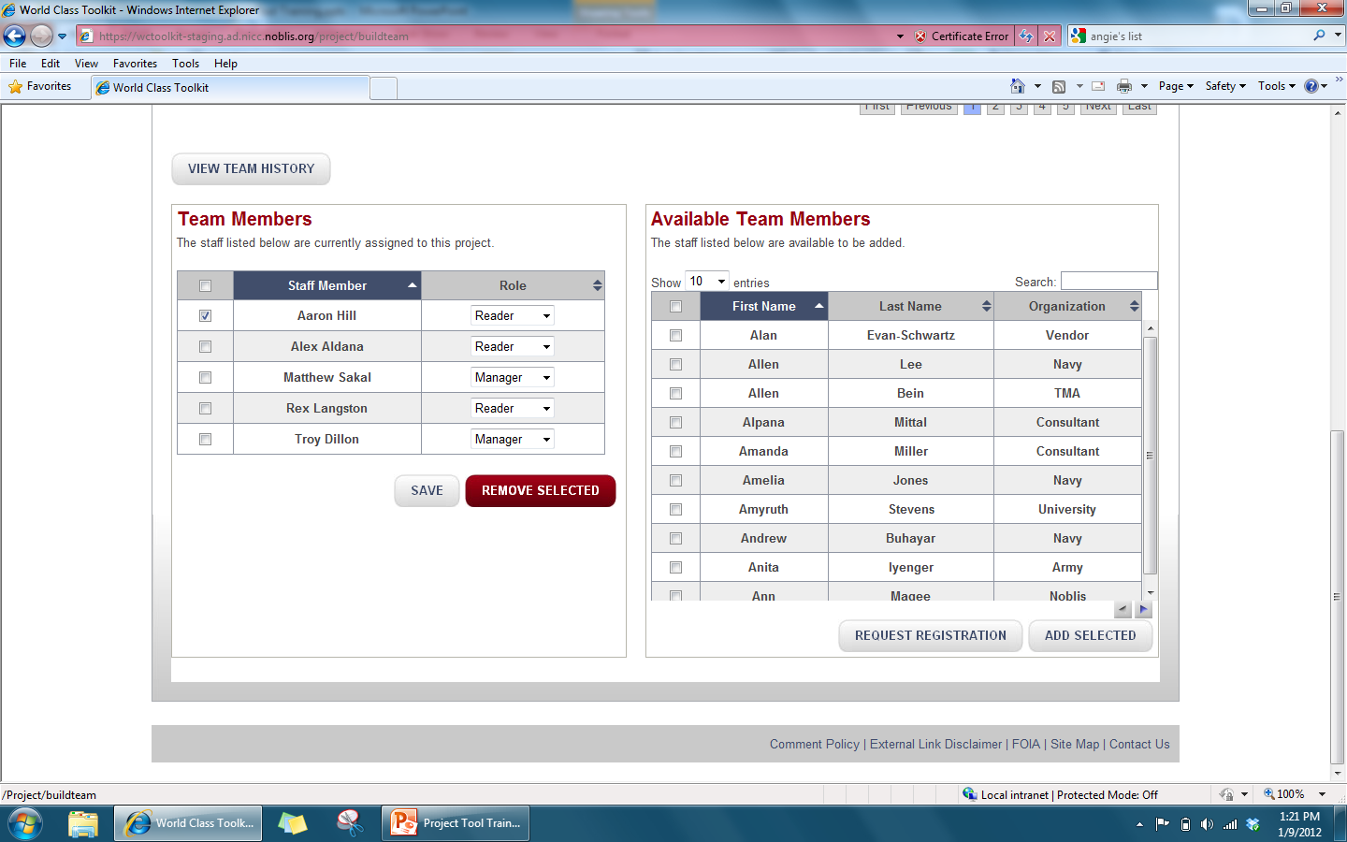
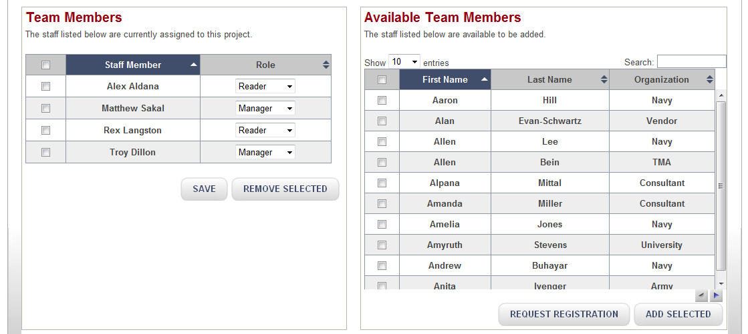
Project Teams – Removing Users
MODULE 5: Building a Project Team
From the list of team members on the left, select those to be deleted from the project
Click REMOVE SELECTED
Team members are removed from the project team and appear on the right

Slide 40
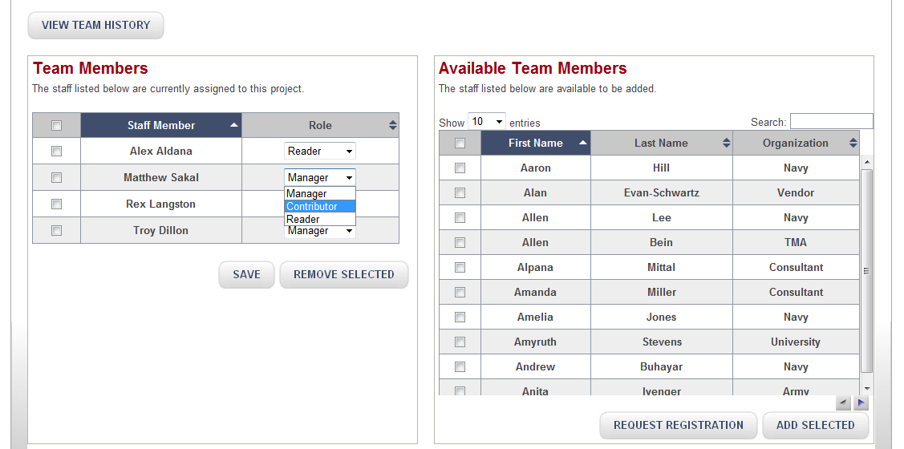
Project Teams – Modifying User Roles
MODULE 5: Building a Project Team
To change a user’s role, use the Role dropdown menu to choose a different role.
Roles can be changed at any time by a Manager.

Slide 41
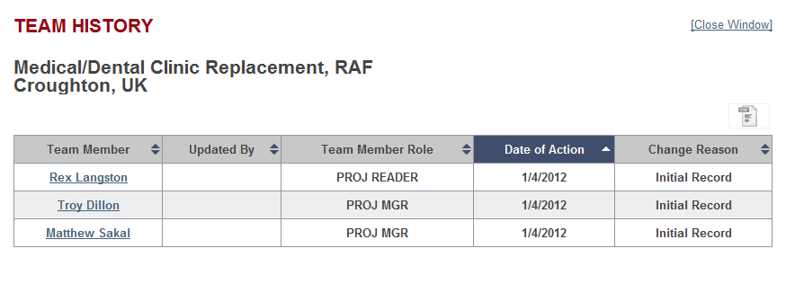
Project Teams – Viewing Team History
MODULE 5: Building a Project Team
All users who have been assigned over the history of the project will be listed on this table.

Slide 42
Module 6: Project Information Pages

Slide 43
Module 6: Understanding the Project Information Pages
What is covered
Header Information
Action Buttons
Information Tabs
Associated Documents
Who is involved
Users with access privileges to a project or admin privileges

Slide 44
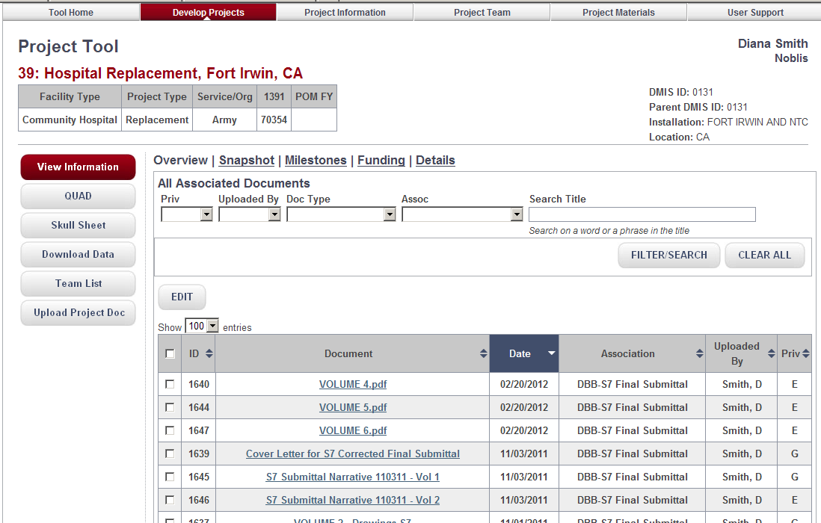
Project Page – Key Features
MODULE 6: Understanding the Project Information Pages
1
Header Area
Info Tabs
2
3
Actions
Assoc. Documents
4
1

Slide 45
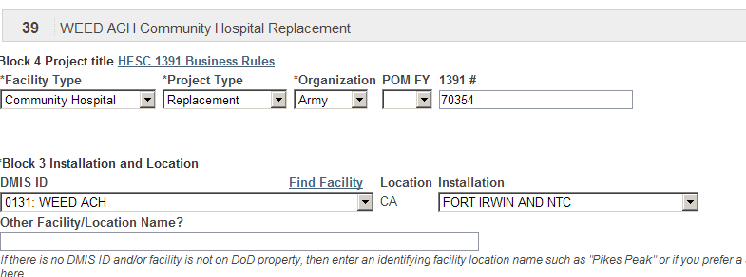
Project Page – Headers
MODULE 6: Understanding the Project Information Pages
Header Area
The differences between the two types of projects is most evident in the header display. The information relates 100% to a Facility Project and 5% to a contract support project.
The header information is filled in when a project is set up. It can be modified (Project Information | Modify Project)

Slide 46
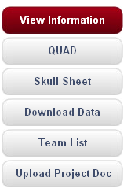
Project Page – Action Buttons
MODULE 6: Understanding the Project Information Pages
While the user is working from the Project Information Page, the Action Buttons are always available.
Default – select a project and the overview button is active
Select , and a QUAD development
page is opened
Select and a Report is generated. The information was Created while working on project information
CSV downloads of key data related to the project : Project Information, Funding, Milestones, workload
List of all current team members is provided for
the selected project
!
Connects user to the repository; Its important to understand project associations and the connection to which current TAB the user is working in (Module 8)
The actions are also skewed to facility projects. Only facility projects have Skull Sheets and QUAD charts. Most of the downloaded information is Facility oriented. The button for UPLOAD and Team List are not centric to facility projects

Slide 47
Project Page – Project Information Tabs
MODULE 6: Understanding the Project Information Pages
The purpose of Project Information is to collect and review project information. Each Tab is a different subject area -- with opportunities for collection and review.
There are five tabs for Facility Projects
There are three tabs for Contract Support projects.
Overview | Lists all documents associated with the project
Snapshot | Provides key, salient information about each facility project
Milestones | allows users to identify project milestones and to associated document deliverables with those; allows users to identify milestone contracts and maintain a history of notes
Funding | Government users maintain funding estimates for facility projects; 2851 data is uploaded for easy access by facility planners
Details | Descriptive information related to the project is maintained under this tab

Slide 48
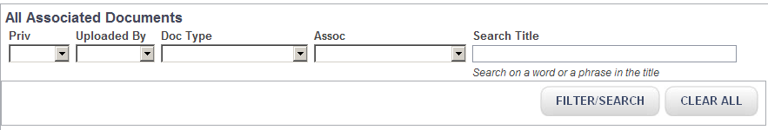
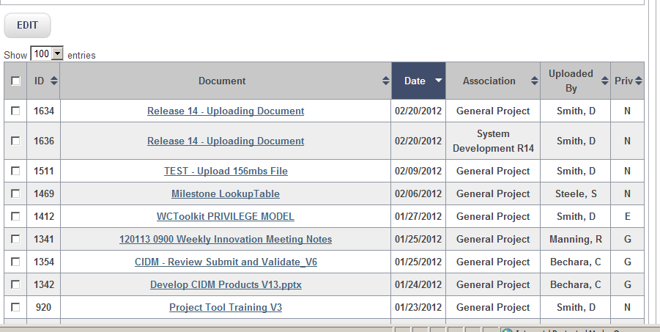
Project Page – Associated Documents
MODULE 6: Understanding the Project Information Pages
A lengthy list of documents may be reduced to a specific set by using the filters. Document Type and Project Association are critical filters (more information in Module 8). The title is searchable
The Overview Tab shows all documents; the other tabs shows documents related to the tab
Users may select one or more documents to edit by selecting the check boxes and then the Edit Button
Each column is sortable
All team members see all documents on the list. Only documents matching a team member’s privilege can be opened or edited
1

Slide 49
Module 7: Adding Project Information

Slide 50
Module 7: Adding Project Information
What is covered
Snapshot information
Funding Information
Details Information
Who is involved
Users with access privileges to a project or admin privileges

Slide 51
Adding Project Information – Business Rules
MODULE 7: Adding Project Information
Each “Tab” on the Project Information page is associated with a specific topic; the tabs create “virtual folders” for collecting and organizing documents and information
The table of associated documents is found under all tabs – but the documents displayed based on the tab.
The document list is visible to all users accessing the project; the documents are accessible based on the user’s privilege level and that of the document.
From each “page” users may upload documents
Documents are associated with the page and/or with a specific element on the page (Milestone) - PROJECT ASSOCIATIONS. The Project Association is a key method for grouping documents into Virtual Folders
Users with Edit privileges may select the EDIT button on each page
  When the button is selected, no other user will be allowed to edit the page. This action prevents users working on same project from over-riding each others’ work.
  Readers may never select the EDIT Button
  If the EDIT is locked, the page is still readable

Slide 52
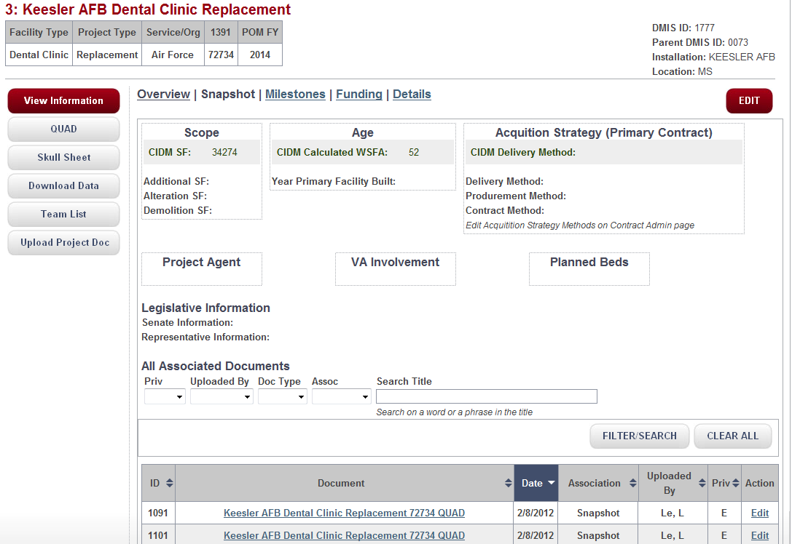
Project Snapshot Page
MODULE 7: Adding Project Information
2
1
Main Elements:
  Snapshot Information includes Scope, Age, Project Agent, VA Involvement, Planned Beds and Legislative Information
  To edit Snapshot info, click on Edit. If another user is currently editing the page, the EDIT button will not be available
  Associated Documents: Search/Filter Fields
  List of documents uploaded for project from the SNAPSHOT Page or from CIDM
3
4

Slide 53
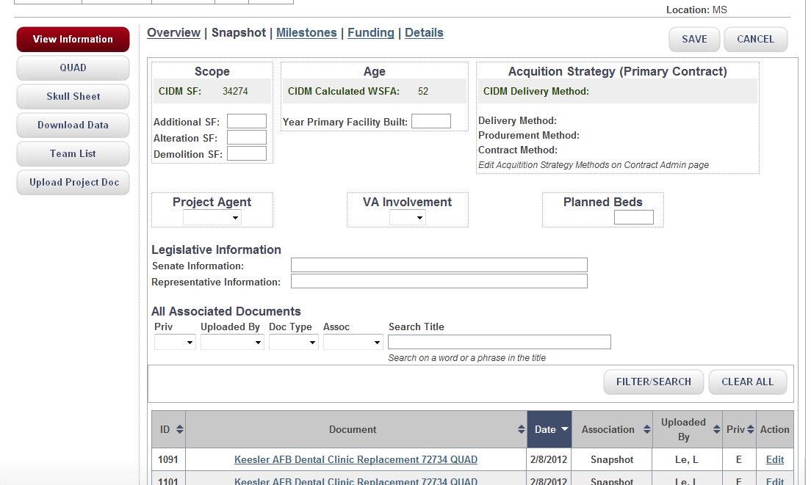

Editing Project Snapshot Information
MODULE 7: Adding Project Information
8
1
2
3
4
5
6
7
Add/edit the SF information on the Skull and QUADs by changing Additional, Alteration, or Demolition SF here. The amount is summed for reporting out as total SF.
Add/edit “Year Primary Facility Built”; age of the primary building is calculated against the current year
Acquisition Strategy Methods are based on the selection of a primary contract (Milestone Tab)
Choose a Project Agent from the dropdown list
Choose from the dropdown list (Yes/No) whether there is VA Involvement
Add/Edit the Planned # of Beds
Add/edit Legislative Information
Make sure to save your changes before exiting

Slide 54
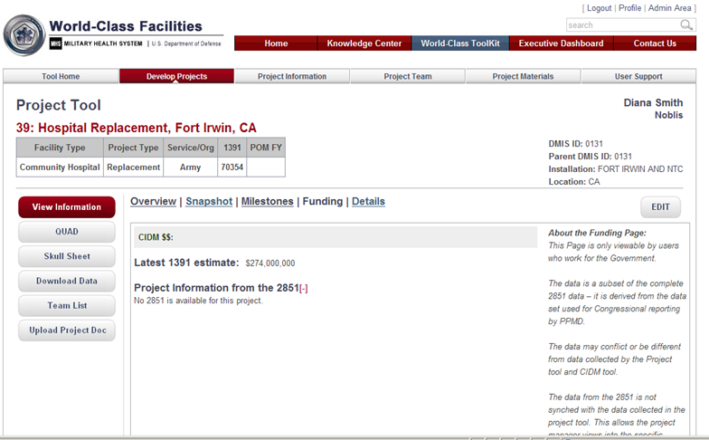
Project Funding
MODULE 7: Adding Project Information
This page is restricted – only Government Users working on a project have access
Once a month (or so) the Data Administrator will upload current 2851 data

Slide 55
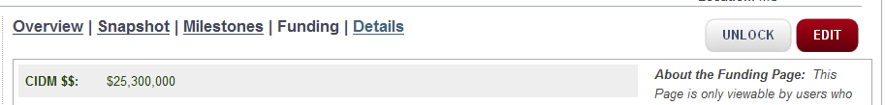
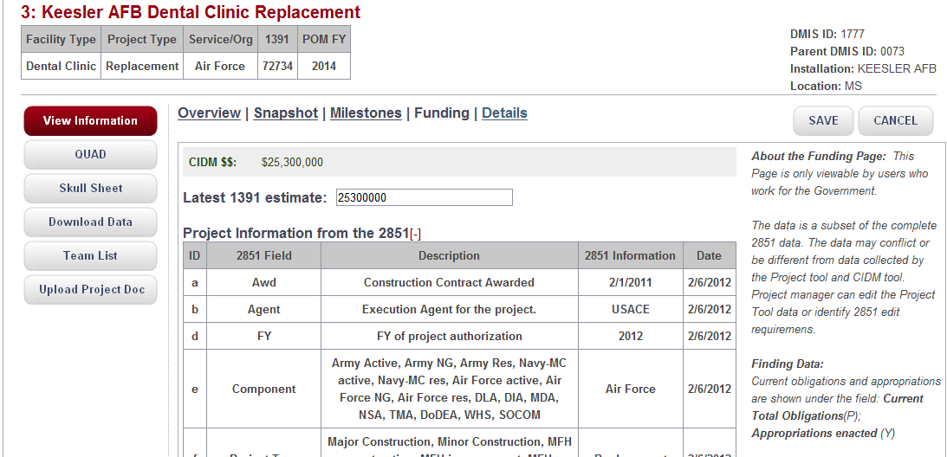
Project Funding – Updating the 1391 Estimate
MODULE 7: Adding Project Information
1
1
4
2
POM FY___
3
To change the 1391 Amount, click on EDIT in the main “Funding” page.
Type in the Latest 1391 Estimate
Add/Update POM Year
Make sure to save your changes before exiting

Slide 56

Downloading Funding Data
MODULE 7: Adding Project Information
The user is able to download funding data:
  the 2851 data in a CSV file
  The set of records related to the 1391 estimate amount (CIDM event estimates, and changes from the funding page)

Slide 57

Project Details
MODULE 7: Adding Project Information
Descriptive data from CIDM transitions to the project
The descriptive data is collected and edited from this page
The Skull sheet, as indicated, reports out data collected here
Documents uploaded from this page have the project association “Details”
Suggested uploads include requests for information/justification

Slide 58
Module 8: Milestones

Slide 59


Milestones
MODULE 8: Milestones
Users can associate milestones with their projects
Milestones may be added to or edited by project administrators
The current set of milestones includes those for Facility projects and Contract Support Projects
The milestone association is key for executive understanding of project status, plans, and achievements!!

Slide 60

Milestone Page
MODULE 8: Milestones
The Milestone tab has two sections:
  a. List of Milestones
  b. List of Associated Documents
Users may select milestones for each project and provide descriptors
Users may upload documents associated with each milestone
Result is a “virtual sub-folder” for each set of documents where documents are tied to the milestone
The User determines the organization scheme for their project document
2
1a
.
3
1b
4,5
.

Slide 61

Editing Project Milestone Information
MODULE 8: Milestones
John Jones
5
2
3
4
1
Click on “Add a Row” to add a new Milestone.
You can edit/add the milestone description in this column – the Project Association is the milestone and the description
You can update the Status by entering the latest “percent complete” amount
Planned and Actual dates can be added/edited in these columns

Slide 62


Project Milestones – Associating the Project to a Contract
MODULE 8: Milestones
Facility Project Contracts: each milestone may be associated with the contract that is responsible for the milestone
If a contractor is selected as the Primary Contractor, then the Acquisition Methods of this contract are displayed on the Snap Shot Page and in the Skull Report
5
1
1. Popup screen shows the current contract (or is empty)
2. Select edit to add/edit the selected contractor
3. !! User may indicate here if this is the primary contractor for the project
2
3
Note: If the Acquisition Methods fields are not filled in, contact Support and request the information be added to the contract

Slide 63

Uploading a Document Specific to a Milestones
MODULE 8: Milestones
To upload …select Milestone, click on
“Upload” link
Milestone documents are organized by the milestone event and the description of that event – the Project Association
The user may only upload with the milestone upload link (1); The Upload Button on the left side of the page is inactive when the user is working in the Milestone Tab
During the upload, the user defines the Document Type (Module 9); the combination of the Project Association and Document Type create powerful filter combinations -- virtual Sub-folders

Slide 64

Example of the “Sub Folder” Affect
MODULE 8: Milestones
All requirements documents for Release 14 can be identified
All requirements documents for all Releases can also be identified
Or, All Release 14 documents.
.
.
.

Slide 65



Download CSV View of Milestones
MODULE 8: Milestones
From the Milestone Tab
Or From the Download Information Button, detailed information including the associated contracts to each milestone

Slide 66

Project Milestones – Viewing and Adding Notes
MODULE 8: Milestones
2
1
1. Select the NOTE link, to add or view information written by team members concerning the project’s milestone
The Note pop-up screen appears. All notes added are viewable; Notes may be added
Save your changes when done.

Slide 67
Module 9: Managing Project Documents

Slide 68
MODULE 9: Managing Project Resources
Module 9: Managing Project Documents
What is covered
Quick-path for uploading
Uploading from a project information tab
Parsing, Indexing, Editing
Sharing documents with links
Replacing a document with an updated version
Who is involved
Users with privileges to manage, contribute or administer projects
Document access is based on assigned privileges of documents and users (Gov, Non-Gov, etc.)

Slide 69



Quick-Path to Uploading Documents
MODULE 9: Managing Project Resources
Select Develop Project – Open Project Viewer
2. Select Project ID – Open Project Info Page
3. The Project Information Page has “folders” – Overview is the Default Folder
From Project Information Page, use the Upload Button to add documents
A document may be uploaded from each folder – documents are tied to the folders
If the document is a deliverable it should be uploaded from the Milestones page
Note: Facility Projects have 5 folders; Contract Support Projects have 3 folder

Slide 70

Upload Documents From Project Information Page
MODULE 9: Managing Project Resources
  The Project Managers (M) and Contributors (W) are able to upload documents specific to a selected project.
  Select “Upload Document” Button or upload link on the Milestones Page
  An upload dialog will open.
  The user may upload 1 or more documents and/or links
  The process takes time – documents 0-50mbs are indexed by the system so that it can be readily located through searches and filters
  Larger documents are not indexed (but user added data will be part of their searchable content)
  Files greater than 250 MB also may not be uploaded (try zipping like materials together)
Note: Some file types are not allowed; users will be informed if they try to upload a file of the wrong type

Slide 71


Uploading a document(s) – Waiting for Indexing
MODULE 9: Managing Project Resources
  Uploading takes time – the more you upload, the larger the files, the more time is required
  System stores the document and then “reads” everything in the document and adds the content into the search index
  The user will know while this is going on
1,2,3
4
  4. and when it is done

Slide 72
Uploading a document(s) – Waiting for Indexing
MODULE 9: Managing Project Resources
  Upon successful UPLOAD, each document has its own unique ID
  The user now has three options:
    Return back to the starting place – where they first selected UPLOAD
    Edit each document one at a time (more details can be added)
    Or mass edit all as a group (fewer details but swifter updating process
  What is important to remember?
    You are adding the key elements required for swiftly finding a document or a group of documents

Slide 73

Adding Links
MODULE 9: Managing Project Resources
  Links are added just like documents – only the user types/pastes in the link instead of uploading a file
  Until the user leaves this page, they may continue adding links to the list
  When finished, the user has an opportunity to edit information about each link
1
2
3

Slide 74

Document Data
MODULE 9: Managing Project Resources
The system adds: File Type, File Size, File Name, who uploaded, when Uploaded
The system provides default values: Document Date, Security Role, Project Association
The user may modify and add the following values:
Editable Data
Project Association Source
Title/Name
Security Role
Document Date
Abstract
Document Version Comment
Keywords
Associated Project
Project Association
Document Type
CIDM Event
Based on the Tab, the system sets the project association

Slide 75

Editing Resource Information
MODULE 9: Managing Project Resources
  Users can elect to edit resource data (documents & links) from two directions:
      the project information page
      The project repository
  Documents can only be deleted from the Project Repository Page
To edit a document, the user selects the resources from whatever list they are viewing and then the EDIT button
If more than one document was selected, a MASS EDIT form is provided
If one document was selected, the user is provided with the edit form
Project Repository
EDIT, DELETE

Slide 76


Sharing Documents
MODULE 9: Managing Project Resources
Users may send a document link to another user – they can do this by identifying the URL (file location).
If the user has the right privileges to open the document, they will be able to by clicking on the sent link:
If a document has privileges set so only registered users can access the document, the user must first be logged in before they can access the document.
If they do not have the right privilege, the system will not let them access the document
To get URL, right click on name, and then copy the address

Slide 77


Replace a Document
MODULE 9: Managing Project Resources
To replace a document, find the document in any resource list and select it (alone). The Single-Edit Page will be provided
The user selects the REPLACE Link and identifies the new document.
While the document is being replaced (and the new version indexed) the user will have a Wait Message
The previous version is maintained in the repository but it is taken out of the main list. The New Document is assigned the original’s Resource ID
Any links sent with that original ResourceID will still be viable – but they will lead to the new document and not the original
1
2
3

Slide 78

Viewing the History
MODULE 9: Managing Project Resources
The user selects the link “View Document History”
A record of each previous document is kept in the repository data store
If the user added Version Comments when editing the document, then that note will be included in the history view
2
1
3

Slide 79
Module 10: Skull Sheets and QUADs

Slide 80
Module 10: Skull Sheets and QUADs
What is covered
Creating/Editing a QUAD chart
Viewing a Skull Sheet
Who is involved
All users assigned access to the project as Managers and Contributors
The Project administrators

Slide 81

Select Project
MODULE 10: Skull Sheets and QUADs
  Filters and Search for project
  Select the facility project to develop or edit QUAD chart and/or Skull Sheet.
John Jones
1
2

Slide 82



Add/Edit QUAD charts
MODULE 10: Skull Sheets and QUADs
  Click on QUAD button
  Click on EDIT QUAD
  Add/Modify Planned Amount (PA) and Fiscal year (FY)
1
2
3

Slide 83



Quad Chart: Add/Edit QUAD sections
MODULE 10: Skull Sheets and QUADs
1
  Select “Edit Instructions” to view instructions to Add/ Modify QUAD sections 1,2 and 3
  Modify QUAD section titles as necessary
  Save
2
3

Slide 84





QUAD chart: Add QUAD Images
MODULE 10: Skull Sheets and QUADs
  To upload QUAD Image, select “Upload Image” button or click “Upload an image here”
  Add/Modify Image Caption
  Click UPLOAD to upload single image or multiple images
  When Upload complete, select Return or Mass Edit or Edit New resources to edit Image information
  View QUAD in pdf or pptx format
1
1
2
5
3
4

Slide 85



Skulls sheet – Add/Modify Snapshot and Milestones
MODULE 10: Skull Sheets and QUADs
  Select project “Snapshot” and “edit” buttons to add/modify project information
  Save project Snapshot
  Select project “Milestones” and “edit” buttons to add/modify project milestones
  Add rows as necessary for additional milestone/event
  Save project Milestones information
1
2
3
5
4

Slide 86


Skulls Sheet – Add/Modify Funding and Details
MODULE 10: Skull Sheets and QUADs
  Select “Funding” and “edit” buttons to add/modify project funding information. Then Save
  Select “Details” and “edit” buttons to add/modify project details. Then Save
  Select (+) to expand and (-) to collapse information views
1
3
2
3

Slide 87


Skulls Sheet – View/Print/Save
MODULE 10: Skull Sheets and QUADs
  Click on “Skull Sheet” button to view, print, or save Skull sheet to Project Repository
The data for the Skull sheet comes from the M2 database, user input, and CIDM history.

Slide 88
Module 11: Closing a Project

Slide 89


Close Project
MODUL 11: Closing a Project
From the Project Tool page, select Close from the Project Information navigation dropdown
Select Project
Select Reason for Status Change
Add any relevant notes
Select SAVE to Close the Project
Select CANCEL to keep the project open

