Slide 1


Welcome!
BIM in the DoD-MHS
(an overview)
EcoBuild 2011
S401: BIM in the DoD's Military Health System Facility Life Cycle Management
December 6, 2011

Slide 2
Agenda/Topics To Be Covered
Introduction
BIM Basics
  Definition
  Overview
  BIM in the Federal Government…
MHS BIM Objectives
  FLCM Applications | Enabler
UFC 4-510-01 (Chapter 20 – BIM)
Questions

Slide 3
Introductions
Who’s in the audience?

Slide 4
Who’s here?
Planners?
Designers (Architects & Engineers)?
Builders?
Software Developers?
Owners?
Lawyers?
Contracting | Agents?
Others?

Slide 5
Introduction – Russ Manning
DoD Military Health System (MHS)
  Portfolio Planning and Management Division (PPMD), Capital Planning Branch (CPB)
Job Relating to BIM:
  Developing “Corporate” BIM Policy
  Coordinating BIM across the Facility Life Cycle Management (FLCM)
  Coordinating with DVA, Kaiser Permanente and Sutter Health in the Healthcare BIM Consortium (HBC) with BIM Software Developers – what do we really need for FLCM

Slide 6
Introduction – DoD MHS
DoD Military Health System (MHS)
Approximately 77million GSF of facilities:
  Hospital Facilities – 59
  Medical Clinic Facilities – 364
  Dental Clinic Facilities – 282
  Veterinary Facilities – 288
  Multiple Medical Research Laboratories
Approximately $9B currently in design or construction
Approximately $1B annual capital investment

Slide 7
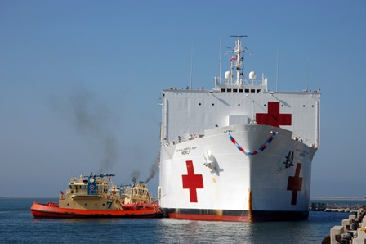
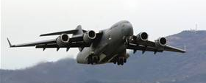
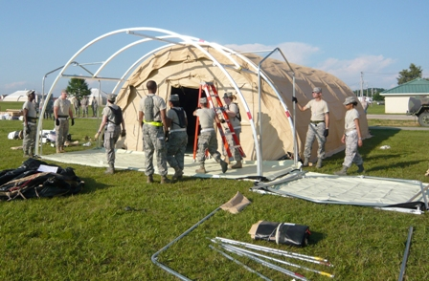

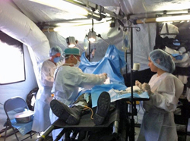
Introduction – Many Delivery Platforms

Slide 8

Introduction – Many Locations
Pick a location…DoD’s MHS has likely provided care there
Direct Patient Care of Service Members & Families
Veterans
Humanitarian Aid
Disaster Relief
Infectious Disease Response
War Zone Casualty Care
Etc.

Slide 9
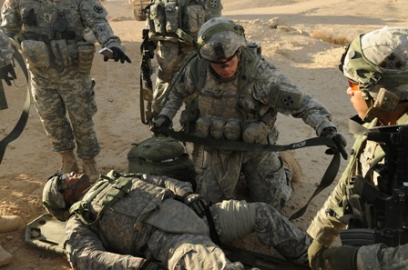
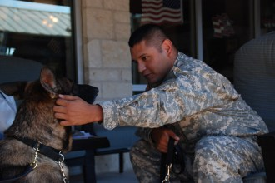
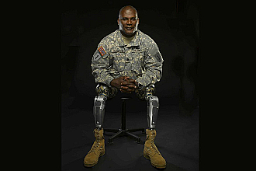



Introduction – Big Picture Reality
It is not about this…
…this supports what it is about.
It is about the delivery of healthcare…

Slide 10
Introduction – DoD MHS
BIM’s value as an enabling tool to support our FLCM and better exchange data/information.
Historically:
  Project by Project Basis (fragmented approach)
  Have had BIM in contracts since 2005
  Incremental and Objective Driven Approach.
  All construction projects over $5M are utilizing BIM in varying degrees.
Currently:
  Healthcare System Approach
  Corporate BIM Policy in UFC 4-510-01 – minimum BIM requirements, directly related to our “corporate” BIM Objectives.
  Required on all FY13 Projects and Beyond – all designs started this fall

Slide 11
BIM Definitions

Slide 12
BIM Basics – Definition (GSA)
Building Information Modeling is the development and use of a multi-faceted computer software data model to not only document a building design, but to simulate the construction and operation of a new capital facility or a recapitalized (modernized) facility. The resulting Building Information Model is a data-rich, object-based, intelligent and parametric digital representation of the facility, from which views appropriate to various users’ needs can be extracted and analyzed to generate feedback and improvement of the facility design.
http://www.gsa.gov/portal/content/105075

Slide 13
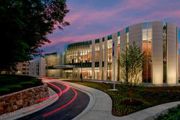


BIM Basics - Definitions
The data & information is even more important!
The image is important….

Slide 14
BIM Basics - Definition
data-rich
object-based
intelligent and parametric digital representation of the facility
Supports:
  views appropriate to various users’ needs can be extracted and analyzed
  generate feedback
  improvement of the facility design & construction

Slide 15
BIM Basics - Overview
Ability to impact project costs and functions
Cost ($)
Idealized design process
Information Provided Earlier and Quicker in the Design Process.
Traditional design process
PD Pre-Design
SD Schematic Design
DD Design Development
CD Construction Docs.
Proc. Procurement
Const. Construction of building
Operations Operations of building
PD
SD
DD
CD
Proc.
Const.
Operations

Slide 16
BIM Basics - Overview
Ability to impact project costs and functions
Cost ($)
Idealized design process
Traditional design process
Reduced effort:
Repetitive Tasks Automated
Bad / Lack of information reduced
Trade coordination / updates sooner (increased collaboration)
Ability to provide better information to users, to support effective user/client input.
PD
SD
DD
CD
Proc.
Const.
Operations

Slide 17
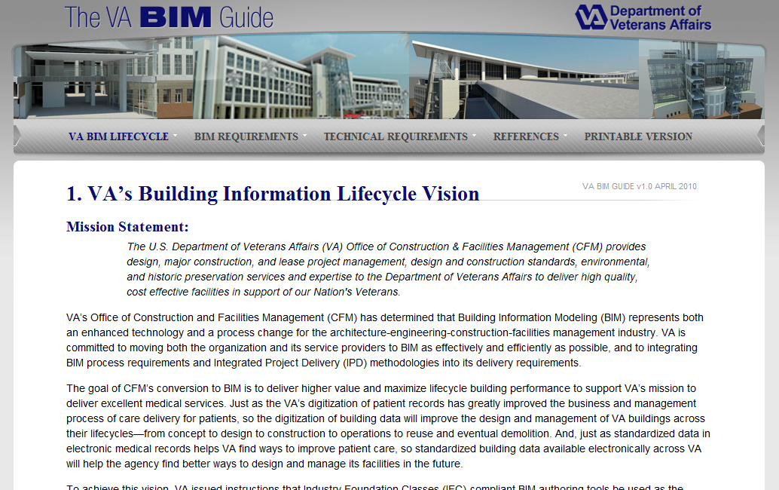
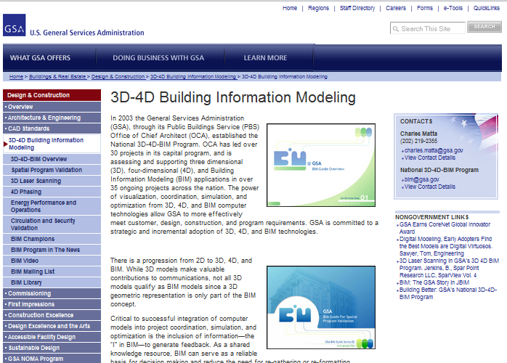
BIM – Other Federal Agency Use
GSA
VA
DoD – USACE Centers of Standardization
FAA
NIH
DoE
DOI
http://www.cfm.va.gov/til/bim/BIMGuide/

Slide 18
BIM – Broader AEC Healthcare
System Owners:
  Kaiser Permanente
  Sutter Health
  Etc.
System Owner Supporters | Team Members:
  Healthcare Designers
    Ellerbe Becket, HDR, HKS, HOK, LAD, RLF, TJD/JI, etc.
  Healthcare Builders
    Balfour Beatty, Clark, Mortenson, Turner, etc.

Slide 19
Facility life cycle management (FLCM)
The perspective of looking at the facility capital investment holistically – from inception to grave. The capital investment is not just the planning, design and construction effort. While important, they are dwarfed by the rest of the FLCM.

Slide 20
BIM Basics – FLCM Information
Plan
Design
Build
Transition
Operate
Goal: Continuous Data Flow – reducing waste of redundant effort
Mission
20

Slide 21
BIM FLCM
(effort by cost)

Slide 22
BIM FLCM
BIM solutions that ignore the FLCM miss the value.
BIM Platforms that don’t support FLCM (at least ability to exchange information) are nothing more than new legacy systems.
  We have too many of those already…

Slide 23
DoD-mhs bim objectives
Q: Why is the MHS implementing minimum BIM standards? A: The owner is the one entity responsible for the continuum of the capital asset and its maintenance as it supports the delivery of healthcare.

Slide 24
MHS BIM Objectives
Currently 10 Objectives – Grouped in Bands:
  Level of Detail (LOD) Clarity
  Validation / Simulation
  Integration to DMLSS-FM and DMLSS-ET&M
  Energy Optimization
  Planning Feedback Loop
  Transition Support
  FLCM Interoperability

Slide 25
MHS BIM Objectives - LOD
Providing clear expectations for team on level of detail for each submittal associated with the BIM
  Standardized expectations of information to reduce confusion. (AIA, BuildingSmart, VA, etc.)
  Stretch goal: Synchronize with VA and others in the healthcare industry | with broader AEC industry
1

Slide 26
MHS BIM Objectives - Validation
Choke Points:
Importing Data to use in Model.
Exporting Data from Model to use.
CMMS/CAFM
Facility
Logistics
Inventory
CMMS
Medical
Equipment
Furniture
Planning Database
Design
BAS
Planning to Operations
Benchmarking
Way finding
Construction
Patient Monitoring
The data flow is an Iterative Process, not an event

Slide 27
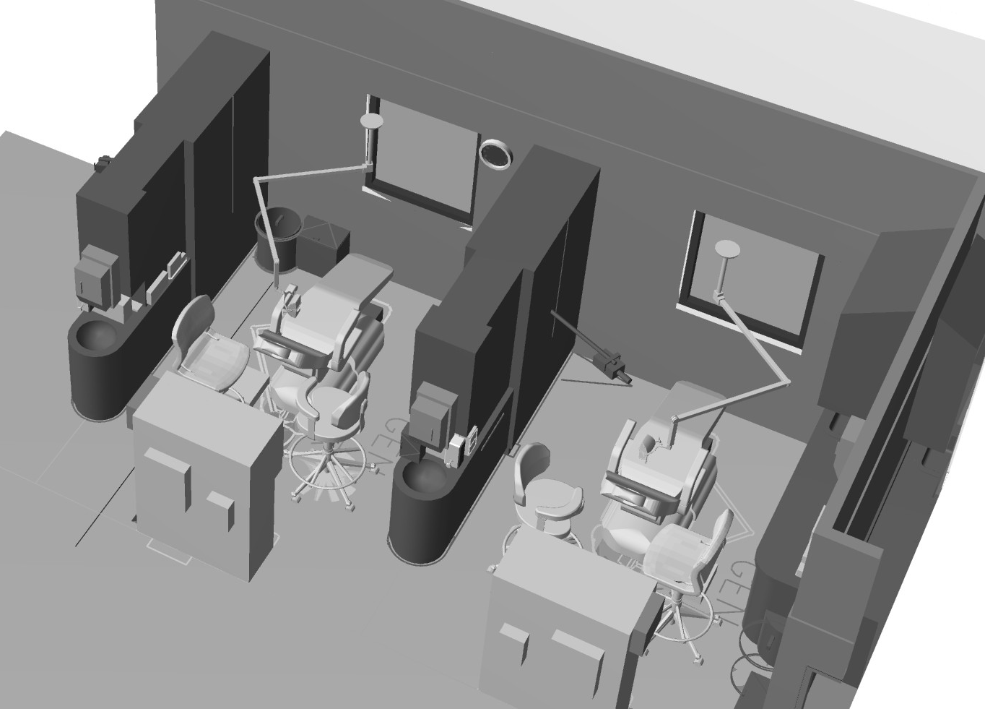
Validation
When we get clarity on plan today
When we got clarity before.

Slide 28
MHS BIM Objectives - Validation
Automate the validation process – Program for Design (PFD) and Project Room Contents (PRC)
  Real Time (or much closer)
  Increase Accuracy & Confidence
  Reduce redundant effort
Requires bringing SEPS data to the BIM
  Internal or External Linkage
2
3

Slide 29
MHS BIM Objectives - Validation
Space Planning Criteria
Medical Equipment & Furniture Data
Space Technical Criteria
Space Program & Technical Criteria
Design
Planning Database
Construction
Room GUID
Medical Equipment & Furniture
(1) Space = (Many) Equipment
Corporate
Project Specific

Slide 30
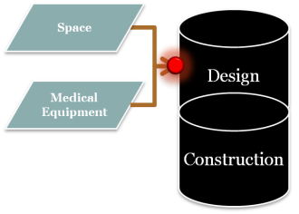
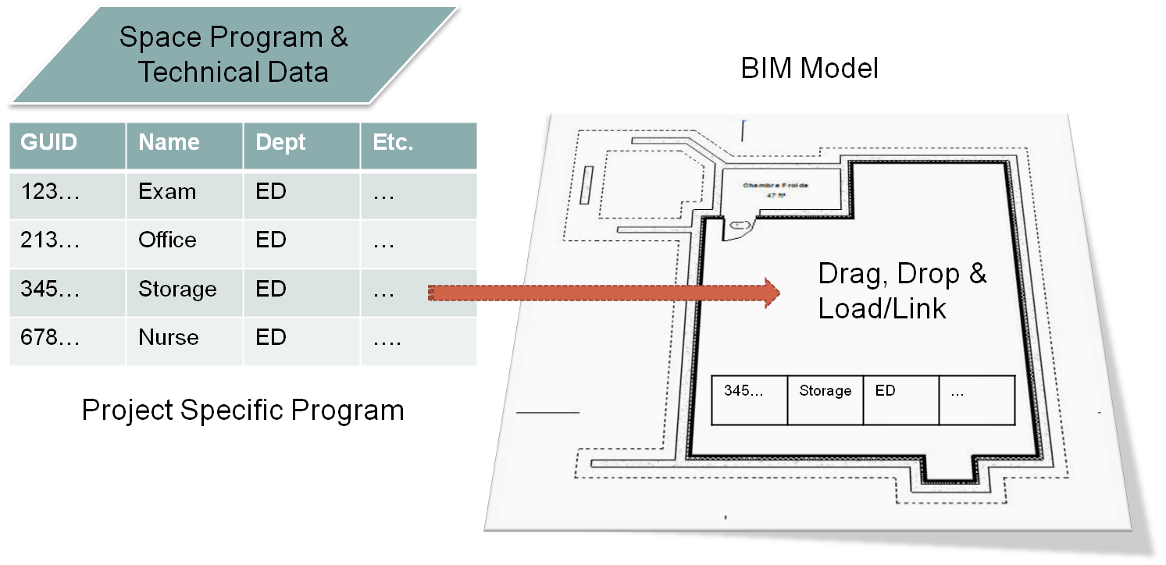
MHS BIM Objectives Validation
Relate Contractual Program Requirements (Planning Program for Design [PFD]) to model
  Other viable solutions welcome
Basic Concept

Slide 31
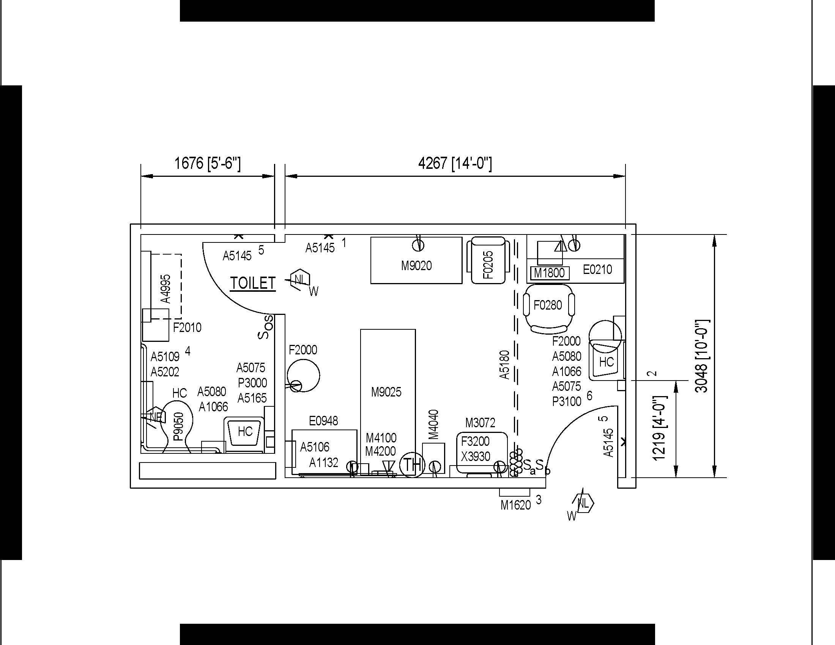
MHS BIM Objectives Validation
Example: Plan/sheet view automatically displays selected parametric variable (e.g. JSN or SPECNO)
Has been a contractual requirement for decades
Existing Requirements

Slide 32
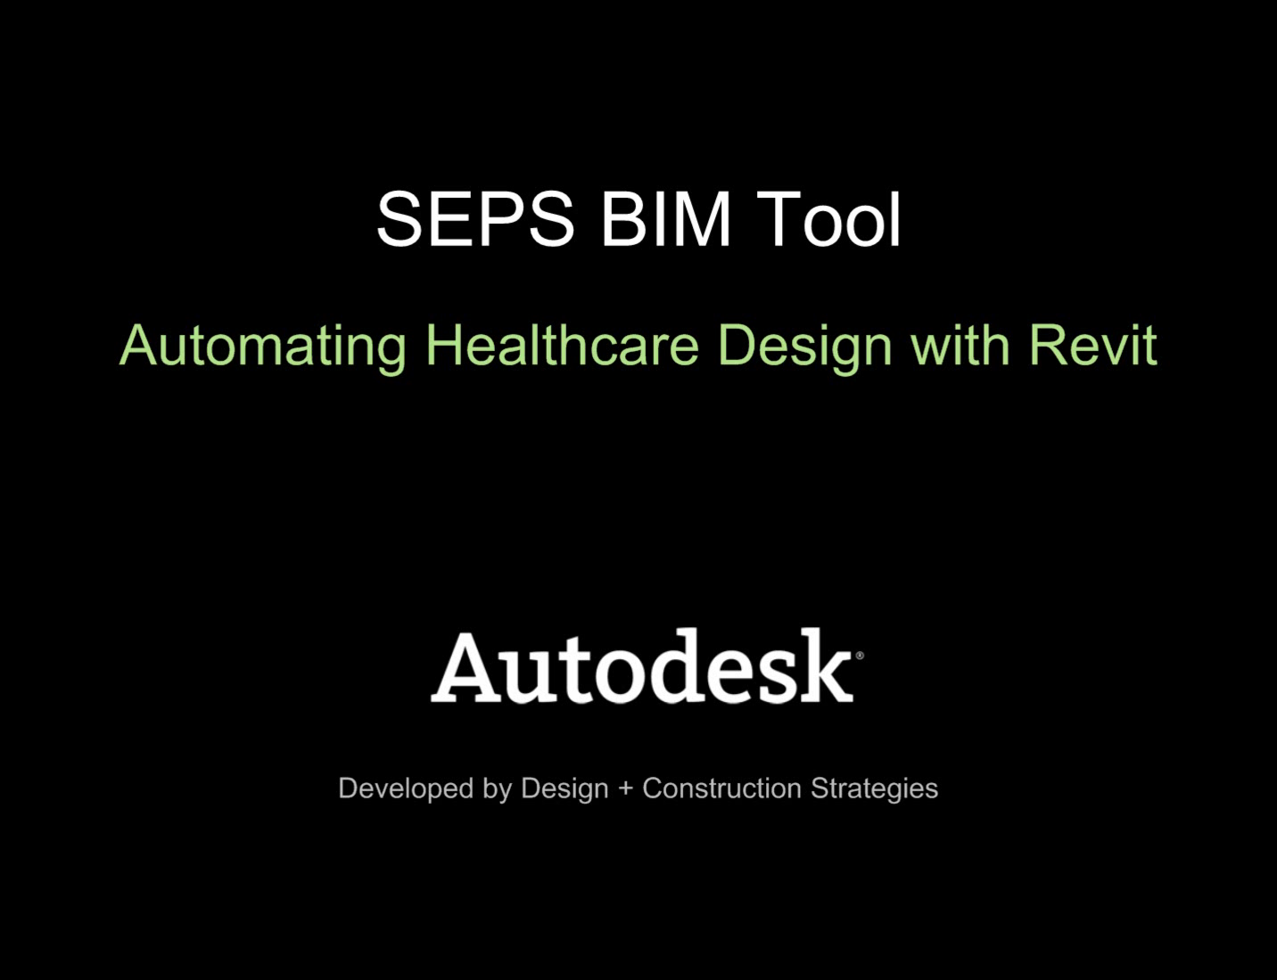
MHS BIM Objectives Validation
SEPS Import Example

Slide 33
MHS BIM Objectives - DMLSS
Support transfer of critical data into DMLSS-FM for operations
  Streamline process (info available at BOD)
  Reduce effort required
  Increase accuracy
Support transfer of critical data into DMLSS-EM&T for operations
  Streamline process
  Reduce effort required
  Increase accuracy
  Support IO&T
4
5

Slide 34
MHS BIM Objectives - DMLSS
CMMS / CAFM
Facility
Space Program & Tech. Criteria
Way finding
Design
Benchmarking
Medical Equipment & Furniture
Logistics
Inventory
Construction
Data to Operations
Patient Monitoring
CMMS
Medical
Equipment
& Furniture
BAS
Project Specific
Output back to Corporate Systems

Slide 35
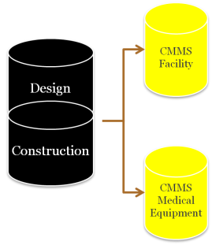
MHS BIM Objectives DMLSS
Automate the data population of computerized maintenance management software (CMMS)
Exporting to a common
definition
Importing against a common
definition
BIM
.dgn, .rvt, etc.
Common Language
“The Latin”
Import Routine based on common Language
O&M Management System
COBIE
Other ?
DMLSS-FM
Maximo
ArchiBus
Other ?

Slide 36
MHS BIM Objectives DMLSS
Automate import of equipment and furniture data process (FFE / Initial Outfitting)
  Includes building system and medical equipment & furniture
Exporting to a common
definition
Importing against a common
definition
BIM
.dgn, .rvt, etc.
Common Language
“The Latin”
Import Routine based on common Language
Medical Equipment & Furniture Mgmt. System
COBIE
Other ?
DMLSS-EM&T
Maximo
ArchiBus
Other ?

Slide 37
MHS BIM Objectives - Energy
Support more effective energy analysis, planning, design, fabrication and operations
  Support integration of energy data and interoperability of data to energy analysis modeling software
  Increase timeliness of energy analysis to allow better integration into design process
Increase efficiency of fabrication and assembly Support transfer of critical data into DMLSS-FM for operations
  Streamline process (info available at BOD)
  Reduce effort required
  Increase accuracy
6

Slide 38
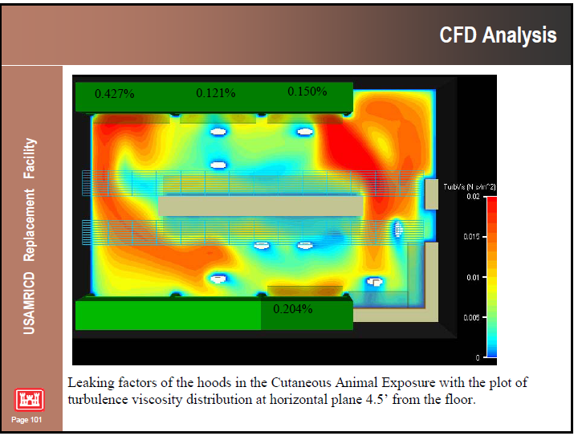
MHS BIM Objectives - Energy
Process flow to analysis programs such as Trace 700, HAP, CFD, etc.
Lighting and Day Lighting Applications

Slide 39

MHS BIM Objectives - Planning
Inform the planning process
  Criteria
  Guideplates
  Net to Gross
  Costing
  Utilization
  Capacity
7

Slide 40
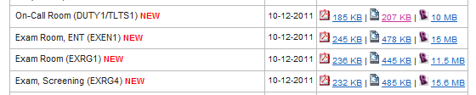
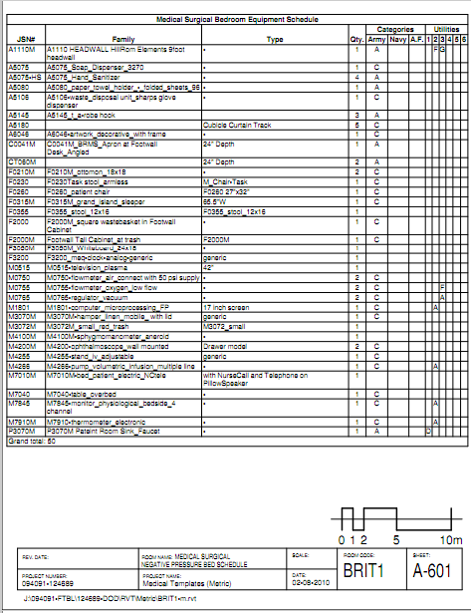
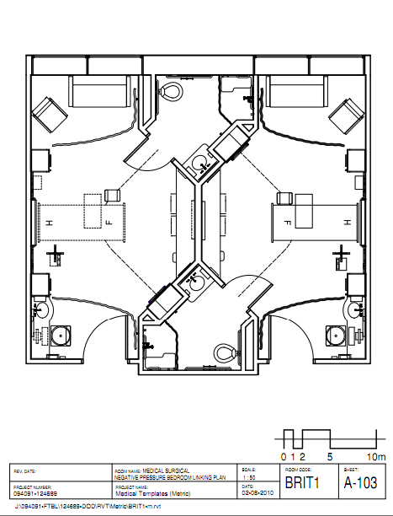
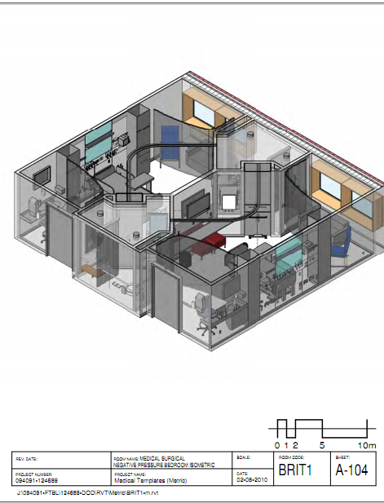
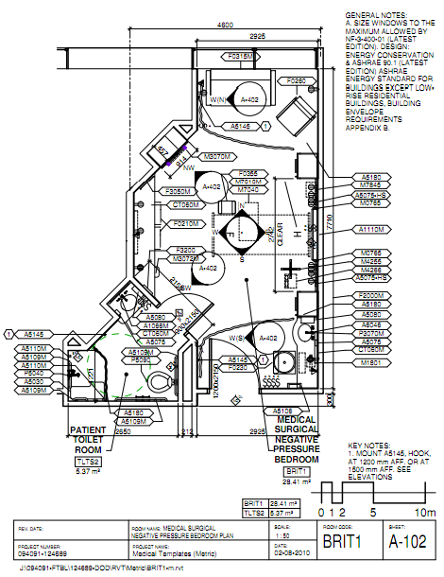
MHS BIM Objectives - Planning

Slide 41
MHS BIM Objectives - IO&T
Support the initial outfitting procurement process
  Sequence phasing
  Programming of IO
Support the transition process
  Sequence / phasing support
  Inform users – familiarization with new spaces and training
8

Slide 42
MHS BIM Objectives - Interoperability
Support and Insist on BIM solutions that support the interoperability AEC information.
  Participate in AEC industry dialog on degrees of interoperability – get technology focused on solutions that support the FLCM work.
9

Slide 43
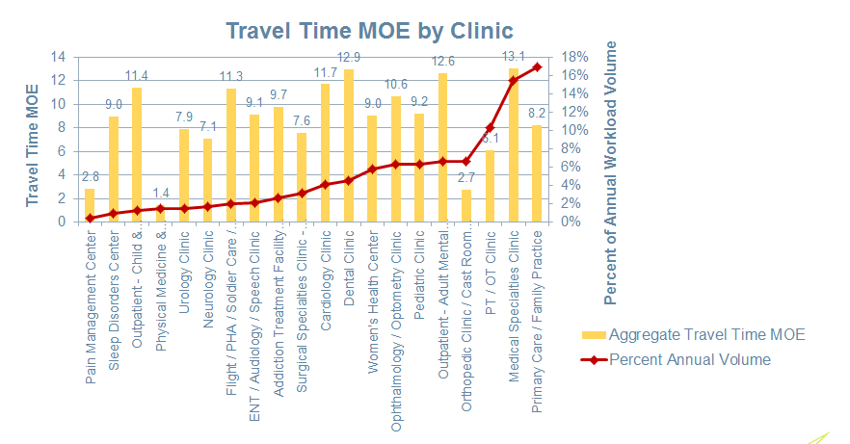
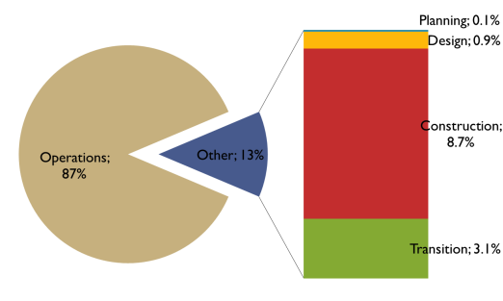
MHS BIM Objectives – Support Simulation
Support simulation efforts relating to planning and access healthcare process and association with facility solutions.
10

Slide 44
DoD UFC 4-510-01
DESIGN: MEDICAL MILITARY FACILITIES
Chapter 20 BIM
Chapter 20 describes requirements and provides details on minimum requirements. Located in www.wbdg.org site: http://www.wbdg.org/ccb/DOD/UFC/ufc_4_510_01.pdf

Slide 45
UFC 4-510-01 Chapter 20
Minimum Requirements
  Built on the USACE BIM contract language for non-platform specific BIM tools.
Defines DoD-MHS FLCM characteristics
  Key data points to support objectives
Starts the process to align with VA efforts
Works towards supporting a greater information flow with the broader US healthcare system
Works support bigger picture national disaster relief coordination of information for healthcare.

Slide 46
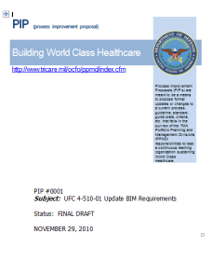
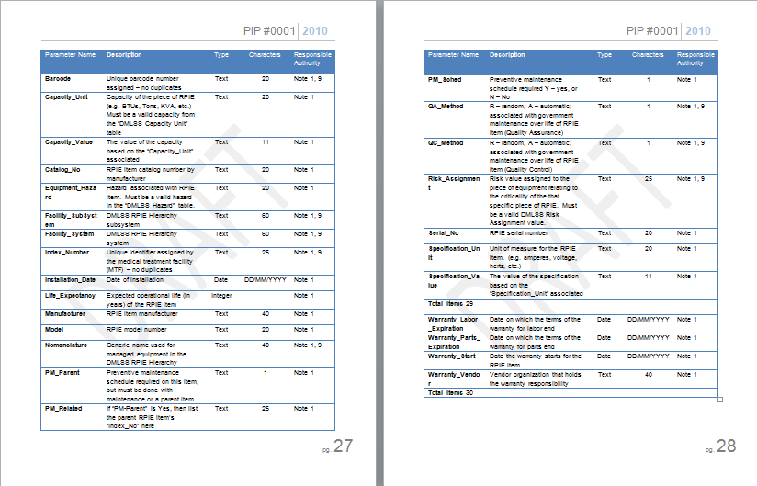
UFC 4-510-01 Chapter 20
Attributes Defined:
  Project Level
  Room Level
    PFD
    UFC Appendix A
  Object Level
    Real Property Installed Equipment (RPIE)
    Medical Equipment & Furniture (MIL-STD 1691) - PRC
Reports / Queries Defined
Internal vs External Options for Data

Slide 47
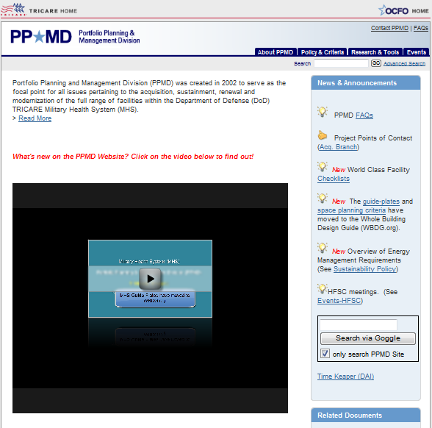
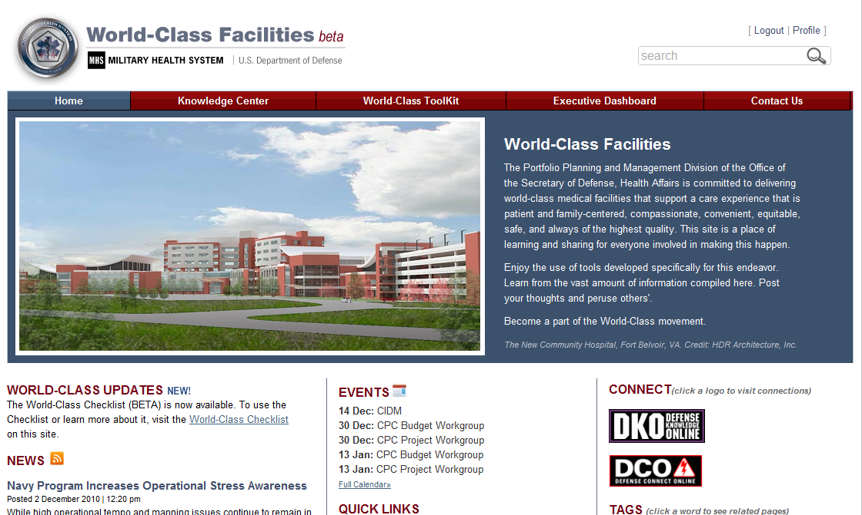
MHS Facilities Websites
www.mhsworldclassfacilities.org
http://www.tricare.mil/ocfo/ppmd/index.cfm

Slide 48
Questions
More info at:
http://www.tricare.mil/ocfo/ppmd/guideplates.cfm#Tools-BIM

Slide 49
Examples
Health / Dental Clinic
Laboratory
Hospital
Medical Center
Vet Clinic
Guideplate

Slide 50
Other Resources
UFC 4-510-01
www.WBDG.org
Etc.

